Slide 1
Bringing Life to our program with NSP II funding
Chesapeake College Nursing

Slide 2
Overview
Assistance for Major Program Challenges
Declining NCLEX Scores
An overall decrease in well-qualified applicants (recruitment piece of grant funding)
Accepting more and more marginally qualified applicants (data r/t admission points)
Increasing success of marginal students (retention piece of grant)
Associates to Bachelors Pathway

Slide 3
Overview
Fall Admission | GPA 3.0 or Above | GPA less than 3.0 | TEAS Score 2 or above | TEAS Score less than 2 | Program Points above 12 | Program Points 12 and below | Total Number that did not complete/failed
2015 | 7 | 13 | 10 | 10 | 5 | 15 | 20
2016 | 3 | 12 | 7 | 8 | 2 | 13 | 15
2017 | 14 | 13 | 18 | 9 | 2 | 25 | 27

Slide 4
Retention-APC Coordinator
Workshops
Critical thinking
Hot Topics!
Boot Camp
Time Management
Learning Style
Tutoring
Stress Management
Remediation
One-on-one
Remote
Group
Face-to-face
Enhanced Learning Plans
Concept Review with retention coordinator

Slide 5
Progress Report
Nursing students with program points below 12
 | Program |  | Tutoring |  | Wkshp |  | Pass/Fail
 | Points |  | Sessions |  | totals
 | 10 |  | 10 |  | 5 |  | P
 | 11.5 |  | 8 |  | 6 |  | P
 | 10 |  | 10 |  | 6 |  | P
 | 11 |  | 10 |  | 6 |  | P
 | 10 |  | 17 |  | 7 |  | P
 | 10 |  | 11 |  | 5 |  | P
 | 11.5 |  | 12 |  | 4 |  | P
 | 10 |  | 16 |  | 7 |  | P
 | 10 |  | 6 |  | 5 |  | P
 | 11 |  | 10 |  | 6 |  | P
 | 10 |  | 11 |  | 6 |  | P
 | 11.5 |  | 12 |  | 6 |  | F
 | 11 |  | 8 |  | 3 |  | P
 | 10.5 |  | 6 |  | 4 |  | P
 | 10 |  | 10 |  | 7 |  | P
 | 11.5 |  | 10 |  | 3 |  | P
 | 11.5 |  | 1 |  | 3 |  | W
 | 11.5 |  |  |  |  |  | W
 | 11.5 |  | 10 |  | 5 |  | W
 | 11 |  |  |  |  |  | W
Purple: Provisional Students |  |  | Total Passing: 11 out of 12 students |  |  |  | 91%
Red: Repeating Students |  |  | Total Passing: 4 out of 4 |  |  |  | 100%
Black: Withdrew from course |  |  | Total withdrawing: 4
Total Students on Provisional Status: 19 |  |  |  |  |  |  | 34%
Nursing students with program points above 12
Program |  | Tutoring |  | Wkshp |  | P/F
Points |  | Sessions |  | totals
12 |  | 2 |  | 3 |  | F
13 |  | 0 |  | 3 |  | F
13 |  | 1 |  | 4 |  | F
13 |  | 7 |  | 4 |  | F
14 |  | 7 |  | 6 |  | F
13.5 |  | 9 |  | 6 |  | F
15 |  | 1 |  | 5 |  | F
Total Failures: 7 out of 36 students (19%)

Slide 6
A to B
College Fair
Planning Meetings
College Wall
Starting Early

Slide 7
Recruitment
“Nurse for a Day”
Nursing Club
Information Sessions
Bridge Program
Back to Basics
High School Workshops
Healthcare Career Day
Our goal is to provide several different opportunities to serve our students and to better prepare those students entering our nursing program. By providing these outreach opportunities we are providing a seamless transition from high school to pre-nursing at Chesapeake to nursing school.

Slide 8
What’s New in Chesapeake Nursing

Slide 9
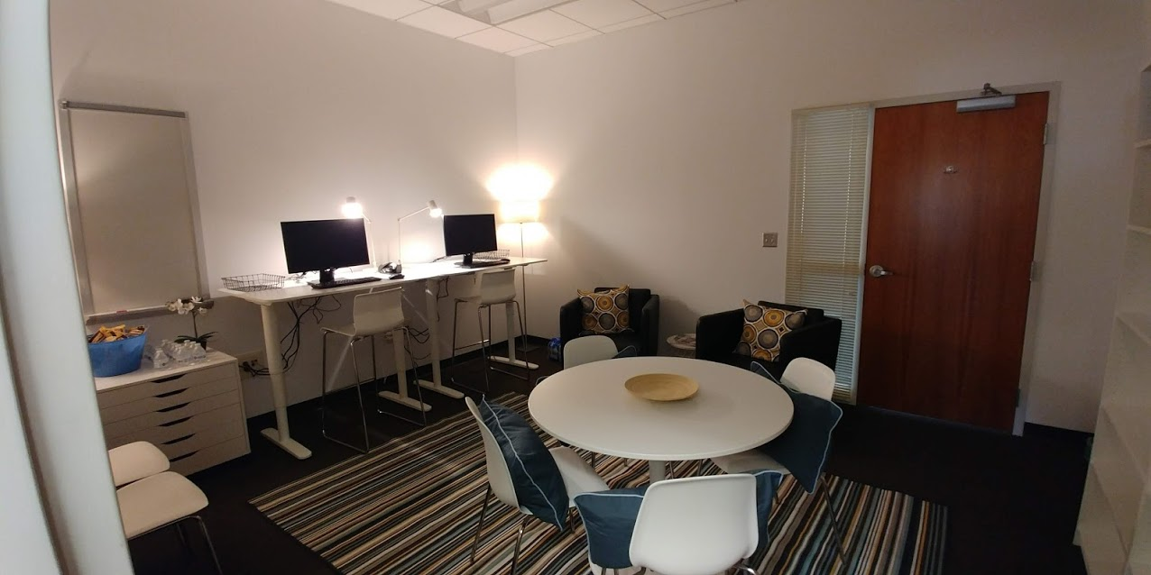
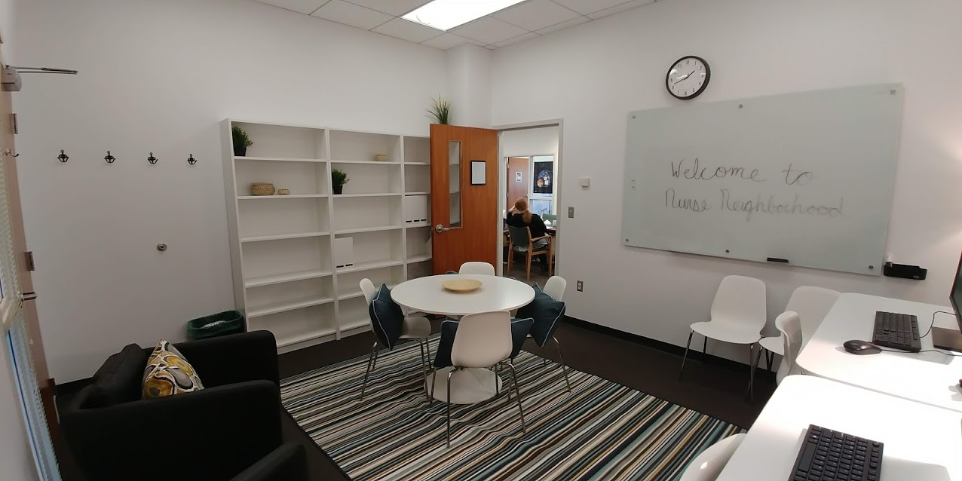
Nurse Neighborhood

Slide 10
Professional Development Opportunities
Yearly Nursing Colloquium for local Nursing educators to enhance their knowledge and skills and better prepare nursing students for the profession.
Marianne Jefferys
Melissa Geist
Guest Speakers invited to assist Chesapeake College Nursing Faculty better assist the students.
Lydia Zager and Loretta Manning from “I Can Publishing”
Sylvia Rayfield
Exam Review
Guided faculty with steps to increase the rigor and complexity of exam items
CNE prep
One faculty member attended and successfully passes exam

