Slide 1
Innovations in Simulation- use of telepresence robots Increasing capacity for pediatric care across the healthcare continuum through innovations in education-Accelerated post-NP pediatric acute care education-NSP II-18-114
Shawna Mudd, DNP, CRNP
Acknowledgements to Drs. Kim McIltrot and Kristen Brown for their assistance

Slide 2
The problem
2 motivating factors
Need to increase capacity of PNPs to provide care across the continuum of settings- primary to acute care and vice versa
The need to have PNPs certification in alignment with practice setting/s
Notes:
Healthcare is changing –sicker patients at home; subspecialty and chronic care involving more than clinic care- inpatient consultation and management, etc

Slide 3
Additional factors
They are working adults
They are experienced PNPs
Notes:
Working adults- need to work to pay for school, have busy patient panels; need flexibility in their education- when and where

Slide 4
The solution
Development of a high quality, innovative and accelerated online curriculum
3 semesters
Online
Clinical experiences starting with first semester
Simulation integrated throughout

Slide 5
Simulation
Semester I
Onsite immersion
Procedural skills
Delivering bad news
Diagnostic evaluation and interpretation
Managing a decompensating patient

Slide 6
Simulation
Semesters II and III
High stakes evaluation to meet acute care PNP competencies
Use of a telepresence robot- “Double”
Requires a computer with webcam and a reliable internet connection
Browser based
No additional software needed
Notes:
https://youtu.be/0F_WKOkDm1I

Slide 7
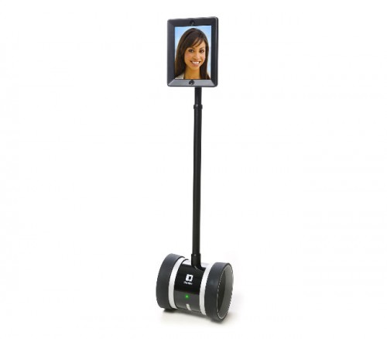

Slide 8
Student schedules a time for their simulation that they will participate in from home
About 1 week in advance, students are given a patient census “shell”
Inpatient unit or emergency department
Meets with the advanced practice simulation director for practice “driving” the robot

Slide 9
PED census-student copy
Peds ED
Room | Patient | Age | Gender | Chief complaint | Current status | Ongoing Issues | Notes
1 | A.J. | 14 yo | F | Syncopal episode | Just arrived; awake and alert
2 | D.M. | 2 yo | F | Altered mental status at home; fever | Looks good; stable; Labs sent; LP sent- opening pressure 8 No travels; previously well; immunizations UTD; NKDA; IV in place | Awaiting CSF results and labs-sent for culture
3 | J.B. | 4 yo | M | Fever; onc patient | Just arrived-pre-B ALL, PICC in place; started on induction chemo-discharged home a week ago after receiving doxorubicin, vincristine, PEG-asparaginase and steroids; fever to 38.2 at home; onc called upon arrival
4 | K.C. | 2 yo | M | Swallowed foreign body | Stable respiratory status- just arrived; xray ordered
5 | M.S. | 4 yo | M | Limp/right leg pain; fever | Labs sent; in xray
Notes:
Student receives sign out from outgoing provider- very brief, limited information- some guidance that the onc pt needed to be seen first

Slide 10
PED Census- faculty copy
Room | Patient | Age | Gender | Chief complaint | Current status | Ongoing Issues | Notes
1 | A.J. | 14 yo | F | Syncopal episode | Just arrived; awake and alert
2 | D.M. | 2 yo | F | Altered mental status at home; fever | Looks good; stable; Labs sent; LP sent- opening pressure 8 No travels; previously well; immunizations UTD; NKDA; IV in place; fluid bolus given | Awaiting CSF results and labs-sent for culture start abx if abnormal CSF | Will notify student of CSF values during sim- opening pressure of 8cm H2O Appearance- cloudy, WBC- 50cells/mm², 85%PMNs, glucose 25, protein 105mg/dL; cx’s pending Should start Vancomycin 15mg/kg/dose /q6+ ceftriaxone 100mg/kg/24hr div q12hr; could consider dexamethasone 0.15mg/kg/dose IV q 6h x 2-4 days 15kg
3 | J.B. | 4 yo | M | Fever; onc patient | Just arrived-pre-B ALL, PICC in place; started on induction chemo-discharged home a week ago after receiving doxorubicin, vincristine, PEG-asparaginase and steroids; fever to 38.2 at home; onc called upon arrival |  | Should get hx, labs, cx’s; start cefepime-50mg/kg/dose IV q8; could add vanc 17 kg
4 | K.C. | 2 yo | M | Swallowed foreign body | Stable respiratory status- just arrived |  | Recognize emergent nature of battery; stat page surgery
5 | M.S. | 4 yo | M | Limp/right leg pain; fever | Labs sent; in xray
Attending/resident to give signout-directed to see fever/onc pt first
Student- get hx and PE- allow about 10-15 min
Interrupt for call with LP results
Later call from radiology

Slide 11
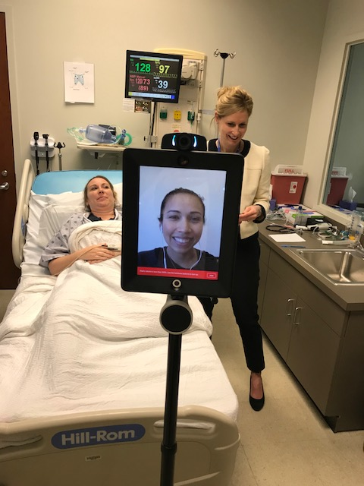

Slide 12
Simulation evaluation
Likert scale 1-5
Assessment
Appropriately responds to an acute situation; obtains an accurate and appropriate focused history; develops proper differential diagnoses based on exam reports and clinical findings; correctly interprets available data
Plan
Develops an appropriate management plan that includes relevant needs such as lab evaluation, imaging, consultation and medication prescribing.
Communication
Effectively communicates with the patient/family, healthcare team

Slide 13
Reflections and feedback
Students liked interactions with faculty and managing multiple patients
Prepared pages of notes in advance
We limited the need for the student to need to do any complex navigation of the robot
They need reliable internet connection from their home
Allowed us to evaluate students without need for travel and extended time away from work

Slide 14
Next steps
Scaling up-considerations of time expenditure with increasing student enrollments
Continue to develop simulations based on best practices
Increased use of interprofessional teams

Slide 15
