Slide 1
Collaborative Partnership Program (CaPP)
Goal: To strengthen relationship between academia and practice
Addresses needs:
Of students for additional training in clinical settings in preparation for new graduate nurse positions
Of the TU Department of Nursing for clinical sites
Of Maryland hospitals for new graduate nurses to fill staff nurse positions
Outcome: Approximately 150 Towson University Department of Nursing graduates will have completed clinical experiences through CaPP and have full time positions as staff nurses at partner health care systems

Slide 2
CaPP Partners

Slide 3
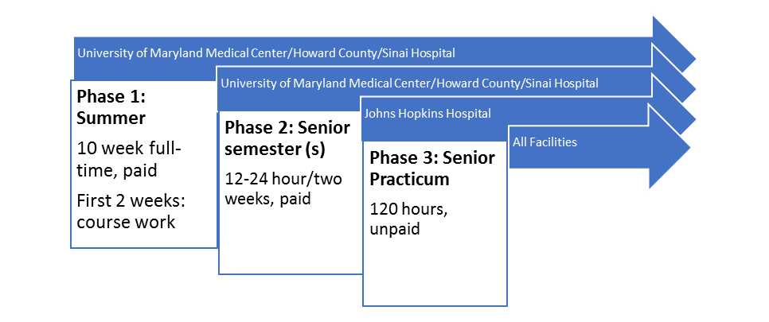
Phases
Phase 4: Full time employment
Paid, 2-3 year commitment

Slide 4
What Is CaPP?
Hospital | Senior Practicum | Summer Employment | Part-Time Employment During Academic Year | Scholarship Available? | Commitment Post-Graduation
Howard General | Yes | Yes | Yes | No | 2-years
Johns Hopkins | Yes | No | No | No | 3-years
St. Joseph | Yes | Yes | Yes | No | 2-years
Sinai | Yes | Yes | Yes | Yes | 3-years
UMMC | Yes | Yes | Yes | Yes | 2-years

Slide 5
Collaborative Partnership Program (CaPP)

Slide 6
CaPP Challenges To Date
1. Students have reneged on acceptances at approximately three hospitals.
2. Many students reluctant to make 3-year post graduation employment commitment.
3. The hiring cycle, procedures, and CaPP terms vary widely by hospital, making it confusing for students to identify nuances at each facility.
4. Hospital staffing challenges have made it difficult to work out details, identify a responsive “point person”, and ensure impacted staff are aware of all CaPP terms for their facility.
5. An integral component of the CaPP program is TUDON’s offer to train Nurse Preceptors. Some facilities have embraced this opportunity, while others have not.
6. Partner hospitals are not always clear with their staff regarding preceptor obligations.

