Slide 1
Advancing Improvement Science Education (AdvISE) The AdvISE Project will expand statewide capacity in implementation science (IS) and quality improvement (QI)! IS and QI expertise is needed to increase evidence-based practices which improve the quality and safety of healthcare and reduce moral distress and burnout among RNs. Principal Investigator: Debra Bingham, DrPH, RN, FAAN Associate Professor, Healthcare Quality and Safety Department of Partnerships, Professional Education, and Practice dbingham@umaryland.edu
Notes:
My name is Debra Bingham and I am an Associate Professor for Healthcare Quality and Safety in the Department of Partnerships, Professional Education, and Practice at the University of Maryland School of Nursing.
UMSON is recognized as one of the state and national leaders in nursing education. UMSON is also one of the largest schools of nursing in the state of Maryland and the United States. The depth and breadth of UMSON as a leader of DNP education cannot be over stated. For example, to date, UMSON has graduated over 200 DNP students and currently has approximately 500 DNP students enrolled.

Slide 2
Institute of Medicine - 2001
It takes 17 years to translate research into action.
Institute of Medicine (2001). Crossing the quality chasm: A new health system for the 21st Century, pg. 5.
QI Brief 1.1: Released Summer 2017
Notes:
As many of you may know, the Institute of Medicine in 2001 highlighted the fact that it takes an average of 17 years for new knowledge that is generated by randomized controlled trials to be incorporated into practice, and even then application is highly uneven.

Slide 3
Improve the quality and safety of healthcare
Reduce moral distress and burnout among RNs.

Slide 4
"Although respondents’ beliefs about EBP were positive, they reported their ability to implement EBP as extremely low.”
Warren, J.I., McLaughlin, M., Bardsley, J., Eich, J., Esche, C.A., Kropkowski, L., & Risch, S. (2016). The strengths and challenges of implementing EBP in healthcare systems. Worldviews on Evidence-Based Nursing. 12(1), pg. 19.
Notes:
More than one third (36%) of the respondents worked at two of the system's Magnet designated hospitals."

Slide 5
DNP
DNP graduates key to reducing the 17-year research-to-practice gap!
QI Brief 1.1: Released Summer 2017
Notes:
Indeed, DNP’s expertise in translation or diffusion of research practice using QI methods is the key to reducing the 17-year research-to-practice gap!

Slide 6
2016 there were
2,857,180 RNs compared to 338,620 physicians and surgeons
303 DNP Programs
25,289 DNP Students enrolled nationally
4,855 DNP graduates

Slide 7
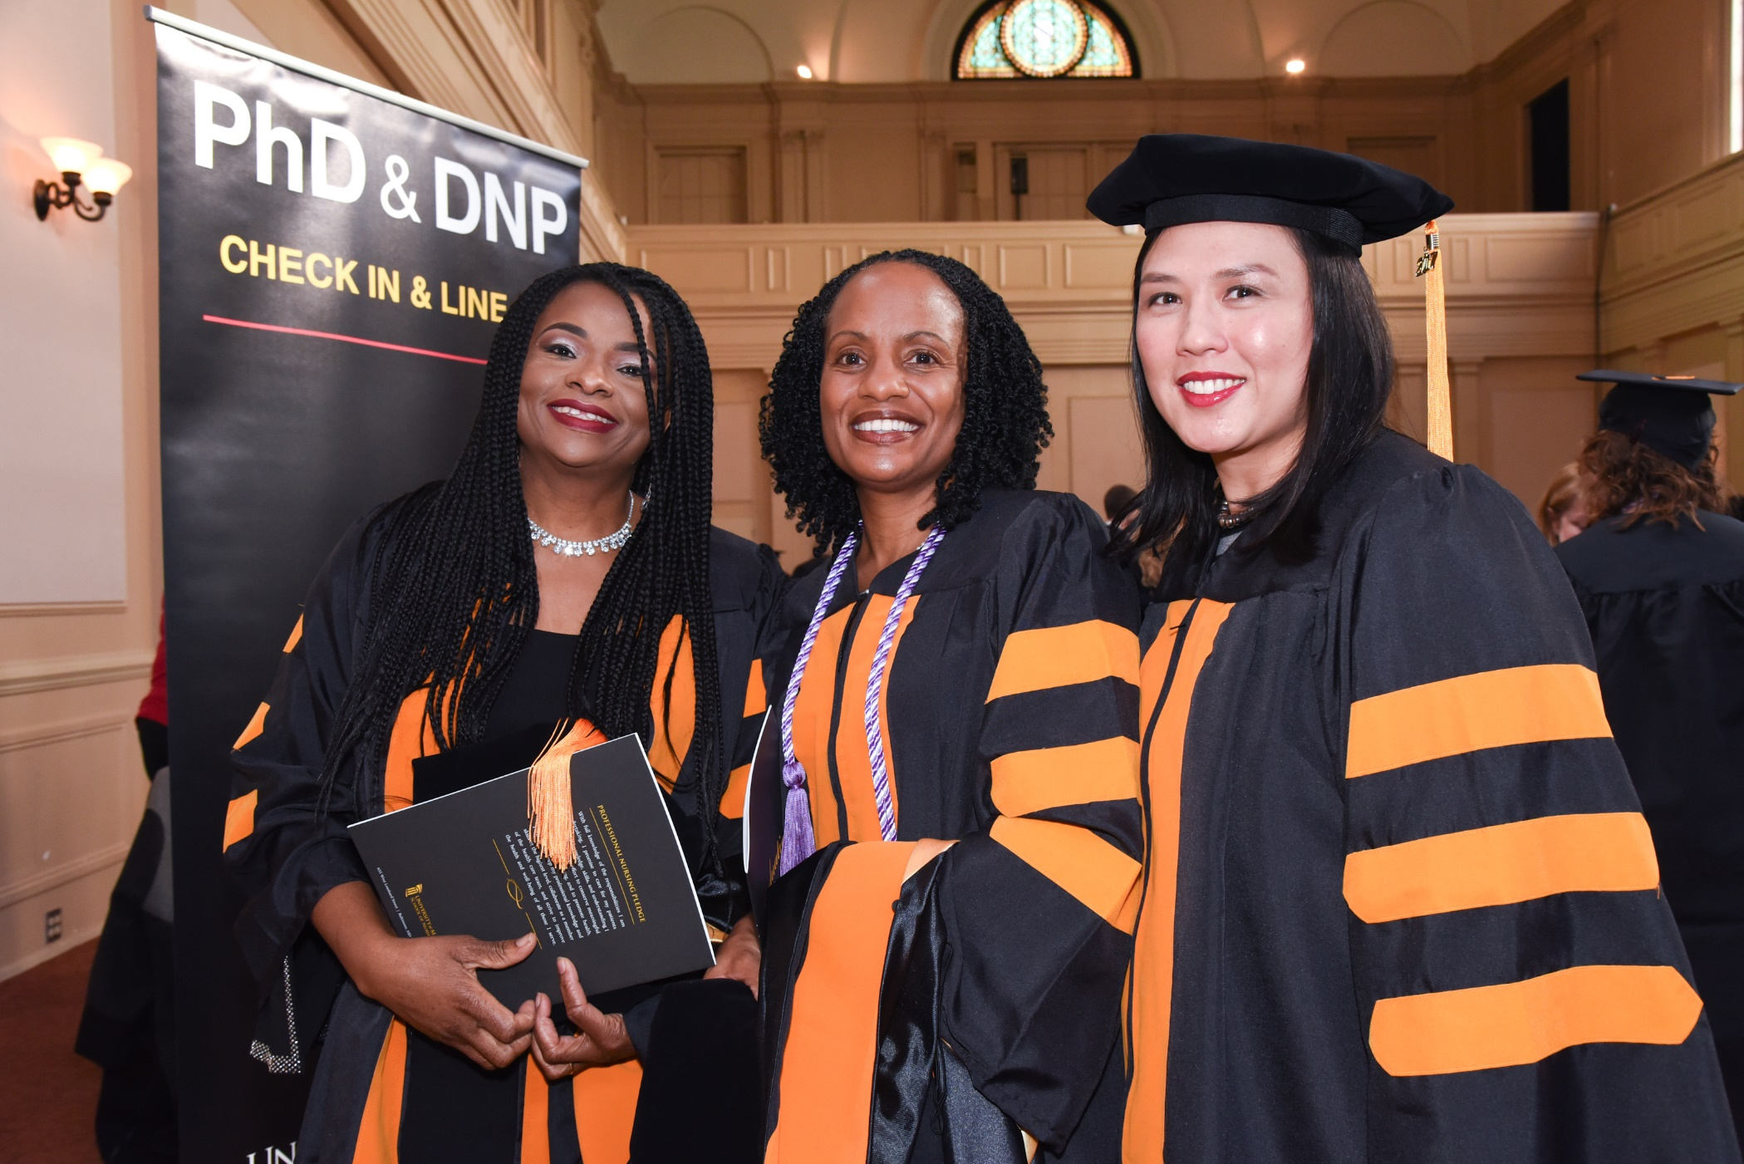
AT UMSON over 200 DNP students have graduated approximately 450 DNP students are enrolled

Slide 8
Vision:
New DNP graduates will be skilled implementers and implementation scholars.
They will graduate with the knowledge, skills, and confidence to develop and lead quality improvement initiatives that transform population health and healthcare.
QI Brief 1.1: Released Summer 2017
Notes:
The reason we are developing these QI Briefs and are identifying and implementing other strategies and tactics is to expand the University of Maryland School of Nursing’s Faculty expertise in utilizing and teaching QI and Safety concepts, methods, and tools.
We see this as a joint effort where everyone is engaged in helping each other grow and learn! We will work together to expand our expertise in order to reduce the 17 year research to practice gap!

Slide 9
Definition of Quality Improvement
“… systematic, data-guided activities designed to bring about immediate, positive changes in the delivery of health care in particular settings.”
Baily, M.A., Bottrell, M., Lynn, J., & Jennings (2006). Special report: the ethics of using QI methods to improve healthcare quality and safety. The Hastings Center: Garrison New York, pg. S5.
Notes:
First – let’s make sure we are all clear on the definition of quality improvement.
The Hasting Center – a prestigious ethics think tank – defined QI as:
The systematic, data-guided activities designed to bring about immediate, positive changes in the delivery of health care in particular settings.
QI relies on data and leads to immediate and positive changes.

Slide 10
Challenges
Science on quality improvement and implementation science is rapidly expanding
The journal of Implementation Science is only 11 years old
It is hard for faculty to keep up-to-date
Many faculty may not have had education or experience implementing and evaluating QI
DNP degrees are new and were started by faculty with PhDs

Slide 11
The University of Maryland School of Nursing has launched the:
Advancing Implementation and Improvement Science Education (AdvISE) Initiative in 2017
NSP II Funding was obtained in July 2018
to enhance the AdVISE effort

Slide 12
Steering Committee
Shannon Idzik DNP, CRNP, FAANP, FAAN
Margaret Hammersla, PhD, CRNP-A
Kathryn Montgomery, PhD, RN, NEA-BC
Kathleen Buckley, PhD, RN
Susan Bindon, DNP, RN-BC, CNE, CNEcl
Jeff Martin, MBA
Linda Costa, PhD, RN, NEA-BC
Patricia Franklin, PhD, RN
Debra Bingham, DrPH, RN, FAAN
Lucy Rose Davidoff, RN, DNP* - Project Management Specialist/Research Assistant
Notes:
Do I include deb bingham on these lists?

Slide 13
AdvISE NSP II Goals & Objectives
Develop a list of the implementation science (IS) and quality improvement (QI) gaps in knowledge and recommendations for action based on the results of a needs assessment.
Identify best practices for expanding IS and QI expertise.
Develop and implement IS and QI professional development for faculty, students, and graduates.
dbingham@umaryland.edu
Notes:
Put in the abstract and background info (the why)
Research vs QI flow chart in

Slide 14
Year | Major Activities for the AdvISE Project
Year 1 | Perform a UMSON needs assessment Obtain state and national input Form the AdvISE Expert Panel
Year 2 | Host the one-day AdvISE Summit – 9/24/2019 Synthesize and summarize the key recommendations for action based on the information gathered during year 1 Develop the IS and QI professional development education
Year 2 and 3 | Develop the IS and QI professional development education
Year 3 | Dissemination activities and final report
dbingham@umaryland.edu

Slide 15
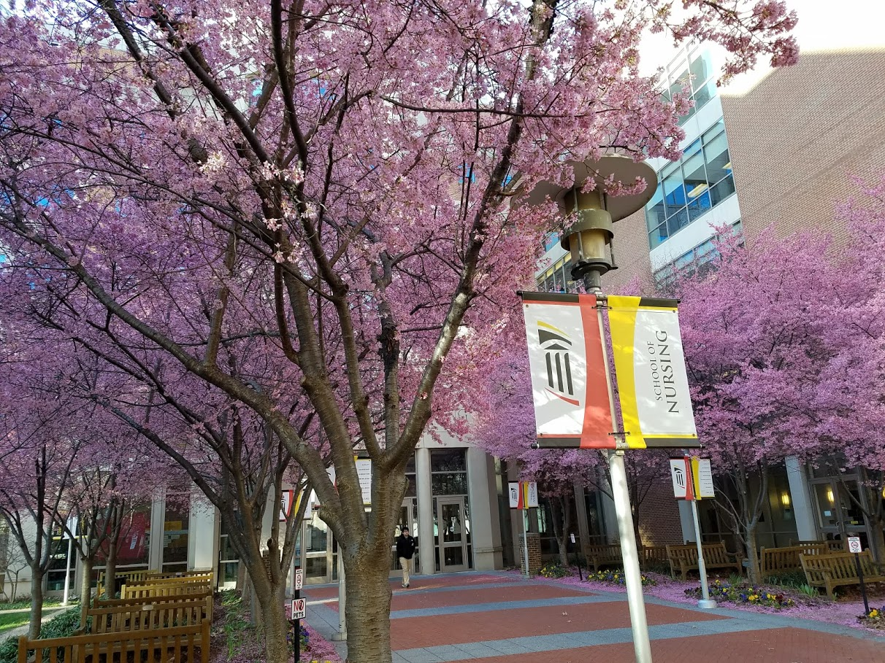
Year 1: UMSON Faculty and Students’ Needs Assessment

Slide 16
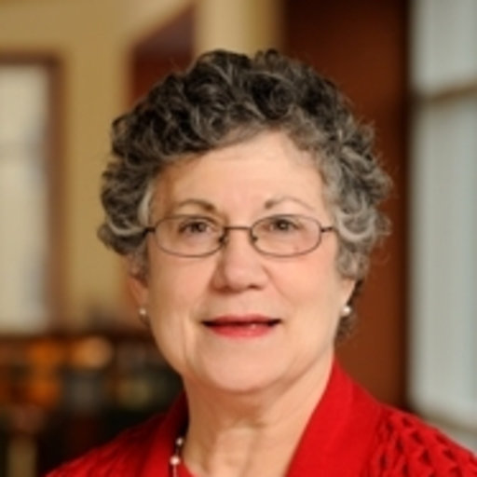
Consultant on the Needs Assessments
Anne Belcher, PhD, RN

Slide 17
Faculty Needs Assessment
38 (52%) out of 73 Faculty Responded
Student Needs Pre-DNP Project Courses Assessment
53 (36%) out of 147 DNP Students Responded
Follow up Post-DNP Project Courses Assessment
Fall 2019
Employer and Recent Graduate Survey
Survey
Semi-structured interviews & 2-3 focus groups
dbingham@umaryland.edu

Slide 18
2018 Faculty Survey
38 (52%) out of 73 Faculty Responded
79% had more than 5 years of experience
37% reported having led a QI Project in their current practice setting
88% participated in the development or planning of a QI project in their current practice setting
When asked about their level of expertise in healthcare quality and safety:
3% stated expert
42% stated proficient
47% somewhat proficient
8% Not very familiar
dbingham@umaryland.edu
Notes:
93% agree or strongly agree with “I believe that continuous quality improvement is an essential part of the daily work of the doctorally prepared nurse.”

Slide 19
Year 1: Obtain State and National Input

Slide 20
2. Obtain State & National Input
Mary Dolansky, PhD, RN, FAAN
Director, QSEN Institute
Assistant Professor, Frances Payne Bolton School of Nursing & School of Medicine
Senior Faculty Scholar, VA Quality Scholars Program
Donald Goldmann, MD
Chief Medical and Scientific Officer, Institute for Healthcare Improvement
Professor, Department of Immunology and Infectious Diseases
Professor of Epidemiology, Harvard. T. H. Chan School of Public Health
Clinical Professor of Pediatrics, Harvard Medical School
Notes:
Advisors go here: Dolansky & Goldmann. Do I need to cite photos? https://www.hsph.harvard.edu/ecpe/faculty/don-goldmann/
https://case.edu/nursing/about/fpb-directories/faculty-directory/mary-dolansky

Slide 21
Year 1: Form the Expert Panel & Plan the Summit

Slide 22
AdVISE Expert Panel
Bryan Weiner, PhD
Professor, Department of Global Health and Department of Health Services, University of Washington
Author: Theory of Organizational Readiness for Change (2009)
Laura Damschroder, MS, MPh
Lead author of the Consolidated Framework for Implementation Research (CFIR)
Research Investigator with the Veterans Affairs (VA) Ann Arbor Center for Clinical Management Research
Project Principle Investigator with the PrOVE (PeRsonalizing Options through Veteran Engagement) Quality Enhancement Research Initiative (QUERI)
Anne Sales, PhD, RN
Associate Chair for Health System Innovation PhD, University of Michigan
Professor, Division of Learning and Knowledge Systems
Director of the Health Infrastructures and Learning Systems (HILS) program
Research Scientist, Center for Clinical Management Research, VA Ann Arbor Healthcare System
co-Editor-in-Chief of Implementation Science Journal
Jeannie S. Garber, DNP, RN, NEA-BC
DNP Program Coordinator at James Madison University
Notes:
B. Weiner - Widely published on implementation science, quality improvement, and readiness for change

Slide 23
Summit on 9/24/2019
Notes:
Follow up student survey
Curriculum changes
Publication schedule

Slide 24
Dissemination Activities Year 1 & 2
State-wide Webinars
Video summary of the summit
Presentations
State
National

Slide 25
Major Question for the Summit
What implementation and improvement science knowledge and skills do DNP graduates need to be proficient in if they are going to be adequately prepared to more effectively translate research into action?
Implementation Science
Quality Improvement

Slide 26
*Metrics of Success (Selected)
The number of participants invited and the number who attend the AdvISE Summit.
AdvISE Summit Proceedings which includes key recommendations for action.
The list of IS and QI education priorities for the UMSON.
The number of educational offerings developed and implemented.
The number of educational offerings enhanced.
The number of faculty, students, and graduates who participate in the new educational offerings.
The number of abstracts submitted and accepted for in-state and national conference presentations about the AdvISE Project.
The number of views of the IS and QI on-line open access videos.
A description of what went well and lessons learned.

Slide 27
Vision:
New DNP graduates will be skilled implementers and implementation scholars.
They will graduate with the knowledge, skills, and confidence to develop and lead quality improvement initiatives that transform population health and healthcare.
QI Brief 1.1: Released Summer 2017
Notes:
The reason we are developing these QI Briefs and are identifying and implementing other strategies and tactics is to expand the University of Maryland School of Nursing’s Faculty expertise in utilizing and teaching QI and Safety concepts, methods, and tools.
We see this as a joint effort where everyone is engaged in helping each other grow and learn! We will work together to expand our expertise in order to reduce the 17 year research to practice gap!

Slide 28
Questions?
dbingham@umaryland.edu

