Slide 1
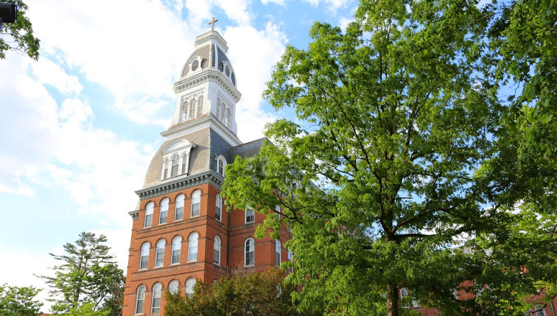
NDMU Rn to BSN CREDO: Curriculum Revisions to expand delivery Options
Marleen Thornton, PhD, RN
Kathleen Wisser, PhD, RN, CNE, CPHQ
Project Directors
NSPII-17-110
June 14th, 2018
Notes:
Good afternoon. Thank you for this opportunity to provide some updates and next steps related to our NSP17 grant “RN to BSN CREDO” or ” Curriculum Revisions to Expand Delivery Options”. I am Marleen Thornton, one of the project directors.

Slide 2
CREDO: Curriculum Revisions to Expand Delivery Options
GOAL:
To increase the number of BSN-prepared nurses who can serve in Maryland hospitals and health care facilities and are prepared to care for poor, underserved and marginalized populations within a framework of caring science.
Notes:
Our overall goal for this project was to increase the number of BSN-prepared nurses who can serve in Maryland hospitals and health care facilities that are prepared to care for poor, underserviced and marginalized populations with a framework of caring science. All of the programs within the SON at NDMU are grounded in caring science but the RN to BSN program was in need of a curriculum revision and we wanted to be sure that while completing that revision, that we were also intentionally grounding all of our courses in caring science and improving our nurses’ abilities to care for our underserved populations.

Slide 3
OBJECTIVES
1. Curriculum Update
2. Increase the Number of Graduates/BSN Prepared Nurses
3. Create an Online Delivery Option for the RN to BSN Program
4. Research and Dissemination

Slide 4
OBJECTIVE 1: Curriculum Update
Initial curriculum revisions were completed during AY2016-2017
Revisions focused on better preparing nurses to care for vulnerable populations
Lens of caring science used as a foundation for revisions
NUR300 Foundations of Caring Science | NUR411 Healthy Aging for Professional Nurses*
NUR302 Caring Approaches to Practice | NUR412 Population Health through a Caring Lens*
NUR306 Writing for Professional Nursing | NUR420 Nursing Research for Professional Nurses*
NUR319 Holistic Health Assessment and Nutrition for Professional Nurses | NUR440 Caring Nursing Leadership for Professional Nurses*
NUR400 Information Systems for Caring Practice* | NUR450 Capstone Experience
*identifies existing courses in previous RN to BSN curriculum that received significant revision

Slide 5
OBJECTIVE 1: Curriculum Update
New electives were developed, allowing students to tailor their educational program to individual interests and highlight areas of expertise in the SON
All new and revised courses have been offered, reviewed by faculty, and had additional revisions
Faculty development related to caring science
3 New Electives
NUR314 Spirituality in Nursing Practice
NUR315 Advocacy, Politics, and Power in Nursing
NUR316 Nursing Situations in Palliative Care

Slide 6
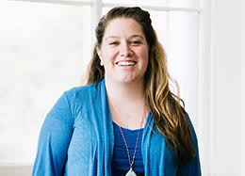
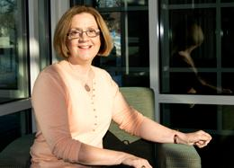
OBJECTIVE 2: Graduation
Project goal to graduate 698 registered nurses with BSN by 2021.
In May 2019, first graduates of online RN to BSN program.
Implementing new recruitment and advisement plan.
Enrollment Manager Adult Student Advisor
2017 | 2018 | 2019 | 2020 | 2021 | TOTAL | GOAL
178 | 72 |  |  |  | 250 | 698
New Sep. 2017
New Jan. 2018
Notes:
Our goal was to graduate 698 new BSN prepared RNs by 2021, and this was to include nurses from both the traditional face-to-face program and the new online program. We set our goal based on past enrollment and graduation trends, in addition to projections for online enrollment.
In 2017 we had 178 graduates, and in 2018 we had 72 graduates. This includes students from August, December and May of those academic/fiscal years. We anticipated this drop in graduates and are hopeful that new recruitment tactics, .
In May 2019, the first online RN to BSN students will be eligible to graduate. Students thus far are looking for part-time flexible options that can help meet employer demands and work around personal and professional responsibilities.
In an effort to boost enrollment and graduate numbers, the SON hired an enrollment manager focused solely on RN to BSN and MSN students. This is a new model for us and required the decentralization of enrollment and recruiting across campus.
In an effort to maintain retention and student satisfaction, the SON also has a new Adult Student Advisor who is working primarily with RN to BSN students, and also will be working with our ATB students who are also enrolled in many of our RN to BSN classes.
We are seeing some trends in terms of retention. Students who are earlier in their careers seem to be having a harder time maintaining the schedule normally planned for each cohort. We still see students who value the cohort model that exists in our face to face program but the need for flexibility in many of our newer and younger nurses is really presenting challenges for retention. We see students pressured to enroll due to employer requirements and then starting a program but quickly taking leaves of absence or time off. Some report schedule conflicts, some cite reimbursement issues, etc. It is definitely a new set of challenges.

Slide 7
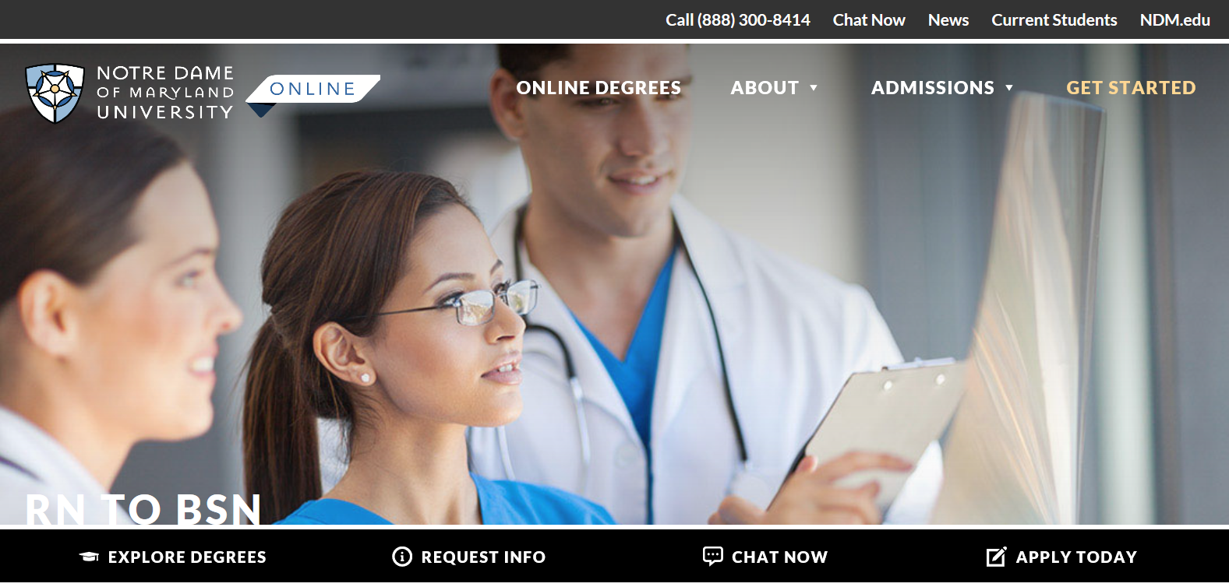
OBJECTIVE 3: Online Delivery Option
Notes:
With the launch of the NDMU Online, the RN to BSN program enrolled its first students in Fall 2017 in the fully online program We currently have 23 students enrolled in the online RN to BSN program. Each new term brings additional interest and we hope Fall 2018 will bring an even larger number of students starting the program.
. The online RN to BSN program utilizes the updated curriculum supported by this project. Seeing that we had about a year between launching the new curriculum in the face-to-face and online formats, this provided time for revisions and refinements to enhance the online experience.

Slide 8
Refining and Re-evaluating Online Delivery
Initial work towards online delivery highlighted the need for an instructional designer that would work solely with the RN to BSN program.
Instruction Design Specialist
An Instructional Design Needs Assessment was completed to develop strategies for faculty development and individual consultation.
Work with faculty helped improve the student experience in the online classroom
New
Nov. 2017
Notes:
In preparing for the full launch of the online program it became apparent that an instructional designer was needed to work with those teaching solely in the RN to BSN program.
Brought someone on board in November and she hit the ground running.
Her ability to guide faculty through the process of creating more innovative online teaching strategies has really improved the student experience in the online classroom.
Have been able to move beyond the traditional discussion boards to using podcasts, faculty videos, online games, and digital clinical experiences.

Slide 9
Faculty Development Workshops
Workshop | Description
Instructional Design in the SON | Overview of ID services, opportunities for professional development, tools and resources.
H5P: Online Interactivity and Accessibility | How to build a more engaging, interactive student learning experience. Tools to ensure ADA accessibility in online course materials, incorporate interactive videos and learning games, and utilize student self-assessments.
LMS Course Cleanup | Well designed and organized online course sites make learning easier for students and instructors. Enhance site design can help provide clear instructions, and help students understand how to interact effectively.
Effective Educational Video | Video is an important part of higher education, and especially hybrid and online courses. Tools to create engaging educational video for students.
Notes:
Our instructional designer has put together multiple workshops for faculty and the response has been incredibly positive. Moving to an online delivery format was a big step for our faculty and many were concerned with the ability to replicate what we feel happens in the classroom/cohort model. Many have been pleasantly surprised by their new found abilties to do just that though.

Slide 10
OBJECTIVE 4: Research and Dissemination
Faculty Scholarship
Being-With in an Online RN to BSN Program: Learning and Living Caring Science Symposium
Mary Packard, Roxanne Moran, and Cynthia Marcus-Simmons
39th Annual International Association for Human Caring Conference, Minneapolis, MN
May 30th – June 1st, 2018
Research
Exploring Caring Behaviors and Caring Efficacy of RN to BSN Students
Investigating face-to-face and online students’ ability to describe, observe, and demonstrate caring behaviors and efficacy in their practice.
Survey and focus group data
Results will support further curriculum development and help faculty identify how the delivery format influences caring behaviors in RN to BSN students
Notes:
We just had our first bit of faculty scholarship come out of the new online RN to BSN program. Two of our faculty and a graduate student presented a symposium at an international conference on caring. Their work focused on presence in online discussions and the concept of “being with” in an online course.
As project directors, Kathy Wisser and I are currently exploring caring behaviors and caring efficacy of RN to BSN students. We are using focus group and survey data to look at our face to face and online students’ ability to describe, observe and demonstrate caring behaviors and efficacy in their practice. We are hoping that in addition influencing further curriculum development that this data will also help us identify if and how delivery format influences caring behaviors in students/nurses.

Slide 11
THE FUTURE
Recruitment for AY2018-2019
A new media suite within the SON will be completed within the next week
Looking at the use of simulation in the online learning environment
Continued faculty development
Notes:
Recruitment for the upcoming academic year looks more promising than we have seen in a few semesters. We hope that in part this is due to having and internal enrollment manager and new marketing tactics
We are very close to completing the new media suite we have created within the SON. This will provide faculty with a really professional space to create videos, podcasts, and other digital media for classes
Over the past few years we have integrated a good number of simulations into the RN to BSN program (thanks to another NSP effort) focused on the social determinants of health. We are looking at how to utilize simulation now in the online learning environment.
And we will continue to move forward with faculty development. This includes content related to caring science, caring for vulnerable populations, and improving online teaching/learning.

