Slide 1
Preparation of Innovative RN-to-BSN Nursing Workforce with Expertise in Care Coordination with Health IT
NSP II Grant Project
(7/1/2016 – 6/30/2019)
University of Maryland School of Nursing

Slide 2
Outline
Grant Project: A Brief Overview
Significance of the Topic / Target Group
Project Progress/Selected Accomplishments
Expanded Goals

Slide 3
Project Goals
Overall Project Goal
  To prepare a new cadre of the BSN nursing workforce with advanced knowledge and skills in care coordination (CC) supported by health IT (CC-HIT)
Goals of the Planning Grant
  To develop and implement an optional CC-HIT focus area within the RN-to-BSN program
  To assess its preliminary impact for the next multi-year implementation project.
Ultimate Project Impact
  Improved patient outcomes and healthcare efficiency in Maryland hospitals
[Guiding Principles: Practically applicable CC courses]

Slide 4
CC-HIT Focus Area
Strengths of the focus area
  RN-to-BSN students are already in the workforce and need BSN education that is applicable to their practice.
  No increase in required credits (elective credits used)
  Official recognition of focus area (CC-HIT) on the transcript
Notes:
The program offer an opportunity

Slide 5
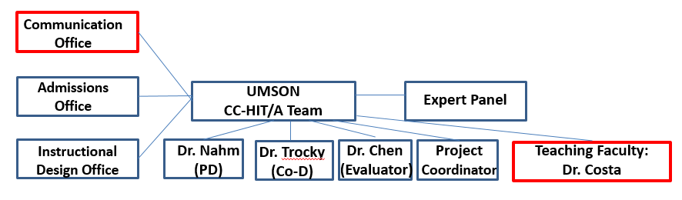
Expanded Project Team Structure

Slide 6
UMSON Project Team: Investigators
Nahm, Eun-Shim, PhD, RN, FAAN
Professor, & Program Director, Nursing Informatics
Nina Trocky, DNP, RN, NE-BC, CCRA
Associate Dean for the Baccalaureate Program
Linda Costa, PhD, RN, NEA-BC, Assistant Professor, UMSON (course development)
Lynn Chen, PhD, Assistant Professor, UMSON,
Evaluator

Slide 7
Expert Panel Members
(CC, HIT, Pt Outcomes, Administration)
Sheila Haas, PhD, RN, FAAN Dean and Professor Emeritus, Loyola University Chicago, School of Nursing | Benjamin Laughton MBA, MSN, CRNP Senior Director of Clinical Informatics, University of Maryland Medical Center
Lisa Rowen, DNSc, RN, CENP, FAAN Senior Vice President of Patient Care Services & Chief Nursing Officer University of Maryland Medical Center | Rebecca Brotemarkle, PhD, RN, CCM , ACRN Assistant Professor University of Maryland School of Nursing
Sherry B. Perkins, PhD, RN Executive VP/COO Dimensions Healthcare System | Beth Kilmoyer, DNP, RN-BC Nursing Informatics Manger, Mercy Medical Center
Ingrid Connerney, DrPH, RN, CPPS Senior Director, Quality, Safety, and Clinical Effectiveness , University of Maryland Medical Center | Kristin Seidl, PhD, RN Director of Quality and Patient Safety Officer University of Maryland Medical Center

Slide 8
Significance of the Topic
Target Group

Slide 9
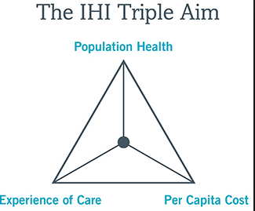


Changing HealthCare Models
9
Notes:
Currently, healthcare is moving forward to VBC.

Slide 10

Importance of Care Coordination
Meet growing demand for accountability within new models of care
Must coordinate a spectrum of care through patient transitions and across multiple practitioners and care settings
10
Notes:
In this healthcare environment, care coordination is becoming more important.

Slide 11
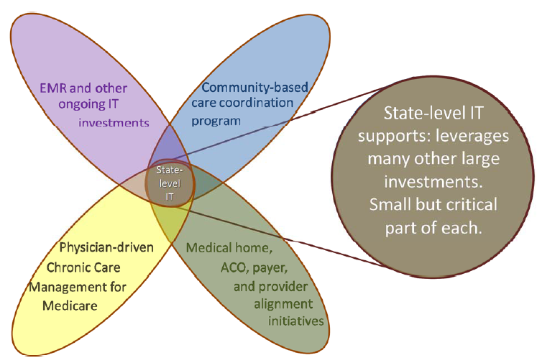
HSCRC Robust CC Infrastructure: Health IT
Notes:
In managing care, the role of health IT is vital. This HSCRC CC model sums up the current changes nicely.

Slide 12

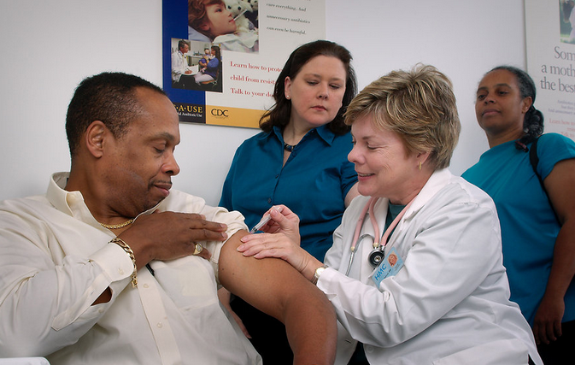

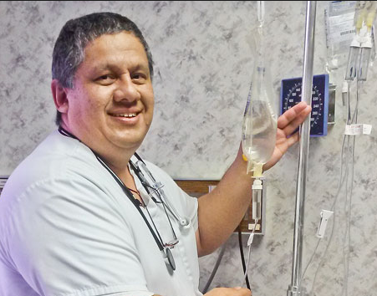
Current practicing nurses?
Prepared for the changes?
Notes:
Are they prepared for the changes?
Did they have the opportunities to learn about those?
They need retooling

Slide 13
RN to BSN Option
Credits (6 core courses; 3 elective courses) Full time/part time Open pool/dual admission
Students | Professionals
Adult learners | Employed in a variety of settings
Practical and relevant course work | Familiar with care coordination and management concepts
Appreciate role of BSN prepared nurse | Participate in workplace performance improvement activities
Notes:
So, in line with the importance of CC in practice, this project focus on the RN-BSN students because these are practicing nurse who are working on their BSN degree.

Slide 14
RN to BSN Plan of Study
 | Semester/Course for Full Time Plan of Study | Total
 | First Semester | 14
NURS 450 | RN to BSN Transition: Implications for Practice, Policy and the Profession | 3
NURS 452 | Nursing Research and Evidence Based Care for the Registered Nurse | 3
NURS 454 | Pathophysiologic Implications to Patient Assessment | 5
NURS 418 | Nursing Elective- Care Coordination I | 3
 | Second Semester | 17
NURS 460 | Health Informatics for the Registered Nurse | 3
NURS 462 | Nursing Leadership and Management for the Registered Nurse | 3
NURS 467 | Public Health Nursing Essentials for the Registered Nurse | 5
NURS 418 | Nursing Elective- Care Coordination II | 3
NURS 418 | Nursing Elective | 3
 | RN to BSN Program of Study Credits | 31

Slide 15


Slide 16
Project Progress/Selected Accomplishments

Slide 17
Development of New RN-BSN Focus Area

Slide 18
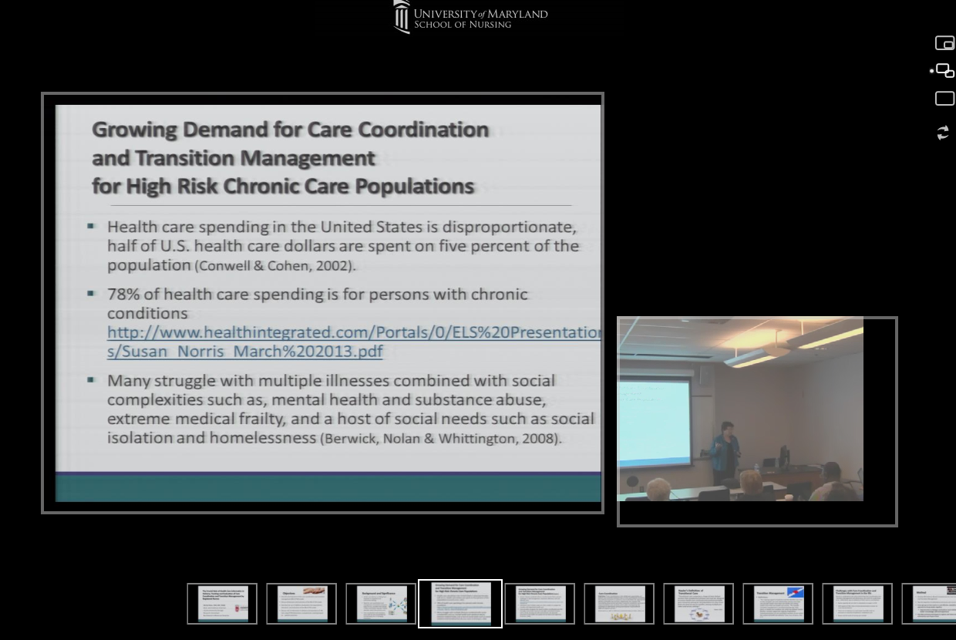
Development of Expert Panel
Collaboration with a strong expert panel, including practice experts and nurse leaders
Notes:
Dr. Sheila Hass

Slide 19

Recruitment Efforts
Established infrastructure, policies and procedures for a new RN-BSN focus area.
Developed recruitment materials and started advertising the program.
Recruitment efforts (new focus area and courses)

Slide 20
RN-BSN Fall 2017: New Students
Among Total Applied | Among Total Accepted Our Offer
Total RN-BSN’s applied fall 2017: 120 | 45 accepted our offer
Total answered CC-HIT focus question: 116 | 33 of accepted students answered question
Answered Yes to focus question: 66 (57%) | 13 (40%) of accepted students answered Yes
RN-BSN Spring & Fall 2018: New Students
Among Total Applied | Among Total Accepted Our Offer
Total RN-BSN’s applied fall 2018: 176 | 76 accepted our offer
Total answered CC-HIT focus question: 164 | 68 of accepted students answered question
Answered Yes to focus question: 92 (56%) | 37 (54 %) of accepted students answered Yes

Slide 21
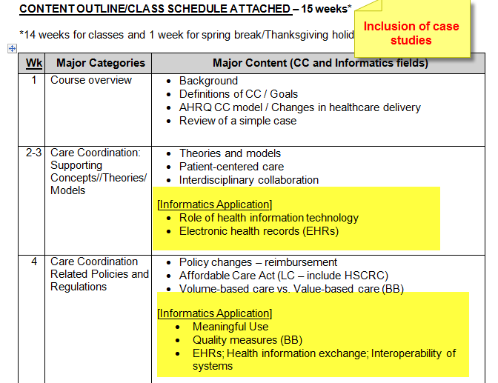
Course Development
Care Coordination I: Theoretical Foundations and Applications

Slide 22
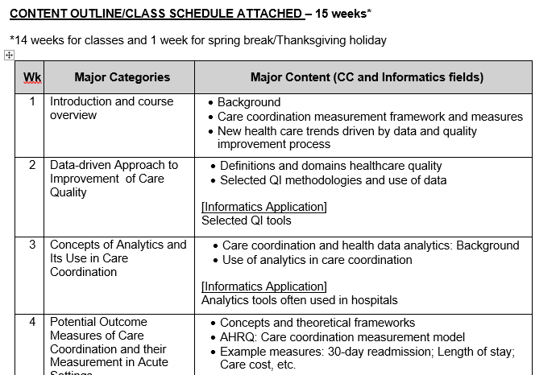
Course Development
Care Coordination II: Process & Outcome Measurement and
Practice Improvement

Slide 23
Online Courses: Development
Emphasis on practical application
  Scenario-driven discussions and deliverables
  Opportunities to learn from experts (e.g., expert interviews)
  Incorporation of CC expert interviews (video) in lectures
Facilitated group work
  Group discussions
  Peer evaluation

Slide 24
Pilot Implementation of New Courses

Slide 25
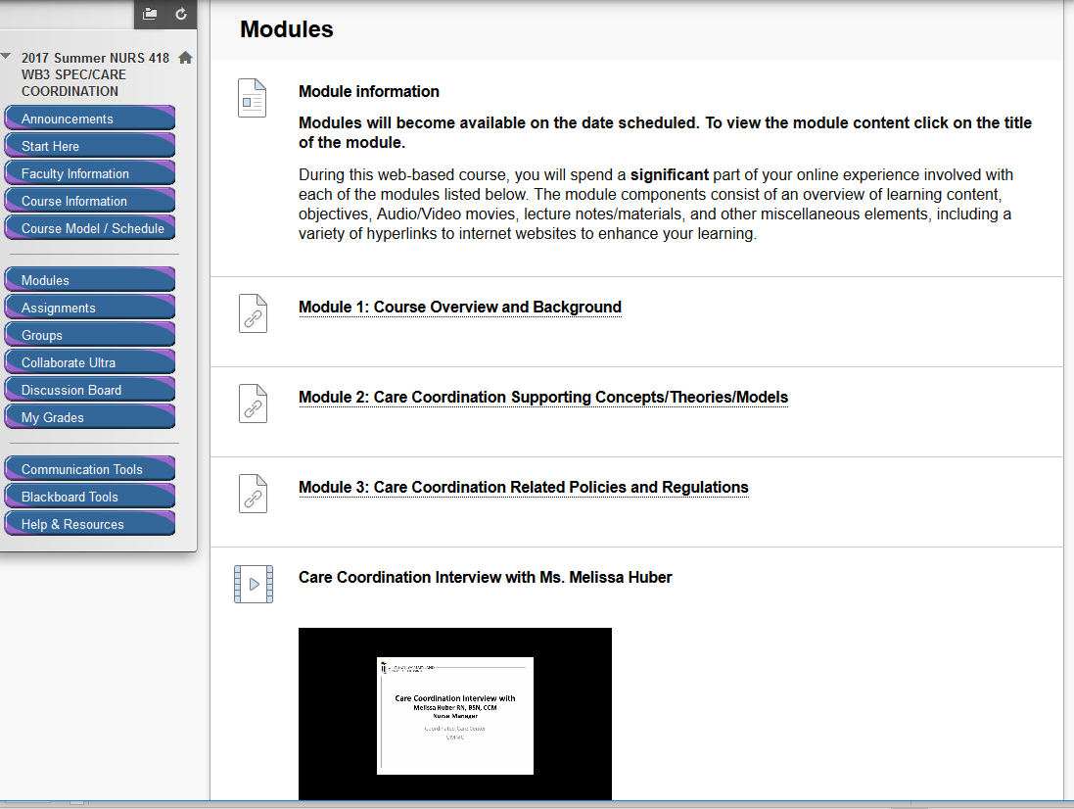
Online Courses: Implementation
Offered CC1 and CC 2 (460 is being offered).
Implemented pre-post evaluation measures.

Slide 26
Student Comments
Why are you interested in the Care Coordination focus area?
  “I used to work in care coordination and think it is extremely useful in many different settings.”
  “To develop my nursing patient care coordination, ability to provide quality care for patients, and reduce patient readmission.”
  “I'd like to eventually go into care coordination.”
  “Better patient care”
  “Important for the management of chronic diseases”

Slide 27
Student Comments
“The discussion board, modules, and assignments contributed to my learning. I learned about Patient Engagement and Self-Management, Care Coordination and Population Health. I also interviewed a case manager at my job. I learned how critical the role of a Nurse is in care coordination and patient discharge. I love the video explanation of the case study. I love the group discussion board, with all linking to leadership roles.”

Slide 28
Student Accomplishments
Graduates with Focus Area on Transcript
  1 in fall 2017
  6 in spring 2018
Some students are in the pipeline.

Slide 29
Additional Accomplishments
Outreach Efforts
  Collaboration in teaching between faculty members and practicing experts.
    Engagement of nurse leaders and care managers in curriculum development and lectures
  Webinar sessions for UMMC case managers
  Introduction of the courses to the director and managers of the UMMC ambulatory care centers.
  Presentation of CC content to parish nurse care coordinators’ group
  Offering Webinars to hospitals
Dissemination
  AACN Baccalaureate Conference

Slide 30
Many lessons learned from the project!
Many more work can be done with the output from this NSP II grant project!
Impact on Patient Outcomes and Nursing Practice

Slide 31
Expanded Goals
Goal 1: Offering CC courses to BSN and RN-MS students and soliciting support from nurse leaders in hospitals.
Goal 2: Reformat CC courses to fit practicing nurses’ needs. (Free Online Care Coordination Toolkit)
  Share the courses/toolkit with the NSP II Nurse Residency Program
  Open the toolkit to practicing nurses
  Store the toolkit on the MHEC website

Slide 32

Q & A
Suggestions
32

