Slide 1
NSP II 17-102 Expanded Pathways to the BSN: ATB 1-2-3
Karen Wons, MS, RN, CNE
Associate Professor, Project Director ATB Grant NSPII 17-102
NSPII Project Director’s Meeting: June 14, 2018

Slide 2
Acknowledgements for ATB
The ATB Program has been made possible with the generous support of two Nurse Support II Grants from the Maryland Higher Education Commission under the auspices of the State of Maryland Health Services Cost Review Commission.

Slide 3
Introduction
Background for ATB model
Goals for NSP II 17- 102
(July 2016 – June 2020)
Outcomes to date

Slide 4
ATB’s Launch Fall ‘12
CCBC & Towson University (TU) developed ATB Option in 2011-2012
First pilot class of 17 began in fall 2012
Classes taken at CCBC and TU
AS degree in May, 2014
Completed summer, fall terms at TU
BS degree in Dec, 2014
Sp ‘13 CCBC awarded NSPII grant to expand the ATB option with other universities

Slide 5
ATB’s Expansion Four Partner Options by Fall ‘15
Towson University (Pub) - F2F/online
Frostburg State U (Pub) - 100% online
Stevenson University (Priv) - blended
Notre Dame of MD University (Priv) - F2F

Slide 6
Dual Enrollment ATB Model
IOM GOAL
by 2020
> 80%
of nurses will have BS degrees
Key features:
Complete pre-reqs for both A.S. and B.S. programs
Begin B.S. courses while enrolled in ADN program
Reduce course repetition where possible
Year round attendance
Take NCLEX-RN upon A.S. degree completion
Begin work as RN
Articulation agreements – 30 credits awarded
Complete B.S. part time within six months to one year

Slide 7
Major Goals for ATB – NSPII 17-102 ( July 2016 – June 2020)
Goal #1 Serve as a resource for other ATB partnerships
Goal #2 ATB Mission: by 2020 80% of CCBC nursing
students connect to BSN program before graduation

Slide 8
Major Goals for ATB – NSPII 17-102 ( July 2016 – June 2020)
Expanded Pathways to the BSN: ATB 1-2-3
Creating a Culture of Academic Progression
* = of entering Fundamentals cohort
ATB 1.0
50% enter* 1st semester
ATB 2.0
20% enter* 2nd year
ATB 3.0
10% enter* 4th semester
by 2020
> 80%
of CCBC’s ADN students connect to BSN program

Slide 9
ATB Outcomes
Faculty Resource Website
Enrollment Trends
Access for Qualified Students
Student Diversity
BSNs Produced

Slide 10
Goal # 1 - Met
ATB Faculty Resource Website
http://blog.ccbcmd.edu/atb/

Slide 11
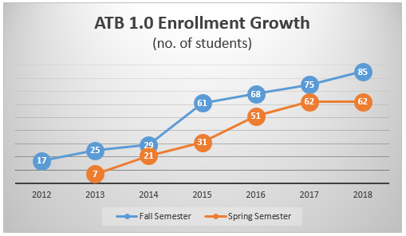
ATB 1.0 Option

Slide 12
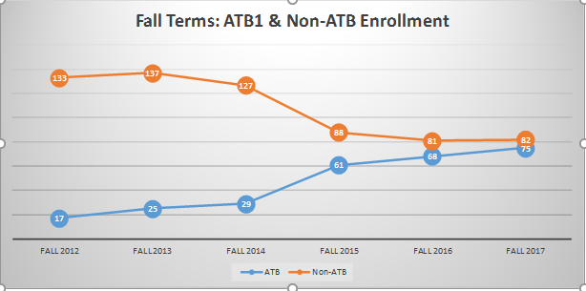
Fall Trending ATB – Non-ATB

Slide 13
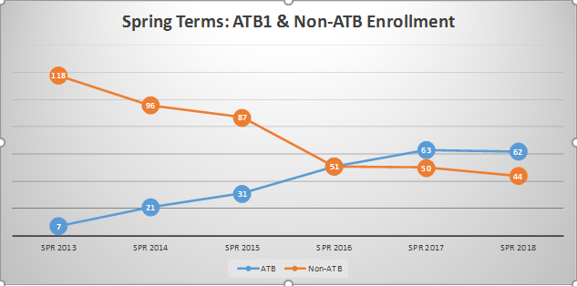
Spring Trending ATB – Non-ATB

Slide 14
ATB 2.0 Enrollment
Year/Partner | Spring ATB 2.0 Enrollment # | Fall ATB 2.0 Enrollment #
2016 (4 Partners) | Not offered | 14
2017 (4 Partners) | 15 | 15
2018 (4 Partners) | 6 | *16
* universities still may accept additional students

Slide 15
ATB 3.0 Connection to RN to BSN
Non-ATB ADN Grads (n)/ Surveyed Month/Year | Grads Reporting Have Applied to RN – BSN Program | Grads Reporting Acceptance to RN – BSN Program | Grads Reporting Plan to Apply to RN – BSN < 6 mos | Grads Reporting Plan to Apply to RN – BSN 6 mos – 1 yr | Grads Reporting Plan to Apply to RN – BSN 1 yr – 2 yrs
N= 61 May 2017 | 16 | 10 | 21 | 11 | 3
N= 26* Dec 2017 | 8 | 6 | 8 | 7 | 2
* Dec 17 responses from Essex grads only

Slide 16
Creating Access to BSN for Otherwise Qualified Students
Nursing Schools are Rejecting Thousands of Applicants -- In the Middle of a Nursing Shortage
by Parija Kavilanz @CNNMoney April 30, 2018
http://money.cnn.com/2018/04/30/news/economy/nursing-school-rejections/index.html
According to AACN, U.S. nursing schools turned away 68,922 qualified applicants from baccalaureate and graduate nursing programs in 2017
ATB is providing additional access to BSN education for this group
Notes:
A very recent CNN Money article with the headline: Nursing Schools are Rejecting Thousands of Applicants in the Middle of a Nursing Shortage has again highlighted what we as educators know – we continue to turn away many qualified applicants from BSN nursing programs each year.
ATB is providing another pathway to the BSN for this group of applicants.

Slide 17
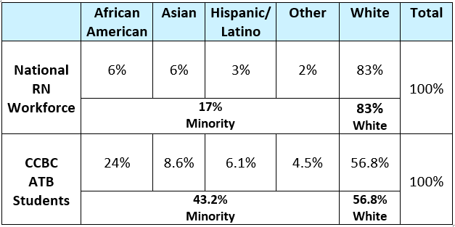
ATB vs National RN Diversity Source National: AACN, 2014
Notes:
In addition to increasing the number of BSN prepared nurses, nurse educators have been challenged to examine ways we can increase the diversity of the nursing workforce.
CCBC’s student population is quite diverse and we are seeing that diversity reflected in ATB participation.

Slide 18
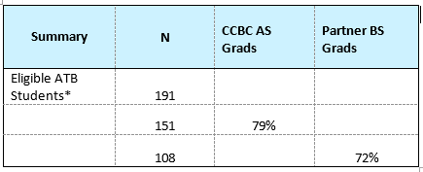
Overall CCBC ATB Graduation Rates
Of note – of OCNE ADN grads in shared curriculum model only 30% reported to transition directly to university
Eligible ATB Students* = those who could have progressed to point of BSN by Dec. 2017
Notes:
OCNE Article title: From Start-up to Sustainability: A Decade of Collaboration to
Shape the Future of Nursing (2017) by Paula Gubrud, Angela G. Spencer, and Linda Wagner
Pri or t o OCNE’ s implementation, national data indicated that 9.6 percent of community college nursing graduates completed a BSN wit hin fi ve year s of ear ning the ADN ( Health Reso urces and Ser vic e Administration, 2010, section 9.3, p. 204). In the first three years the OCNE cur ri culum w as of fered , an averag e of 30 p ercent of par tner community college students transitioned to OHSU to complete the BSN degree (Munkvold et al., 2012), a rate that continues to the present day (Figure 1). Several ADN graduates who transitioned to OHSU have since returned to partner community colleges to serve as instructors, and many OCNE students have gone on to graduate p r o g r am s , i n c l ud i n g m a s t e r’ s o f s c i en c e , m a s t e r’ s i n n u r s i n g education, doctor of philosophy, and nurse practitioner programs.

Slide 19
ATB BSNs Projected to Snowball
Most of 108 BSNs Dec 14 - Dec 17 from TU (earliest partner)
First BSNs from FSU (7) and NDMU (1) produced in Dec 2017
Major milestone Sp 2018 – BSNs produced by all four universities!
42 additional BSNs anticipated to graduate May – August 2018

Slide 20
Karen Wons, MS, RN, CNE kwons@ccbcmd.edu
443-840-2820

