Slide 1
Nurse Support Program II
Technical Assistance Meeting
October 31, 2016
Peg Daw, DNP, RN-BC, CNE
Oscar Ibarra, MS, BS

Slide 2
Nurse Support Program
Nurse Support Program I-
CNO’s -hospitals
Next Evaluation Due: 2017
Nurse Support Program II-
Deans/Directors- schools of nursing
Next Evaluation Due: 2020
Common Goals
Common Funding Mechanism
Common Focus on Registered Nurses

Slide 3
FY 2018 RFA
NSP II Competitive Institutional Grants
RFA Released October 11, 2016
Technical Assistance October 31, 2016
Project Director’s Mtg December 5, 2016
PROPOSALS DUE January 27, 2017
HSCRC Draft April 12, 2017
HSCRC Final Approvals May 10, 2017
FY 2018 Projects Begin July 1, 2017

Slide 4
SB 108-”bedside”deleted
Introduced during the 2016 Maryland legislative session with the purpose of deleting the term “bedside” from the descriptor of nurses in the statutory provision establishing the NSP II
Instead of focusing on “bedside” nurses, SB 108 allows the NSP II to improve the pipeline of nurses with the skills necessary to keep pace with the rapidly changing health care delivery system. It was passed by both the Maryland Senate and the House and approved by the Governor on April 26, 2016.
RFA pg. 5

Slide 5
RN-Shortages by 2025
STATE | 2012 Supply and Demand | 2025 Projected Demand | 2025 Projected Supply | Difference
Maryland | 60,600 | 72,000 | 59,900 | -12,000
West Virginia | 20,600 | 21,100 | 29,000 | +7,900
Delaware | 10,600 | 12,500 | 16,200 | +3,700
Virginia | 69,900 | 87,300 | 106,700 | +19,400
Pennsylvania | 145,000 | 152,600 | 178,400 | +25,800
US | 2,897,000 | 3,509,000 | 3,849,000 | +340,000 (HRSA, 2014)

Slide 6
MONL Workforce Survey
Survey of CNOs representing 32 MD hospitals:
Top 3 RN needs: Emergency (71%), ▫ Critical Care (68%) and ▫ Operating Room/Perioperative ( 58%)
Most difficult nursing roles to fill were:
▫ Nurse Manager (63%)
▫ Director ( 50%)
▫ Nursing Professional Development Specialist (hospital based nurse educator) (47%)
▫ Experienced clinical bedside nurses (34% )
(Warren,2014)

Slide 7
Initiatives FY 2015-2020
Type of Competitive Grant Initiative:
☐1. Initiative to Increase Nursing Pre-Licensure Enrollments and Graduates
☐2. Initiative to Advance the Education of Students and RNs to BSN, MSN, and Doctoral Level
☐3. Initiative to Increase the Number of Doctorally prepared Nursing Faculty
☐4. Initiative to Build Collaborations between Education and Practice (new nursing roles-pt. care continuum)
☐5. Initiative to Increase Capacity Statewide
RFA Pg. 25

Slide 8
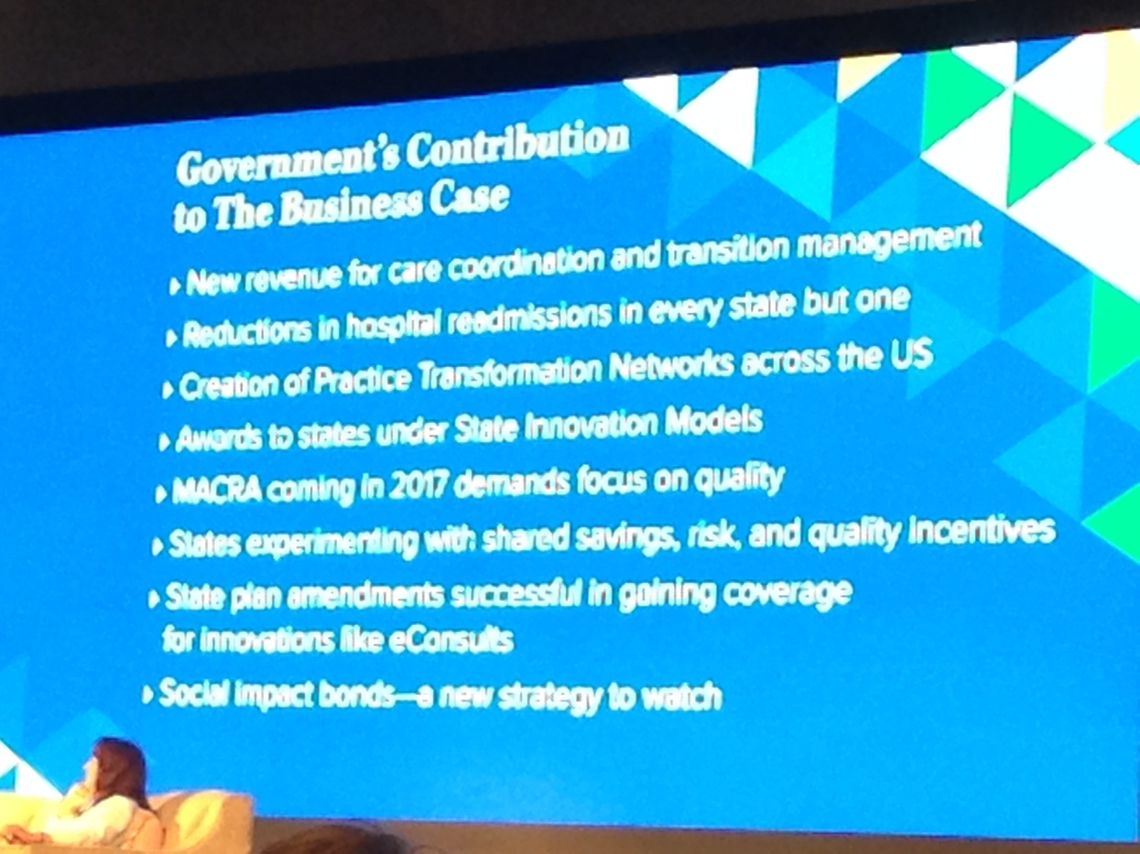
American Academy of Nurses

Slide 9
Maryland RNs in US model
Care Coordination and Transition Management
Reductions in Hospital Readmissions
Creation of Practice Transformation Networks
State Innovation Models ( Modernization of Waiver)
Focus on Quality
Savings, Risk and Quality Incentives ( Global Budgets- Reducing Agency RN costs)
Social Impact Bonds- Population Health

Slide 10
Care Coordination
Facilitate collaborative relationships among providers, patient advocates, public health agencies, faith-based initiatives and others with a particular focus on resource planning, resource coordination, and training
Opportunities for Maryland to invest in Care Coordination Opportunities
http://www.hscrc.state.md.us/documents/md-maphs/wg-meet/cc/2015-02-27/2-Opportunities-for-Maryland-Investment-in-Care-Coordination-final.pdf

Slide 11
Faith Community RNs
Faith Communities are more readily becoming partners in health care.
Faith Community Nursing is a specialty practice in nursing, recognized by the ANA, with a specific focus on health education, care coordination, referral to community resources, care navigation, and integration of faith and health.
ANCC Certification in 2014
1. Meritus Medical Center, Hagerstown
2. Holy Cross Hospital, Silver Spring
3. Adventist Healthcare, Gaithersburg
4. Good Samaritan Hospital, Baltimore
5. Western Maryland Health System, Cumberland

Slide 12
Care Coordination & FCNs
 | RNs
Are familiar with motivational and empowering techniques to encourage lifestyle change | yes
Routinely train and utilize volunteers Are mutidisciplinary and interdisciplinary team members | yes
Understand the concept of holistic health functioning Are familiar with, and able to implement, community and public health nursing concepts and practices | yes
Are accessible (long-term), approachable, professional, good communicators, and culturally sensitive | yes
Coordinate, implement, and sustain ongoing care activities Are available to consult and train additional FCNs in Maryland | yes
THINK OUTSIDE THE BOX

Slide 13
Core Approach= Hospitals + SONs
Patient Characteristics
Caregiver Characteristics
High system use—frequent hospitalizations and ED use
Frail elderly, poly-chronic, urban poor
Psychosocial and socioeconomic barriers
Healthy
Chronically ill but under control
Care coordinators (RNs)
Address psychosocial and non-clinical barriers
Community resource navigation
Intensive transition planning
Frequent one-on-one interaction
High need/
complex
Chronically ill but at high risk to be high need
More limited stable chronic conditions
At risk for procedures
Reduce practice variation
Systematic outcomes- oriented care
Scalable team-based coordinated care
Chronic care management
Healthy
Minor health issues
Focused coordination and prevention
Movement toward virtual, mobile, anytime access
Convenience/access is critical
( Warren, NSP I 2016)

Slide 14
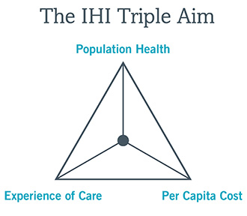
Understanding the Mission
Only 799 of more than 3,400 IPPS hospitals across the US performed well enough in 2015 to avoid reimbursement penalties in 2016.
( Waiver= maintain % below Medicare cost reporting)
We have ~50 acute care hospitals funding NSP
Their mission- Triple AIM
Quadruple Aim- added provider’s experience

Slide 15
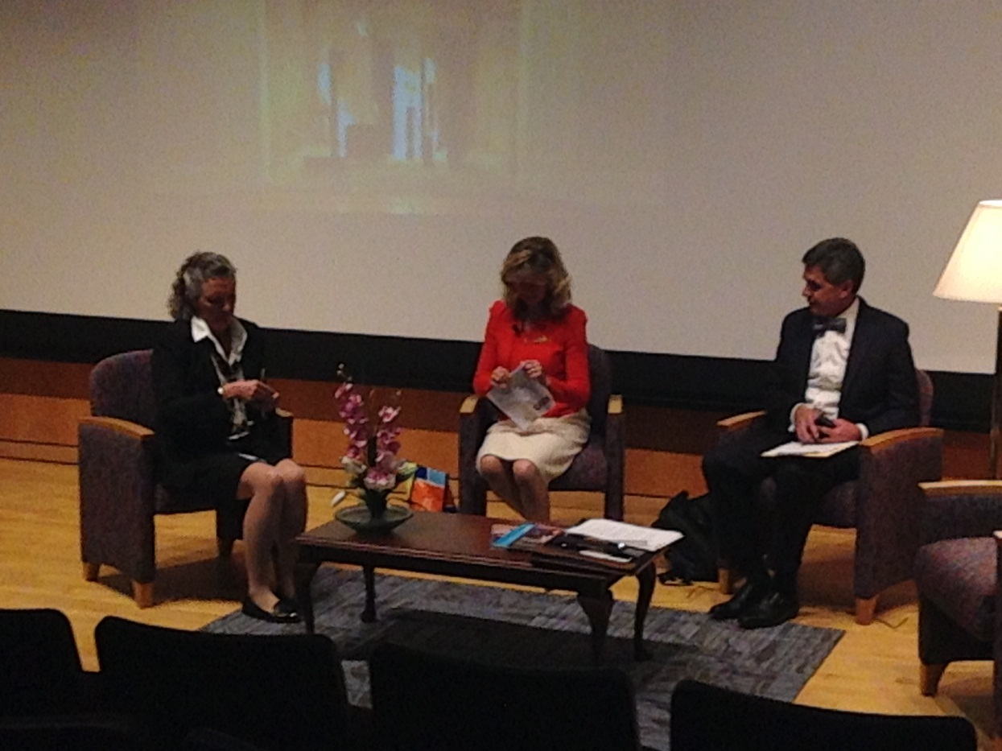
Leadership- Practice and Academia

Slide 16
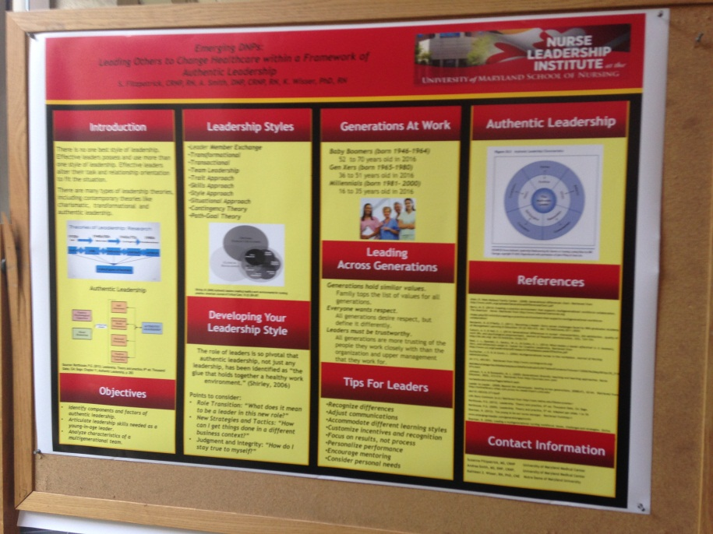
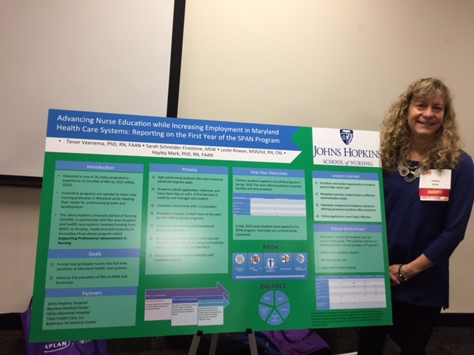
Collaboration at Conferences

Slide 17
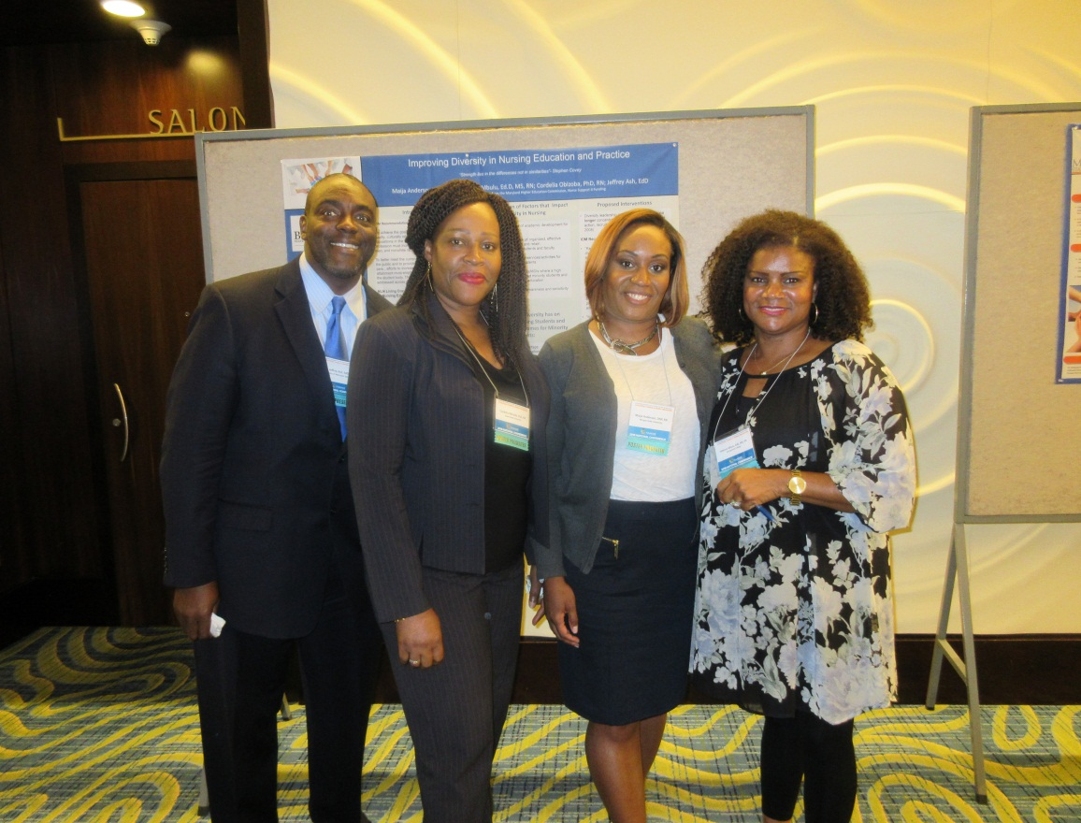
Diversity – our strength lies in our differences- not our similarities ( Stephen Covey)
NLI TEAM:
Morgan State University
Bowie State University
Montgomery College
University of Maryland
Presented 9/14/16:
Improving Diversity in
Education and Practice
National Association of
Minority Medical
Educators Conference

Slide 18
Clinical Simulation
“The true value of simulation lies in its ability to offer experiences throughout the educational process that provide students with opportunities for repetition, pattern recognition, and faster decision making.”
(Doyle & Leighton, 2010)
Utilize as clinical hours? Impact on clinical sites?
  Provides context to situation, clinical judgment, communication, resource management, “thinking on your feet,” teaching skills, management of emotional situations

Slide 19
Types of Simulation
Screen-based/PC-based simulation
Virtual patients
Partial task trainers
Human patient simulator
Standardized patients
Integrated models
Interprofessional/Leadership/Management
Simulation use and identified needs are guided by Dean/Directors and Nursing faculty and educators in nursing programs
Research needed on:
Impact on competence • Impact on patient care
Impact on patient safety • Impact on clinical time

Slide 20
Directions in Nursing Education
Providing more experiential learning opportunity than instruction
Academic progression models
Increased use of learning technology
More emphasis on outcome-based then process-based education
More evidence-based education strategies and curriculum

Slide 21
Faculty Directions
Double the number of RNs with Doctoral Degrees
( PhD in Nursing, Doctor of Nursing Practice, EdD)
Barriers- Money and Time ( NSP II- tuition, loans)
Certified Nurse Educators ( CNE) symbolizes excellence in education
Early career guidance- Mentorship
Dual Roles- Academia and Practice
Research on Nursing Education & Workforce Shortages

Slide 22
NSP II Grants Funded
Faculty and Personnel ******
Mandatory Dissemination
Professional Development
Instructional Delivery
Curriculum Redesign
Materials and Teaching Supplies
Consultants
Technology
Evaluation

Slide 23

We need Faculty to Teach

Slide 24
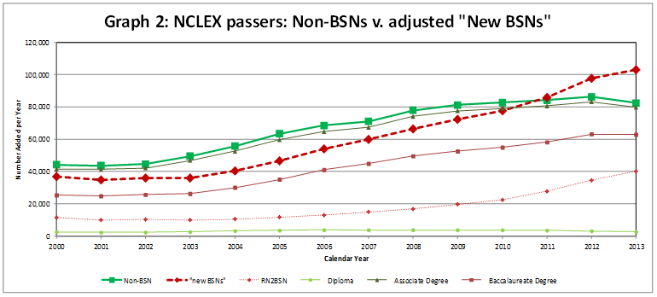
We need new RNs and BSNs
The dashed dark red line with diamond markers represents the sum of the new NCLEX passers with BSNs plus the RNs graduated from RN2BSN programs with new BSNs. In the three years following the publication of the IOM Future of Nursing Report (2011-2013) there were 102,686 ADN RNs who obtained their BSN degrees. That was nearly as many as had earned their BSNs in the preceding seven years from 2004-2010: 109,137. (McMenamin, ANA, 2015)

Slide 25
NSP II Faculty and Hospital Educator Programs
Hal and Jo Cohen Graduate Nurse Scholarships
(Full Tuition and Fees- Faculty or Hospital PDS)
New Nurse Faculty Fellowships
($20,000= over three years- recruit and retain faculty)
Nurse Educator Doctoral Grants for Practice and Dissertation Research ( up to $30,000 )
Maryland Clinical Simulation Resource Consortium
http://cms.montgomerycollege.edu/mcsrc/
Leadership Institute
https://www.nursing.umaryland.edu/academics/pe/nli/

Slide 26
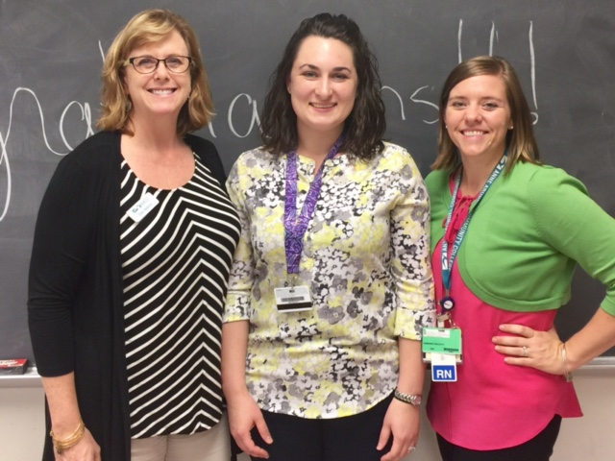
FY 2017 New Nurse Faculty
15 Nursing Programs
Nominated 53 New Nurse Faculty
All were eligible and All were funded
NNFF 89% retention
Successful program
Open to all SON Deans/ Directors

Slide 27
We need strong data
Nursesupport.org - website enhancements
Documentation of project results
Dissemination of publications
Shared resources for nurses
Annual and Final Reports- Mandatory Data
Results =Met or Did Not Meet proposed outcomes
Highlighting Faculty Awards
Updates on Nurse Support Program

Slide 28
Grant Outcomes
Final Outcomes Projected Increase
(# of Additional Graduates)
Describe Degrees/Results
Nursing Pre-Licensure Graduates __________
Nursing Higher Degrees Completed __________
Nursing Faculty at Doctoral Level __________
Collaborative or Statewide Results __________
Pg. 25 Cover Sheet

Slide 29
Types of Grants-Funds
Funding Requested: _______
Value of Match (Funds, In-Kind, Etc.): _____ ***
Type of Grant:
☐Planning ( 1 yr)
☐Implementation (1-5 years)
☐Continuation (Invitation only)
☐Statewide Resources ( Share final products-pg.43)
☐New Resource Grant ( Up to $100,000- 1 yr.)

Slide 30
Planning Grants
Planning projects are limited to one (1) year of funding. Special requests for no-cost extensions will be considered on a case by case basis. Planning grants award up to $150,000 for planning projects that align with the goals of the NSP II. The outcome of the planning grant will be a detailed proposal to increase the enrollment and graduation of nurses who will then practice in Maryland and/or (2) increase the supply of qualified nursing faculty required to expand the capacity of Maryland’s nursing programs.

Slide 31
Implementation Grants
NSP II Implementation grants are available for projects that will (1) increase the enrollment and graduation of nurses who will then practice in Maryland hospitals and/or (2) increase the supply of qualified nursing faculty required to expand the capacity of Maryland’s nursing programs. Implementation grants have no maximum grant award amounts. However, the budget must be justified by the scope and outcomes of the project. Grants will be funded for a period of one (1) to five (5) years. Produce graduates and fit initiatives
RFA pg. 7

Slide 32
Continuation Grants
NSP II Continuation Grants are available for successful grant projects that are recommended for funding beyond the initial grant period to expand on models or programs that have potential for greater impact with additional funding. Continuation grants are only available for projects invited to apply.
Invitations to continue will be sent out in the last year of the grant. If a continuation is not recommended, you may still reapply for similar programs if desired.

Slide 33
New
1 yr.-Resource Grants
Statewide resource grants award up to $100,000 for small projects that align with the goals of the NSP II but would not qualify as implementation or planning grants. Initiatives that qualify under this program are short-term (up to 12 months) in nature. These grants support a wide-range of eligible expenditures. Proposed expenditures that (1) add overall value to the nursing program, (2) lack alternative funding sources, and (3) are not considered ineligible expenses
RFA pg. 8

Slide 34
Statewide Capacity
The NSP II policy is to ensure intellectual property developed in the course of or under this grant to increase statewide capacity furthers the goals of the NSP II and benefits the nursing profession in Maryland. This policy applies to all grants awarded funding under Initiative 5, Initiatives to Increase Capacity Statewide as identified on the cover sheet of the grant proposal. The NSP II Intellectual Property Policy is as follows:
By accepting these grant funds, the grantee agrees that:
a. The grantee shall deliver a complete, functioning version or copy of the final products developed under the Grant to the Health Services Cost Review Commission (HSCRC) and Maryland Higher Education Commission (MHEC).

Slide 35
What should you think about first?
Future funding is determined by program outcomes.
Insert Initiatives
Insert Outcomes Table
FOCUS- address nursing program needs and intended outcomes in the first two pages of the proposal.
*** MBON NCLEX-RN pass rates below state levels or CCNE/ACEN Accreditation review concerns come first.

Slide 36
Grant Title and Requestors
Lead Applicant Institution/Organization:
School of Nursing at____________
Project Title:
Brief & Descriptive
Partnership Members: ****
This is an important aspect of a fully funded proposal.

Slide 37
Evaluation Criteria
Criteria Maximum Points
Abstract 5
Overview 10
Project Goals and Objectives 15
Scope of Proposed Initiative 15
Management Plan 15
Evaluation Plan 15
Sustainability Plan 5
Budget and Cost Effectiveness 20
Total 100

Slide 38
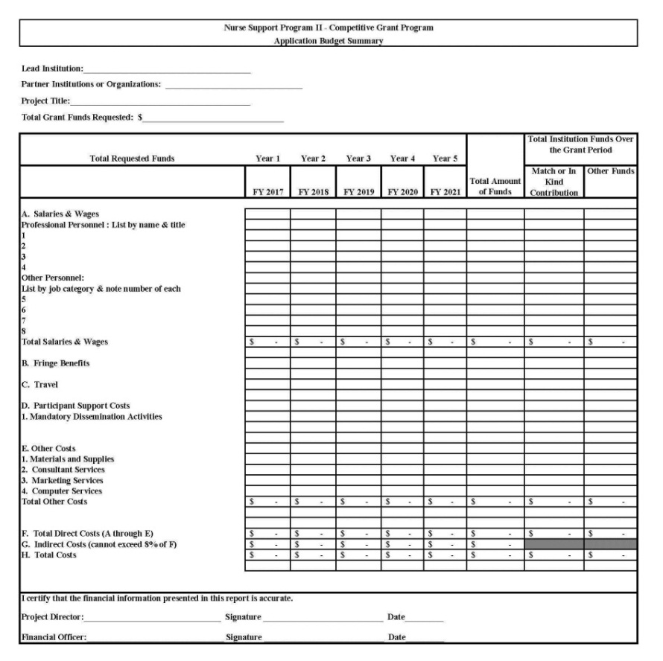
Budget Guidance
Application Budget Summary
Budget Pointers
Accuracy: Check and Double Check Figures
Fringe Benefits: Ensure the Cost Allocated for Fringe Benefits is Reasonable
Budget Narrative: Ensure Budget and Budget Narrative Match

Slide 39
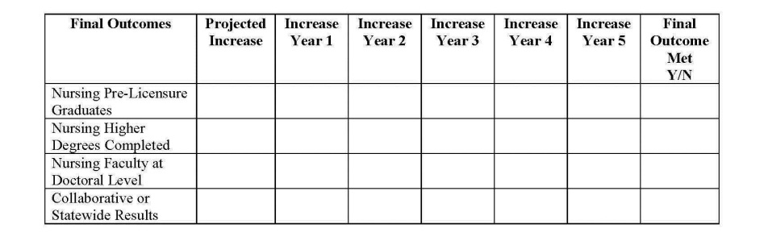
Annual Reporting
Changes
Projected Outcomes Table from Cover Sheet
Due Date: August 31st
Budget Summary: Actual Expenditures
Annual Report: Projected Outcomes & Dissemination Sections
Carryover: Linked to Performance

Slide 40
FY 2018- Proposals
ALL PROPOSALS ARE DUE:
January 27, 2017
Friday by 4 pm
Maryland Higher Education Commission
6 N. Liberty Street
Baltimore, Maryland 21201

Slide 41


Slide 42
References
American Academy of Nurses, Annual Conference and New Fellow Inductees from Maryland. October , 2016
https://higherlogicdownload.s3.amazonaws.com/AANNET/c8a8da9e-918c-4dae-b0c6-6d630c46007f/UploadedImages/docs/Press%20Releases/2016/2016-06-24_New%20Fellows%20Announced.pdf
Health Services Cost Review Commission
www.hscrc.state.md.us
Maryland Higher Education Commission
www.mhec.state.md.us

Slide 43
References
Nurse Support Program www.nursesupport.org
Competitive Institutional Grants FY 2018 RFA
http://www.nursesupport.org/nurse-support-program-ii/grants/competitive-institutional-grants/
Schroepfer, E. (2016). A renewed look at faith community nursing. MedSurg Nursing, 25(1),62-66.
Cooper, J. & Zimmerman, W. The evaluation of a regional faith community network’s million heart’s program, Public Health Nursing, 33(1), 53-64.

