Slide 1
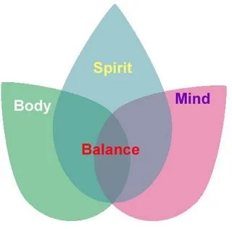
Post Doctorate Psychiatric Mental Health Certificate
Debra Scrandis, PhD, PMHNP-BC & Charon Burda, DNP, PMHNP-BC, CARN-AP
University of Maryland School of Nursing
Background
Methods
Conclusions
There is a shortage of psychiatric mental health nurse practitioners (PMNHPs) in the State of Maryland. PMHNPs only make up 2.5% of all advanced practice nurses.
Due to American Association of Colleges of Nursing’s reaffirmation to recommend the DNP as entry into advanced practice nursing, there are more doctor prepared clinicians than ever before. There needs to be an alternative option to become a certified PMHNP for those with terminal degrees.
Recruitment:
Web site redesign with plan of study
Emails to PhD, DNP alumna of University of Maryland School of Nursing
Advertisements at conferences and local NP organization
Direct mailings to Deans and Directors of surrounding Maryland and DC universities
Partnerships:
Work with Chair of Partnerships, Practice, Professional education and practice to meet with integrated site practices
Retention:
Designate one faculty member to serve as advisor for all post doctorate PMHNP students.
Recruitment was difficult since we were looking for only doctor prepared clinicians, especially faculty members
The certificate program is face to face classes, which may deter students who want online programs
There are practice sites willing to work with post doctorate PMHNP students with the opportunity for faculty practices.
Objectives
Bibliography
The objectives of this grant:
Develop and implement recruitment strategies to attract applicants to the post doctorate PMHNP certificate, especially doctor prepared nurses interested in faculty roles.
Build new partnerships with integrated primary care and behavioral health settings.
Develop and implement retention strategies
American Association of Colleges of Nursing. (2015The Doctor of Nursing Practice: Current Issues and Clarifying Recommendations. . Retrieved at www.aacnnursing.org/Portals/42/DNP/DNP-implementation.pdf.
American Association of Nurse Practitioners. (2019). NP Fact Sheet. Retrieved at www.aanp.org/about/all-about-nps/np-fact-sheet
https://sowingseedsofgreatness.com/f/mind-body-medicine
Development
Results
Notes
The post doctorate PMHNP certificate was based on the current DNP psychiatric specialty courses, which include 810 hours of clinical experience.
Individualized plans of study are available for post doctoral students who already met course objectives in another program.
There were two applicants, one admitted to the program. Admitted student on leave of absence.
Two integrated primary care and behavioral sites were identified as clinical placements and potential faculty practice sites.
This project has been funded with NSP-II grant

