Slide 1
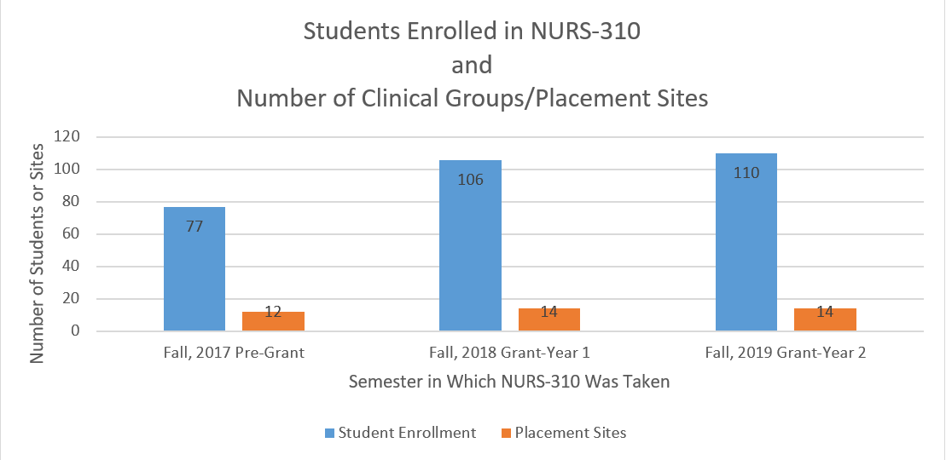
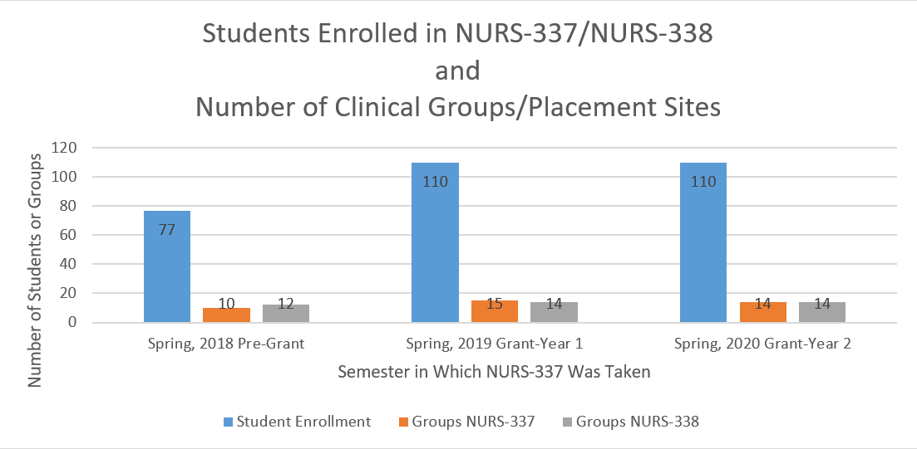
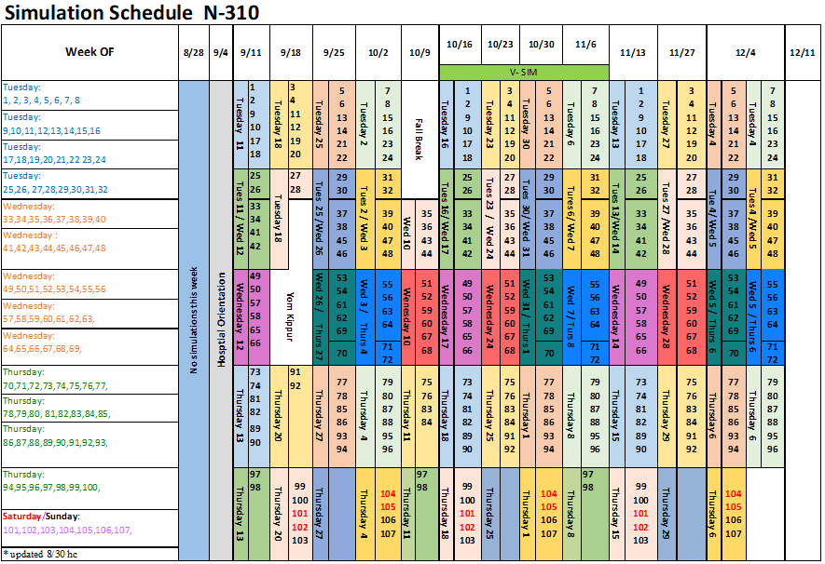
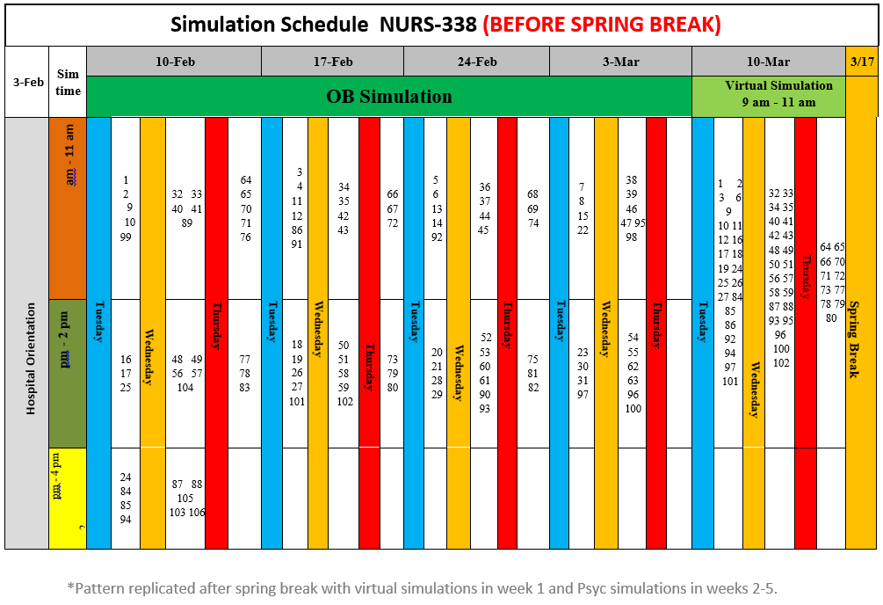
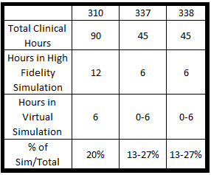
Increasing the Number of Baccalaureate Graduates through the Deliberate Implementation of a Simulation Model
Judith A. Feustle, ScD, RN Stevenson University
Abstract
Year 1 - Fall Semester
Year 1 - Spring Semester
Confounding Variables
The increasing demand for registered nurses in the United States has increased the pressure on nursing programs to find sufficient clinical placements for students. As part of NSP II Grant 19-118, Stevenson University proposes to increase the number of bachelors prepared graduates from the pre-licensure option by 30 graduates per year. The plan to increase enrollment includes a complete redesign of the clinical learning experiences in the pre-licensure program. A key component of the redesign is counting simulation hours as part of the required clinical time in all undergraduate nursing courses that include a clinical component.
The purpose of this poster is to provide details about how the model worked with one clinical course in the fall and with the challenge of three scheduled clinical courses in the spring. A comparison of the days/hours that students spent in the clinical versus simulated setting will be included. Information on the number of clinical days, how the model worked, how simulations were developed and evaluated, and a comparison of the model with one course versus three courses will be presented.
In fall 2018, junior students only take one clinical course, Fundamentals of Nursing (NURS-310). This course includes 90 hours of clinical divided over the full semester.
In spring, junior students take three clinical courses. Two of these courses, Psychiatric Nursing (NURS-337) and Care of the Child-Bearing Family (NURS-338), were included into year 1 of the grant. Each of these courses have 45 hours of clinical and may be taken in either the first or second half of the semester.
For the Spring, 2019 semester, the following were confounding variables:
Inclement weather resulted in cancellation of some clinical days
Some sites were not cleared for students to start clinical until the 3rd week of the semester
The inconsistency of the inclement weather breaks resulted in variable amounts of time between clinical days.
The inconsistent belief among faculty members that replacement of clinical hours with simulation hours is a desirable goal.
References
Breymier, T. L., Rutherford-Hemming, T., Horsley, T.L., Atz, T., Smith, L.G.,
Dadowski, D., & Connor, K. (2015, November). Substitution of clinical experience with simulation in prelicensure nursing programs: A national survey in the United States. Clinical Simulation in Nursing, 11(11), 472-478. doi: 10.1016/j.ecns.2015.09.004
Davis, A., Kimble, L., & Gunby, S. (February, 2014). Nursing faculty use of high-
fidelity human patient simulation in undergraduate nursing education: A mixed-methods study. Journal of Nursing Education, 53(3), 142-150. doi:10.3928/01484834-20140219-02
Khalaila, R. Simulation in nursing education: An evaluation of students’ outcomes
at their first clinical practice combined with simulations. Nurse Education Today, 34 (2014), 252-258. doi:10.1016/j.nedt.2013.08.015
The NCSBN national simulation study: A longitudinal, randomized, controlled
study replacing clinical hours with simulation in prelicensure nursing education. (2014). Journal of Nursing Regulation, 5(2), S3–S40. doi:10.1016/S2155-8256(15)30062-4
Richardson, K. J., & Claman, F. (2014). High-fidelity simulation in nursing
education: A change in clinical practice. Nursing Education Perspectives, 35(2), 125–127. doi:10.5480/1536-5026-35.2.125
Sullivan, N., Swoboda, S. M., Breymier, Tl, Lucas, L., Sarasnick, J., Rutherford-
Hemming, T., Budhathoki, D., & Kardong-Edgren, S. (S.) (2019, May). Emerging evidence toward a 2:1 clinical to simulation ratio: A study comparing the traditional clinical and simulation settings. Clinical Simulation in Nursing, 30 (C), 34-41. doi:10.1016/j.ecns.2019.03.003.
Objectives
Stevenson University received NSP II grant 19-118 to determine if the deliberate integration of simulation as part of required clinical time could allow for increased enrollment without a proportionate increase in clinical sites. After reviewing the poster presentation, attendees will be able to:
Explain the basic methodology of the model designed to count simulation as a part of clinical time.
Explain how the model decreases the need for a parallel increase in clinical sites as the program expands.
Compare the number of clinical placements required using the old and new models across various clinical areas.
Review the evaluation tools for the high-fidelity simulations.
Identify benefits of the redesigned model to the university and the students
Discuss what worked in Year 1 of the model, what did not work as projected in Year 1.
Identify changes in implementation proposed for Year 2.
Methodology
Eight students were assigned to each clinical group, with the understanding that 2 students would be pulled out each week for a simulation experience.
Course faculty and the simulation team worked together to determine which simulations would be most appropriate to the content and provide the best learning experiences.
The rotation of students away from clinical and into simulation was designed with the goal that the student was never away from clinical for more than 1 week at a time.
Over the course of the semester, each student would have 2 days in a high-fidelity simulation experience, one day with virtual simulation, and the rest of the time in the clinical area.
Acknowledgements
Stevenson University is grateful for the funding from NSP II grant 19-118 to make this project possible.
Thanks also to the Simulation Team at Stevenson for their assistance with this poster and their support and work on this project.

