Slide 1
Welcome
Doctoral Education
for Maryland Nurses
January 14, 2020

Slide 2
Maryland Higher Education Commission Nurse Support II Program
Meg Johantgen, PhD, RN (PI)
Goal to help nursing students and nurses explore educational/career goals, particularly doctoral education
Kirsten Corazzini, PhD, FCHE
Marcella Leath, BSN, DNP Student

Slide 3
Welcome
Peg Daw, DNP, RN-BC, CNE
Nurse Support Program II Grant Administrator
Nurse Support Program (NSP) website
www.nursesupport.org

Slide 4
WebEx
Please use camera when speaking
Can connect by phone rather than through computer if audio issues
Mute yourself if not talking
Note: we are audio recording this session to compile a FAQ list

Slide 5
Program
9:45-10:15 Overview of Maryland Doctoral Programs
Meg Johantgen
10:15-10:45 Matching Goals-Program
Dorothea Winter, PhD, Professor, Graduate Program Chair, Salisbury University Susan Bindon, DNP, RN-BC, CNE, Associate Professor, Director Post Masters DNP Program UMD
10:45-11:00 BREAK
11:00-11:30 Optimizing Your Application Kirsten Corazzini, PhD, FGSA, Professor, Associate Dean PhD Program, UMD
Vinciya Pandian, PhD, MBA, MSN, ACNP-BC, FAANP, FAAN Associate Professor and Associate Director DNP Executive and DNP-MBA Program JHU
11:30-12:00 Financial Support and Wrap-up
Meg Johantgen

Slide 6
Assumptions….Objectives
➔ All interested learning about doctoral study opportunities
➔ Varied interests and career objectives
Describe the breadth of doctoral programs in Maryland – both nursing and not nursing.
Distinguish variations in nursing doctoral programs.
Provide resources to help in decision-making.

Slide 7
Growth of DNP vs PhD (Source AACN)

Slide 8
Varied Pathways in Graduate Education
BS → MS → PhD
BS → PhD
BS → DNP
BS → DNP/PHD
BS → MPH →DrPH
BS → MEd → EdD
Notes:
Used to be MS required before doctorate in most professions
Engineering – may progress directly to PhD from undergrad, this leading to engineers obtaining doctorates at a younger age – longer time to develop research career.
Now not uncommon in nursing schools to have pathways directly to doctorate.
Ie, nursing programs have moved to DNP as entry for advanced nursing practice (BS to DNP)
more and more nursing schools having facilitated pathways to transition from BS to PHD for those who want to explore or know that they want a research career
movement in nursing not to have nurses wait to obtain doctorate until 40s – less time to develop career and mentor others
Since ‘97, PharmD is entry to licensing.
Other professions have similar – MPH Med.

Slide 9
Which doctorate is right for you?
Focus – what is your passion?
Career – what do you want to?
-lead research -apply research -make health policy
Feasibility – what works for you? -format -costs -competing demands
Notes:
Later presentations and panels will address many of these topics – and there is not one clear answer.
I wanted to study patient outcomes back in 1988 – I was into hospital administrative data – I interviewed at both nursing schools and schools with health administration programs. One nursing school told me that they did not really study outcomes!!!
Worked for me – I went to PhD Program in Health Services Research that was heavy in organizational and economic theory.

Slide 10
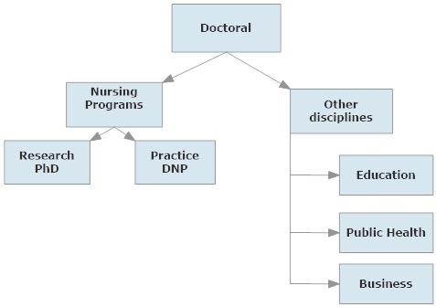
Doctoral Program Overview
Notes:
In Nursing, now PhD and DNP. This is where we will spend the majority of our time today.
I am going to start with considering doctoral programs outside of nursing – education, public health, and business.

Slide 11
Maryland Doctoral Programs in Education
School | Degree | Format | Focus areas
Frostburg (also Hagerstown) | EdD | F2F | Leadership, Curriculum/instruction, Instructional technology
Johns Hopkins | EdD PhD | Online, PT F2F, FT | Educational leadership, EB methods
Morgan | EdD PhD | Online PT/FT | Community college leadership Urban educational leadership
Towson | EdD | F2F, hybrid, online | Instructional technology
Salisbury | EdD | Online, hybrid | Contemporary curriculum theory and instruction
Notes:
Within broad fields there are similarities characteristics, driven by accreditation standards, faculty, and discipline’s needs and practices
K-12 vs higher education
Just give overview – anyone interested I have detailed tables which were abstracted from school’s websites – so you can look there too.
In education, both PhD and EdD are offered. Both focus on improving education/training
PhD – conducting research
EdD – applying research to solving problems
Towson – Dr. William Sadera is the program director – on our last panel.

Slide 12
Maryland Doctoral Programs in Education - cont
School | Degree | Format | Focus areas
UMD-College Park College of Education | PhD | Varied – some FT, F2F | Educational policy & leadership Higher education Measurement, statistics, & evaluation Minority & urban education Technology, learning, & leadership
UMD – Eastern Shore | EdD | Cohort, weekend | Educational leadership
UMD- Baltimore | PhD | Hybrid | Health professions education – UNDER DEVELOPMENT
Notes:
UMCP College of Education – Maryland has several faculty who have graduated from that program –
?Lisa Seldomridge –moderating our first panel
Formats vary - note – weekend format at UMES
– but again, educational leadership and it may be more focused on K-12 so need to check program descriptions
UMB – health professions education - Clinicians who are academics and may have had little formal preparation for teaching. Hope to submit for approval this fall.

Slide 13
Maryland Doctoral Programs in Public Health/Health Services
School | Degree | Format | Focus Areas
Johns Hopkins, School of Public Health | PhD ScD DrPH | F2F, some online | Research Research/Methods in academia Specific PH field – apply knowledge
Morgan, School of Community Health & Policy | DrPH | F2F | Development and implementation of health promotion/disease prevention
UMD- Baltimore School of Pharmacy | PhD | F2F | Pharmaceutical health services research
UMD- Baltimore School of Medicine | PhD | F2F, some online | Epidemiology Gerontology (with UMBC)
UMB- Baltimore County, Public Policy | PhD | F2F, some online | Public policy
UMD – College Park School of Public Health | PhD | F2F, some online | Health services research, policy
Notes:
Public health – closely aligned with nursing
JHU – several faculty graduated from SPH and PhD students take electives there
PHSR – non nurses – study cost, quality, effectiveness, effects of policy related to pharmaceuticals. One of our PhD students was co-mentored by their faculty to study differences in NP and MD prescribing in children.
UMB SOM – Gerontology program with UMBC, interdisciplinary

Slide 14
Maryland Doctoral Programs in Business
School | Degree | Format | Focus Areas
UMD- College Park | PhD | F2F | Organizational behavior/human resources (many others)
UMD- Eastern Shore | PhD | Weekends | Organizational leadership (education, non profit, and business)
Notes:
Examples – need to go to web sites and look at curriculum/courses

Slide 15
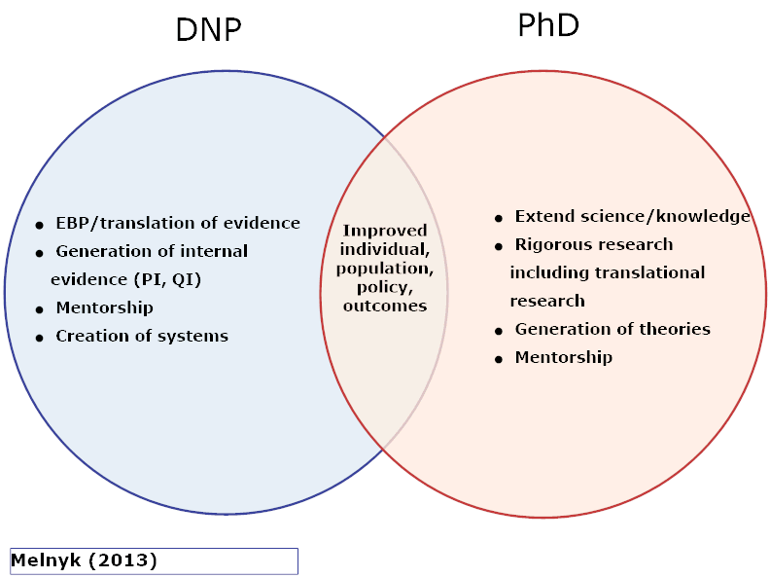
Intersecting Roles
Notes:
Both are working towards improved health outcomes
PhD – Extend science, knowledge, theories – including translational/implementation research
DNP – synthesize and translate evidence to improve outcomes
used knowledge/evidence
Both are charged with mentoring
DNP – systems of care

Slide 16
DNP vs PhD Curriculums
DNP | PhD
EBP, performance/quality improvement, policy, populations, leadership, practicums, advanced practice (post BS) | Theory, research methods, advanced statistics, research practicums, domain content/theory
Full and part time plans of study | Full and part time plans of study
~80 credits post-BSN – 1000 practicum hrs ~37 credits post-MS - 500 practicum hrs | ~76 credits post-BS ~60 credits post-MS
Scholarly project | Dissertation

Slide 17
Maryland DNP Programs
University | Programs
Coppin State University | Post MS
Johns Hopkins University | Advanced Practice/PhD Executive Track Executive Track/MBA Advanced Practice Tracks (check website)
Salisbury University | Post BS Family NP Post MS
University of Maryland-Baltimore | Post BS Advanced practice specialties (check website) Post MS
Frostburg State University | Now MS – planning grant for DNP
Notes:
Maryland DNP programs – check websites
Rita will talk more about this
Of course, other on-line programs – as you will ehar from other panel members, you need to research these programs to see what type of supports are given for arranging clinicals, meeting timelines, etc.

Slide 18
Maryland Nursing PhD Programs
School |  | Focus Areas
Johns Hopkins University | FT/PT F2F | Faculty expertise: Cardiovascular risk reduction, Domestic violence, Health promotion, Chronic disease management, Symptom management, Substance abuse, End-of-life care …and more
University of Maryland-Baltimore | FT/PT F2F | Faculty expertise: Healthy aging, Pain and symptom management, Health systems outcomes, Palliative and end-of-life care, Maternal and neonatal outcomes, Substance abuse Cellular and genetic disease mechanisms …and more
Morgan State University | FT/PT F2F | Particular focus on health service research and policy
Notes:
For PhD programs, having faculty to support research topics is essential. Ideally, students work on faculty research – matching is a critical criteria at admission. Education research is not a strong emphasis since there is little funding for faculty to pursue education topics (small grants NLN, STT, etc.)
For example, both have “bench” research but in specific topic areas.
Also, more and more PhD programs have on-line/hybrid options but you need to consider the quality and what type of support they provide to you. For online doctoral programs, you may need arrange your own clinical experiences and research networking.
Individaul and team mentorship as seen in dissertation committees is essential.

Slide 19
Summary
Many programs to consider
Fit with your passion, goals and life is crucial
Review the websites but also call and talk with graduates of those programs
Getting finished is the goal!

Slide 20
Program
9:45-10:15 Overview of Maryland Doctoral Programs
Meg Johantgen
10:15-10:45 Matching Goals-Program
Dorothea Winter, PhD, Professor, Graduate Program Chair, Salisbury Susan Bindon, DNP, RN-BC, CNE, Associate Professor, Director Post Masters DNP Program UMD
10:45-11:00 BREAK
11:00-11:30 Optimizing Your Application Kirsten Corazzini, PhD, FGSA, Professor, Associate Dean PhD Program, UMD
Vinciya Pandian, PhD, MBA, MSN, ACNP-BC, FAANP, FAAN Associate Professor and Associate Director DNP Executive and DNP-MBA Program JHU

