Slide 1
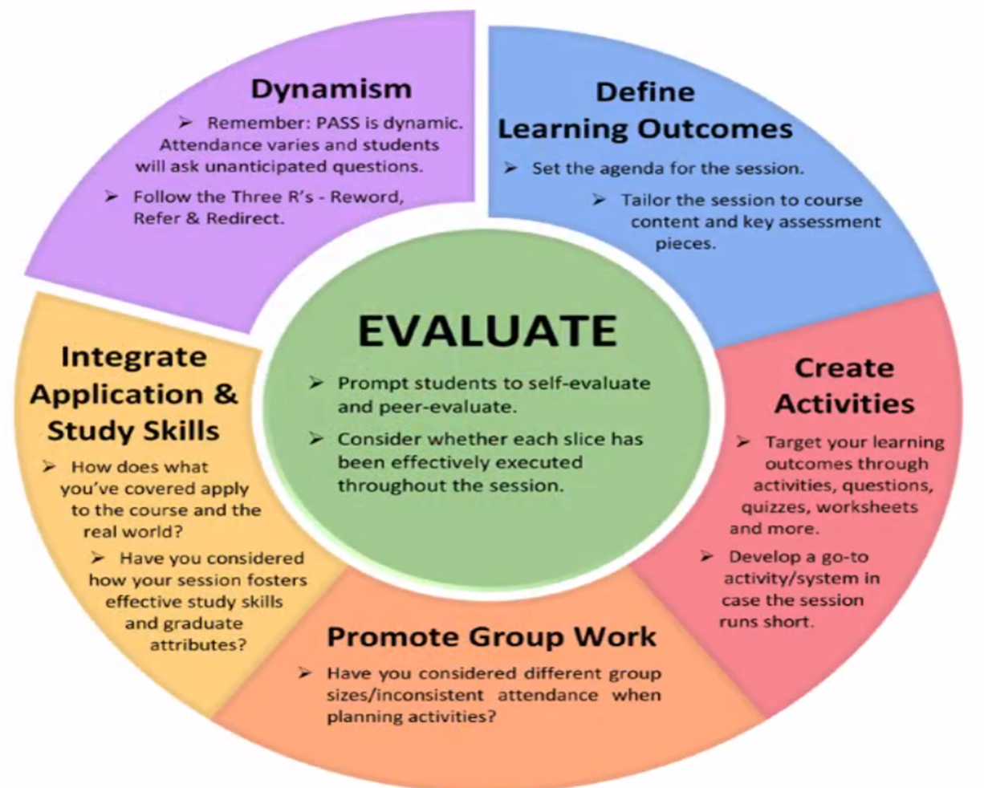
PASS SESSIONS & HOW THEY INCREASE NURSING STUDENTS’ STUDY SKILLS AND IMPROVE GRADES WHILE DECREASING ATTRITION RATES?
Yvonne M. Azeltine, BSN, RN
Wor-Wic Community College (WWCC), Salisbury, MD
What is …
Benefits of PASS
Test taking strategies & cognitive skills improved
Chegg.com
Chegg.com
PASS Leaders
Chosen based on academic success & ability to communicate effectively
“60% agreed their experience as a student leader increased their critical thinking skills & increased self-awareness”
Retention Rates
Bottom Line
Students’ success is evaluated by attrition, retention & graduation percentages
Success at WWCC
Implemented PASS for all nursing courses with “75-100% course pass rate of those who attended more than 3 sessions”
“Students scoring less than 80% on tests or quizzes in all nursing courses are required to either attend PASS or 1:1 tutoring”
1st semester implementation of PASS allows student “buy-in”, encouraging a sense of support by peers & faculty
Encourages students to take ownership of their education
PASS enhances skills to provide quality nursing care for various patient populations in Maryland while enhancing the culture of health
pass.Manchester.ac.uk
Created in 1973 by Deanna Martin at University of Missouri-Kansas City to “increase students’ performance and retention in high-risk courses”
Goal - incorporate “how” to learn & then utilize what was learned in a way to further intellectual growth to be successful on exams and projects
Peer tutoring in programs of nursing “focus primarily on academic skills, knowledge, and development of study skills”
Led by PASS Student Leaders with a Faculty member as facilitator
Sessions are informal & conducted in a nonthreatening environment
References
Blowers, S., Ramsey, P., Merriman, C., & Grooms, J. (2003). Patterns of peer
tutoring in nursing. Journal of Nursing Education, 42(5), 204-210
Demetriou, C., & Schmitz-Sciborski, A. (2011). Integration, motivation, strengths
and optimism: Retention theories past, present and future. Paper presented
at the Proceedings of the 7th National Symposium on Student Retention
Fontaine, K. (2014). Effects of a Retention Intervention Program for Associate
Degree Nursing Students. Nursing Education Perspectives, 35(2):94-9. Doi:
10.5480/12-815.1
Kalil, A., Jones, C., & Nasr, P. (2016). Application of Supplemental Instruction in
an Undergraduate Anatomy and Physiology Course for Allied Health
Students. Supplemental Instruction Journal, 2(1), 33-52. Retrieved from https://info.umkc.edu/si/wp-content/uploads/2016/09/siJ-Volume-Two-Issue-One.pdf
Kift, S. M., & Field, R. M. (2009). Intentional first year curriculum design as a
means of facilitating student engagement: some exemplars. In Proceedings
of the 12th Pacific Rim First Year in Higher Education Conference.
Townsville, Queensland: Queensland University of Technology
Laurs, D. E. (2018). Perceived impact of PASS leadership experience on student
leaders’ transferable skills development. Journal of Peer Learning, 11(1),
27-40. https://ro.uow.edu/au/ajpl/vol11/iss1/3
Martin, D. C. (1977). The learning center: A comprehensive model for college
and universities. Kansas City, MO: University of Missouri-Kansas City. (ERIC
ED162-294)
Martin, D. C., & Ardendale, D. R. (1990). Supplemental instruction: Improving
student performance, increasing student persistence. Kansas City, MO:
University of Missouri-Kansas City. (ERIC ED327103)
Miller, V., Oldfield, E., & Murtagh, Y. (2006). Peer Assisted Study Sessions
Leader Development Handbook. Retrieved from http://www.science.uq.edu.au/peer-assisted-study/filething/get/310/PASS-Leader-Development-Handbook.pdf
Spaniol-Matthews, P., Letoureau, L. E., & Rice, E. (2016). The impact of online
supplemental instruction on academic performance and persistence in
undergraduate STEM courses. Supplemental Instruction Journal, 2(1), 19-32.
Retrieved from https://info.umkc.edu/si/wp- content/uploads/2016/09/siJ-
Volume-Two-Issue-One.pdf
Wor-Wic Community College (WWCC). (2016). WWCC Nursing Program Status
Report for Spring 2016
Wor-Wic Community College (WWCC). (2019). WWCC – CACSIN Initiative
powerpoint presentation

