Slide 1
NSPII Director’s Meeting 6/14/2018 Drs. Seldomridge, Jarosinski, Reid, and Brad Hauck

Slide 2
Agenda
What is ES-FAMI
New Initiatives with ES-FAMI
Over the Bridge Expansion
Towson-FAMI
Mentorship Focus Groups
Continuing Education Initiatives

Slide 3
What We Do
Prepare expert nurse clinicians to become educators
Increase the diversity of available part-time clinical faculty
Encourage educational advancement of Academy graduates
Create a database of available part-time faculty for Maryland
Successfully preparing graduates for adjunct positions since 2011.

Slide 4
Over the Bridge Expansion
Recent budget approval to expand ES-FAMI into other parts of Maryland.
Logistical support provided by ES-FAMI staff and principal investigators.
Identified Towson University as first expansion partner
Seeking a second partner location to host an ES-FAMI academy at their physical location.
Notes:
Adapted from established 16-hour curriculum (Health Alliance of Mid America LLC 2008); at first meeting, obtained consent for videorecording and to use survey data for research presentations

Slide 5
Towson-Faculty Academy & Mentorship Initiative
First Towson-FAMI academy to be launched August 2018.
Identified two Towson Faculty members to participate as Facilitators
Nancy Hannafin is lead facilitator; Nikki Austin is Teaching Assistant (TA).
Goal of 10 Academy participants.
Academy will run from August 15-September 12, 2018 at Towson University.
Second academy scheduled for August 2019.
Notes:
Adapted from established 16-hour curriculum (Health Alliance of Mid America LLC 2008); at first meeting, obtained consent for videorecording and to use survey data for research presentations

Slide 6
Mentorship Focus Groups
Initiative launched to gather analyzed data from first group of year-long mentorship completers.
Obtained data from 75% of mentors and 53% of mentees (12 mentors, 10 mentees).
Large positive response to the ESFAMI program as a whole
Suggestions for improvements
Creating an initial “Kick-Off” meeting between mentors and mentees to help encourage their mentoring relationship.
Notes:
Adapted from established 16-hour curriculum (Health Alliance of Mid America LLC 2008); at first meeting, obtained consent for videorecording and to use survey data for research presentations

Slide 7
Continuing Education
Launched the first ES-FAMI online database of CE courses for ES-FAMI mentorship participants.
Cedirect.com allows participants to choose topics they are interested in and complete a short online course to obtain CE’s.
Planning for in person CE events is ongoing currently
CE events are being created with ES-FAMI partners to include mentorship participants and local hospital staff to help promote education throughout the region.
Events to be held regionally with Eastern Shore Partners
Notes:
Adapted from established 16-hour curriculum (Health Alliance of Mid America LLC 2008); at first meeting, obtained consent for videorecording and to use survey data for research presentations

Slide 8
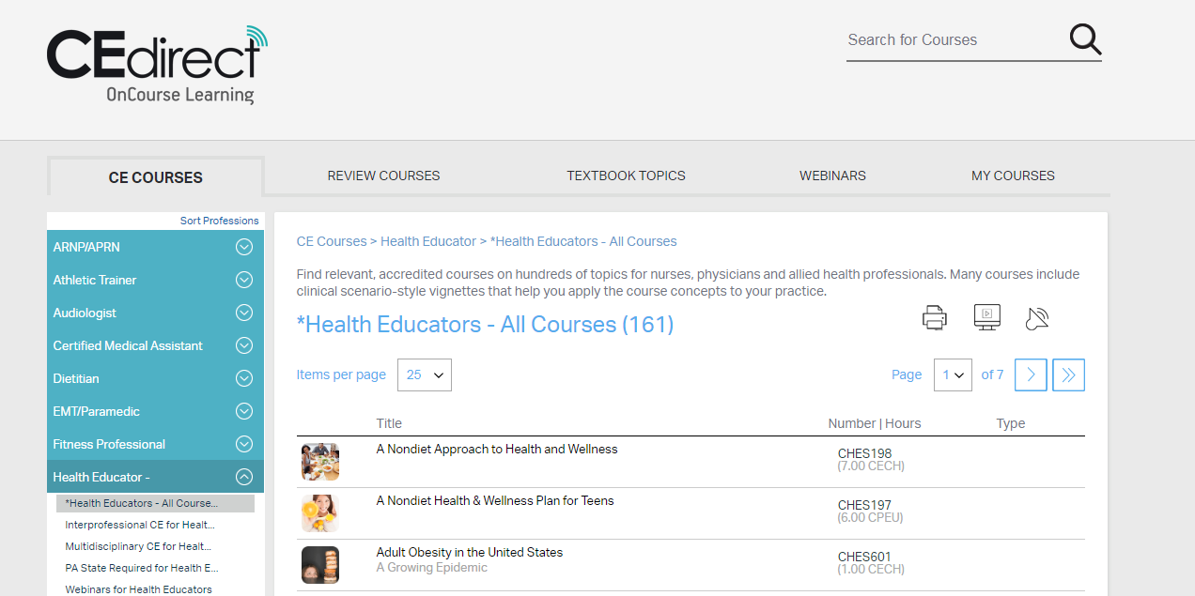
Continuing Education
Notes:
Adapted from established 16-hour curriculum (Health Alliance of Mid America LLC 2008); at first meeting, obtained consent for videorecording and to use survey data for research presentations

Slide 9
Expansion Initiative
Interested in being a partner with ESFAMI
Contact Bradley Hauck
ESFAMI@Salisbury.edu
410-546-2463
Notes:
Adapted from established 16-hour curriculum (Health Alliance of Mid America LLC 2008); at first meeting, obtained consent for videorecording and to use survey data for research presentations

