Slide 1
Development and Implementation of a Collaborative Nurse Practitioner Clinical Training Program
NSP II-17-117
^{June 14, 2018}
Project Director's Meeting

Slide 2
Grant Team
Idzik, Shannon Reedy, DNP, CRNP, FAANP, FAAN (Co-PI)
Bim Akintade PhD, MBA, MHA, ACNP-BC, NEA-BC (Co-PI)*
Gourley, Bridgitte, DNP, FNP-BC
Kristy Novak MS
Susan Gorschboth RN, BSN
Claire Reagan RN, BSN
Notes:
Over the course of the past 5 semesters (going in to the 3rd year of the grant)

Slide 3
Goal 1
Develop a collaborative education and practice partnership to increase readiness of nurse practitioner (NP) students to provide care across the continuum.
  Academic practice partnership was developed between University of Maryland School of Nursing (UMSON) and University of Maryland Upper Chesapeake Medical Center (UM UCMC).
Notes:
Over the course of the past 5 semesters (going in to the 3rd year of the grant)

Slide 4
Goal 2
Increase clinical practice opportunities for NP students.
Increase opportunities in the acute care setting
Increase opportunities throughout Harford County
Notes:
Historically, there has not been many clinical opportunities in Harford County for Advanced Practice Nursing students. This academic partnership between the UMSON and UCMC has opened up many opportunities for our NP students.

Slide 5
Goal 2
The goal was to create a “lock-step” rotation process
  The students would enter the rotation in the Diagnosis and Management (D&M) 2 Clinical and then with each subsequent clinical move to the next specialty or location.
  As one student moves from one level of D&M 2 Clinical to a higher level; a new student will step into their space.

Slide 6
Notes:
The numbers of APN students participating in summer rotations are historically lower simply due to the shortened semester period.

Slide 8
Goal 2
From June 2016 through spring 2018 (in totality)
    54 students completed rotations with 24 providers
    Prior to that, limited clinical rotations for nurse practitioner students
    Inpatient rotations included
      ICU, Hospitalist, Consult Services—Hospice, Pulmonary, Cardiology, Inpatient Behavioral Health, Acute peds/peds ED
    Outpatient rotations included
      Outpatient Psychiatry, Cancer Center, Urgent Care, Addiction Treatment Center
    10 DNP projects implemented
    3 DNP practicums completed

Slide 9
DNP Projects Implemented

Slide 10
Completed DNP Projects
Influenza Vaccination Care Center was implemented in the Transitional Care Center.
Oral Health Screening in Outpatient Transitional Care Center
Improving Provider/Nurse Communication
Notes:
Influenza vaccination care center was a DNP project that was implemented to targeting the population at highest risk of being readmitted to the hospital.
Oral health screening clinic was established in the transitional care center as well– where an expert dental hygienist from the office of oral health completed training sessions for the NP who complete the screenings.

Slide 11
Current DNP projects started Spring 2018
Ventilator Associated Pneumonia Prevention Bundle in the Emergency Department
Two simulation-based projects addressing medical emergencies
  Rapid response setting in Med/Surg setting
  Medical emergencies in a psychiatric/behavioral health setting
Partnering with the Office of Oral Health
  Implementing screening and referral tools targeting Medicaid prenatal population, being established in 3 different prenatal settings

Slide 12
Goal 3
Leverage faculty expertise to inform, develop and aid in a post-graduate fellowship program

Slide 13
Goal 3
Summer 2017 a needs assessment was conducted
Likert scores used to determine level of confidence
Questions based on the core competencies from the Society of Medicine (also congruent with NONPF competencies)
Target population was inpatient NPs in hospitalist role
16 NPs were assessed to identify their perceived needs
Focused on system specific skills or knowledge
Notes:
Society of Medicine core competencies were used because they are in the role of Hospitalists that deliver medical care. The goal was to create an environment where standardized care was delivered. The competencies were also congruent with NONPF competencies

Slide 14
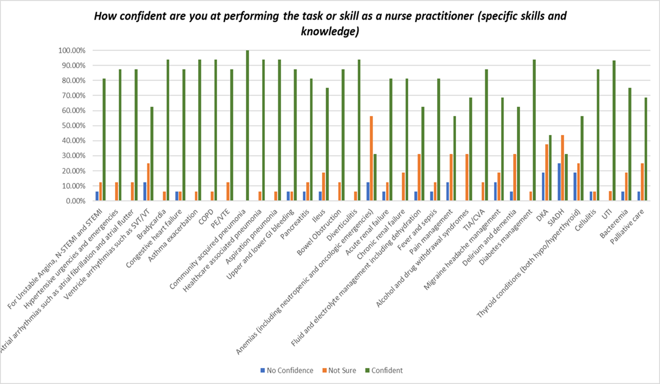

Slide 15
Goal 3
The needs assessment showed a 70% or less confidence level in the medical management and treatment of the following;
  Arrhythmias
  ETOH and Drug withdrawal
  Delirium
  Fluid and electrolyte management/dehydration
  Pain management
  Thyroid conditions
  Palliative care
  Anemia and oncologic emergencies
  DKA/SIADH

Slide 16
Goal 3
To address the identified needs:
  10 lectures were created to address these needs using the objectives from the Society of Medicine/ NONPF core competencies
    An average of 1-2 lectures a month
    Last approximately 2 hours
    Recorded to be used as an educational resource in the future
    Important aspect of these lectures is for the newer NP to understand their resources within the culture of UM UCMC to obtain the ideal patient outcomes (referral process, collaboration with other providers and disciplines)
  Experts from the community and University of Maryland were invited to speak on these topics

Slide 17
Goal 4
Develop faculty practice sites to provide faculty with relevant clinical experience to more readily translate current practice into academia.
Shannon Reedy Idzik, DNP, CRNP, FAANP, FAAN practices in the Transitional Care Center
Fran Valle, DNP, MS, CRNP is practices in the UM UCMC Wound Center

Slide 18
Successes
Relationship building between UMSON faculty and UM UCMC QI Departments to identify potential DNP projects/practicums.
Creating an orientation for DNP students twice a year to familiarize them with the organization, their role and the expectations.
Students who express interest in future employment are being placed within rotations at UM UCMC.
Great feedback from students who have completed rotations at UM UCMC.

Slide 19
Challenges
Some initial challenges with finding preceptors over the first two years (has been overcome as evidenced by the increase in participation)
Lack of a clinical nurse specialist (CNS) role in UM UCMC
  UM UCMC does not utilize CNSs, therefore we had to locate appropriate clinical placements outside of UM UCMC.

Slide 20
Thank you!

