Slide 1
Toward Nursing Faculty Well-Being: Contributions from a Faculty Mentorship Program*
Louise S. Jenkins, PhD, RN, FAHA, ANEF
Darlene Trandel, PhD, RN, FNP, CCP, ICF-PCC
*NSPII #16-124 and NSPII #17-120

Slide 2
Objectives:
discuss identification and value of individual strengths;
describe the concept of a career vision; and
and value the potential role of these in nursing faculty professional health.
Notes:
The objectives of this presentation are designed to draw upon our 3-year experience
with developing, implementing, and evaluating a Faculty Mentorship Program AND to
share some thoughts with you on how this work offers a starting point for consideration
of approaches toward improving and maintaining Nursing Faculty Professional Health, and
potentially well-being

Slide 3
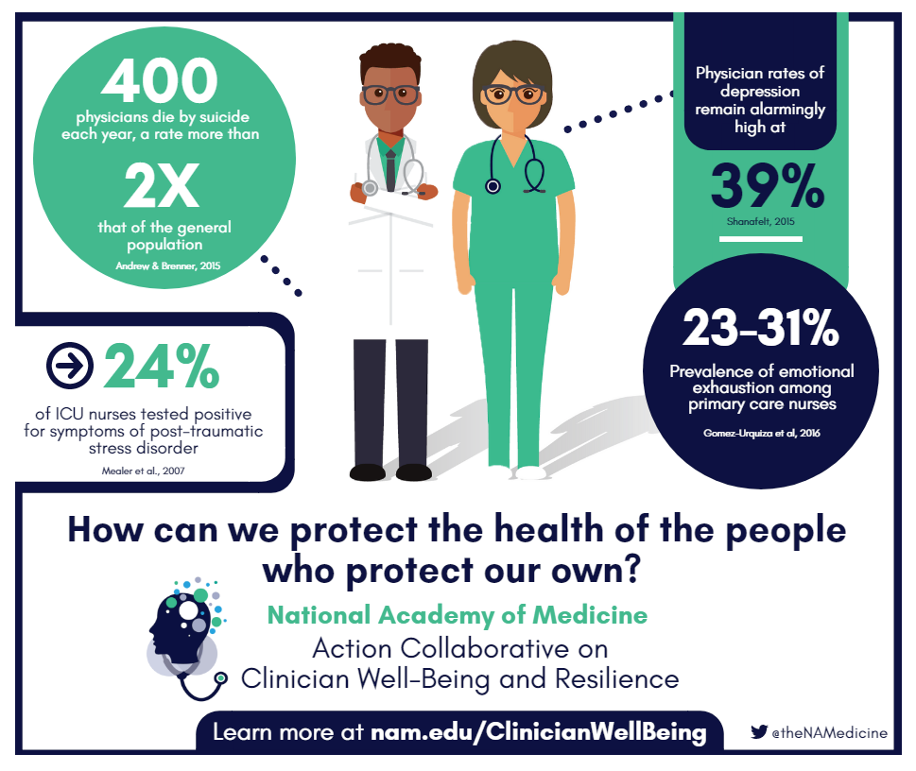
Notes:
Any role in nursing has its own set of challenges encountered along the pathway of career development. Being a nursing faculty member is no exception whether one is new to the role or at various points on the continuum of developing a successful career.
This reality is consistent with the new National Academy of Medicine Initiative on Establishing Clinician Well-Being as a National Priority (NAM, 2018) with activities such as the recent Action Collaboration on Clinician Well-Being and Resilience held in May, 2018.

Slide 4
Notes:
This action collaborative was highly successful after one year of ground work and offers potential for the development of some strategies to strengthen clinician well-being.
We see parallels from our work with Faculty Mentorship that may be consistent with this initiative!
Whether novice on somewhere along the continuum toward being an expert, nursing faculty members have varying visions of ultimate career outcome. Often finding ways to reach more immediate or long-range goals along this road is difficult to sort out as in finding ways to even identify a path. Over the last three years, we have had the opportunity to develop, implement, and evaluate a Faculty Mentorship Program that offers potential for faculty to develop a moderated, envisioned, and feasible path toward reaching goals and contributing to the progress of their “professional health” s toward their desired outcomes in an individualized manner.

Slide 5
Examples of Organizations with Commitment Statements
American Association of Colleges of Nursing | American Medical Association
American Association of Critical Care Nurses | American Nursing Association
American Association of Nurse Anesthetists | American Psychiatric Nurses Association
American Association of Nurse Practitioners | National League for Nursing
Notes:
There are numerous organizations familiar to you who have signed on to support of this initiative in this first year of this program. I have listed a few that I’m sure are very familiar to this audience!

Slide 7
The VIA Survey, developed and validated at UPenn, has been used in hundreds of research studies and taken by > 5 million people in over 190 countries
Take the Values in Action Character Strengths Survey (VIA) for a profile of your character strengths (rank order listing)
http://www.viacharacter.org/www/Character-Strengths-Survey
https://www.authentichappiness.sas.upenn.edu/testcenter
Notes:
Prior to separate training sessions for both nursing faculty Mentors and Mentees, all are asked to take the Values in Action Survey of character strengths from the University of Pennsylvania.

Slide 8
What are your strengths?
Strengths are where
our greatest successes happen,
we experience enormous growth
we enjoy a burst of energy and happiness
Character strengths are connected with a myriad of positive outcomes, from greater life satisfaction, personal growth, work engagement, career success and positive work experiences to more intimate relationships, greater achievement, happiness and well being.
Strengths represent the
core of who we are
Notes:
Interactive discussion between mentor and mentees can be used in developing approaches of how best use mentee strengths in planning pathways to developing and achieving relevant mentee goals.

Slide 9
Strengths offer a way to do the smallest thing to make the biggest difference.
Leverage your strengths
Do more of what:
is working well
• energizes and strengthens you
• others admire about you.
Your greatest successes will come from placing yourself in a position where your strengths meet opportunities
Maximizing your strengths leads to greater productivity and happiness.

Slide 10
Use the best aspects of your self and mentee to move personal and career growth and development forward
Strengths-based mentoring:
A collaborative process between mentor and mentee that is focused on identifying and leveraging the mentee’s unique strengths to increase engagement and accelerate performance
Notes:
The focus on strengths leads to strengths-based mentoring
Which is defined as
a collaborative process between mentor and mentee focused on
identifying and leveraging the mentee’s unique strengths to increase
engagement and accelerated performance

Slide 11
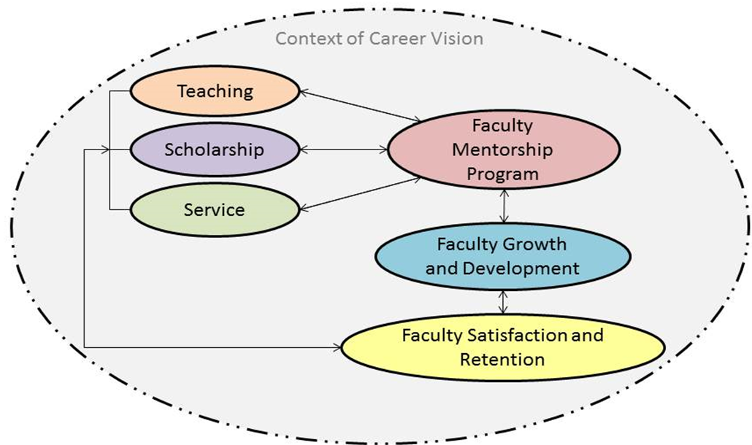
University of Maryland School of Nursing
Faculty Mentorship Program
Louise S. Jenkins, PhD, RN, FAHA, ANEF
Darlene Trandel, PhD, RN/FNP, CNS, PCC
Notes:
We have used a strengths approach in the design of the conceptual model of our School’s Faculty Mentorship Program which we you see in this slide.
The whole program relates to aspects of the faculty role in areas of Teaching, Scholarship, and Services.
As you can see, the program is encompassed within the context of the Career Vision of the Mentee.

Slide 12
Why is a career vision important?
Bridges the present to the future
Serves to inspire, motivate, and engage
Attracts commitment, elicits support and energizes
Provides a template for decision making
Creates meaning and direction in lives
Establishes a standard of excellence and evaluation
Transcends the status quo.
Notes:
The Career Vision of the mentee is discussed to clarify where the mentee would like to be in their nursing faculty role in a specified period of time – e.g. in one year, five years, etc. within the context of their nursing faculty role. Mentee goals are designed to allow for mentee progression within the Career Vision of the mentee.

Slide 13
Discussion points in the vision
Capture a picture of where the mentee is now - Where does he/she want to go?
What are important elements of this vision?
What strengths can the mentee use in achieving it?
Why is the vision important to the mentee? Why does he/she care? Why does it matter?
What will get in the way in achieving he/her vision? What are his/her “big rocks?”
What will help support the mentee in achieving their vision?
Notes:
They are content specific, conceptualized within an aspect of the Teaching, Research/Scholarship, or Service aspects of the nursing faculty role, and are tailored individually tailored to be achievable within a given time-frame (usually 3-6 months).
They are also designed to allow for mentee progression within the Career Vision.

Slide 14
Cultivating A Positive Approach In Mentoring
A positive approach:
Builds on strengths and successes
Looks for the good and what is working well
Elicits positive emotions
vs
correcting weaknesses and fixing problems
Notes:
In summary, the work on the Mentee goals within their own career vision is supportive of mentee progression within their own individual career vision.

Slide 15
Positive emotions build health
Positive emotions start an upward spiral of physical and emotional wellbeing and build resilience for hard times
Increased in positive emotions → calms the nervous system via parasympathetic activity of the autonomic nervous system (vagal tone)
Reaction improves the health of all body systems and brain function.
Barbara Fredrickson, (2013)

Slide 16
Positive emotions broaden thinking and improve performance Fredrickson (2013). Updated Thinking on Positivity Ratios. American Psychologist vol. 68 (9) 814-­822
Positive emotions open awareness and enable the building of new skills and resources.
• open-­minded
awareness
• flexible
• creative
• adaptable
• peripheral vision
• big picture
This is in stark contrast to the negative emotions that tend to narrow or restrict behavior.
Notes:
We know that positive emotions broaden thinking AND improve performance
that can facilitate progress in individualized goal achievement
which we think can contribute to Nursing Faculty Professional Health.

Slide 17
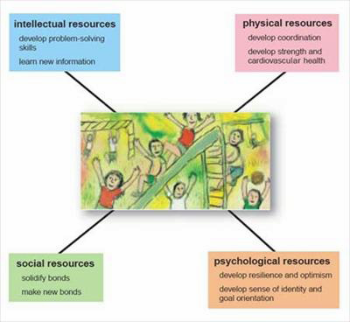
Positive emotions build resources
Fredrickson (2013). Updated Thinking on Positivity Ratios.
American Psychologist vol. 68 (9); 814-­822
Notes:
There is evidence that positive emotions build resources.
These resources can be:
Intellectual,
physical,
social, and/or psychological.

Slide 18
Notes:
While our evidence to make claims in support the success this work , it is exciting to think of even the possibility that this work might better support
creation and facilitation of a positive and supportive learning environment
that may extend to better learning experiences for our students in addition to enhanicing Nursing Faculty Professional Health.

Slide 19
Desired Outcomes
Productive work on:
Professional Health
Nursing Faculty Well-Being
Strong intention to stay in the nursing faculty role.
Notes:
Used together, these two approaches have proven to be very helpful in tailoring work of the Faculty Mentorship Dyad in ways that are highly individualized as well as flexible. They appear to be critical attributes for the success of a Faculty Mentorship Program with measurable goals that are accomplished in short phases of 3-6 months. This approach has yielded “win-win” situations for both mentor and mentee that contribute to reasoned progress on the Career Vision.
In this era of renewed growth of the faculty shortage, this approach offers productive work on professional health of both and hopefully a strong intention to stay in the faculty role.

