Slide 1
High School to Associate Degree in Nursing Pathway NSP II Project Directors Meeting March 9, 2019

Slide 2
The Nursing Pathways to Higher Education at Anne Arundel Community College has been made possible through the generous support of Nurse Support II Grants from the Maryland Higher Education Commission under the auspices of State of Maryland Health Services Cost Review Commission. NSP II 18-101

Slide 3
Nurse Progression Navigator
Kaycee Rump, MSN, RN
School of Health Sciences 410-777-7022 | klrump@aacc.edu

Slide 4
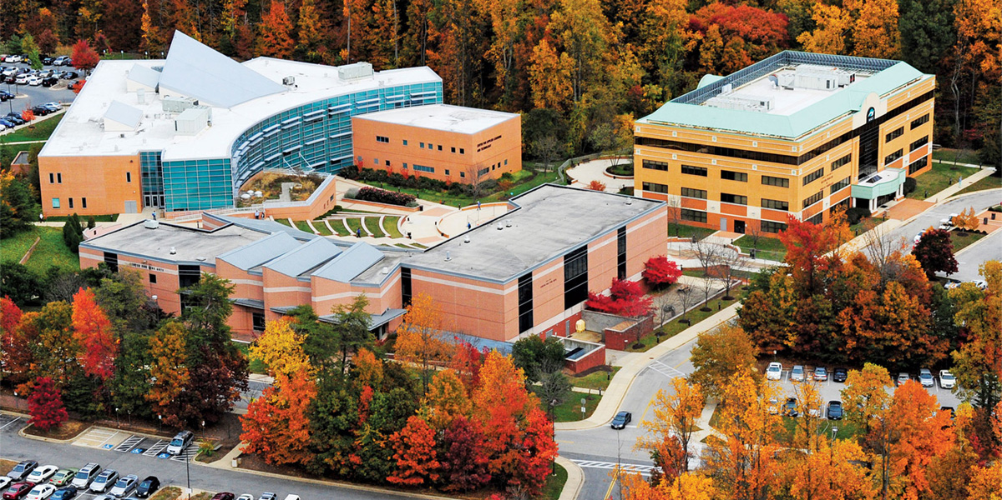
AACC Nursing Snapshot
300 students, many working
Current ATB partners:
University of Maryland, School of Nursing
Stevenson University Online
Upcoming ATB partners:
American Public University System
Frostburg State University
Notes:
Associate's Degree Prepared
National Average 84.3%
Maryland State Average 86.3%
AACC (Spring & Fall 2017 classes) 98.1%
Bachelor's Degree Prepared
National Average 90.0%
Maryland State Average 89.1%

Slide 5
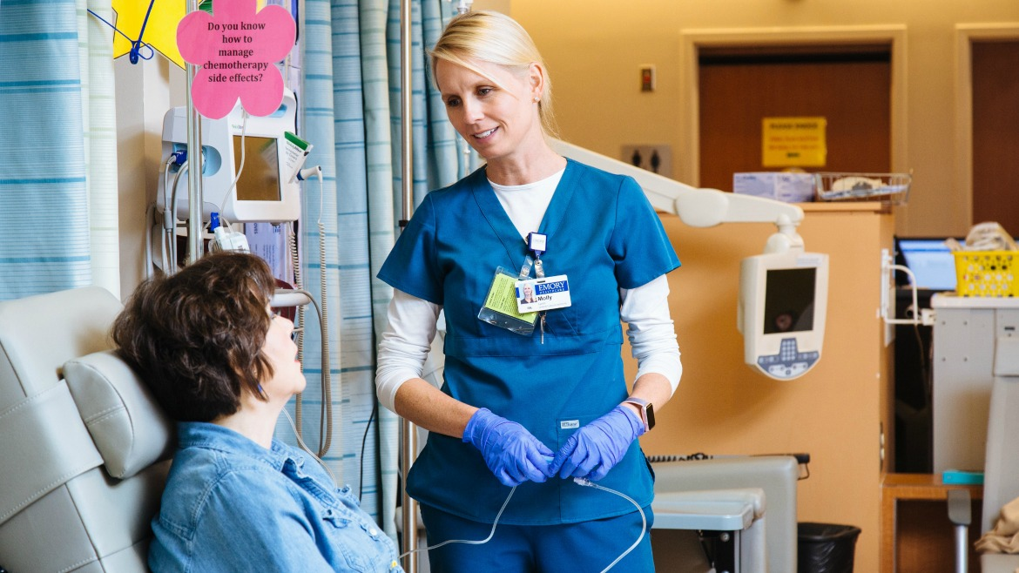
Goals vs Reality
Save time-cost-get started!
Long, windy, road…
10 non-nursing courses required
Change of admissions process coming Fall 2019
3 Prerequisite courses

Slide 6
Setup for Success
IF…
Maintain academic rigor
Closely advised
THEN…
Stronger academically

Slide 7
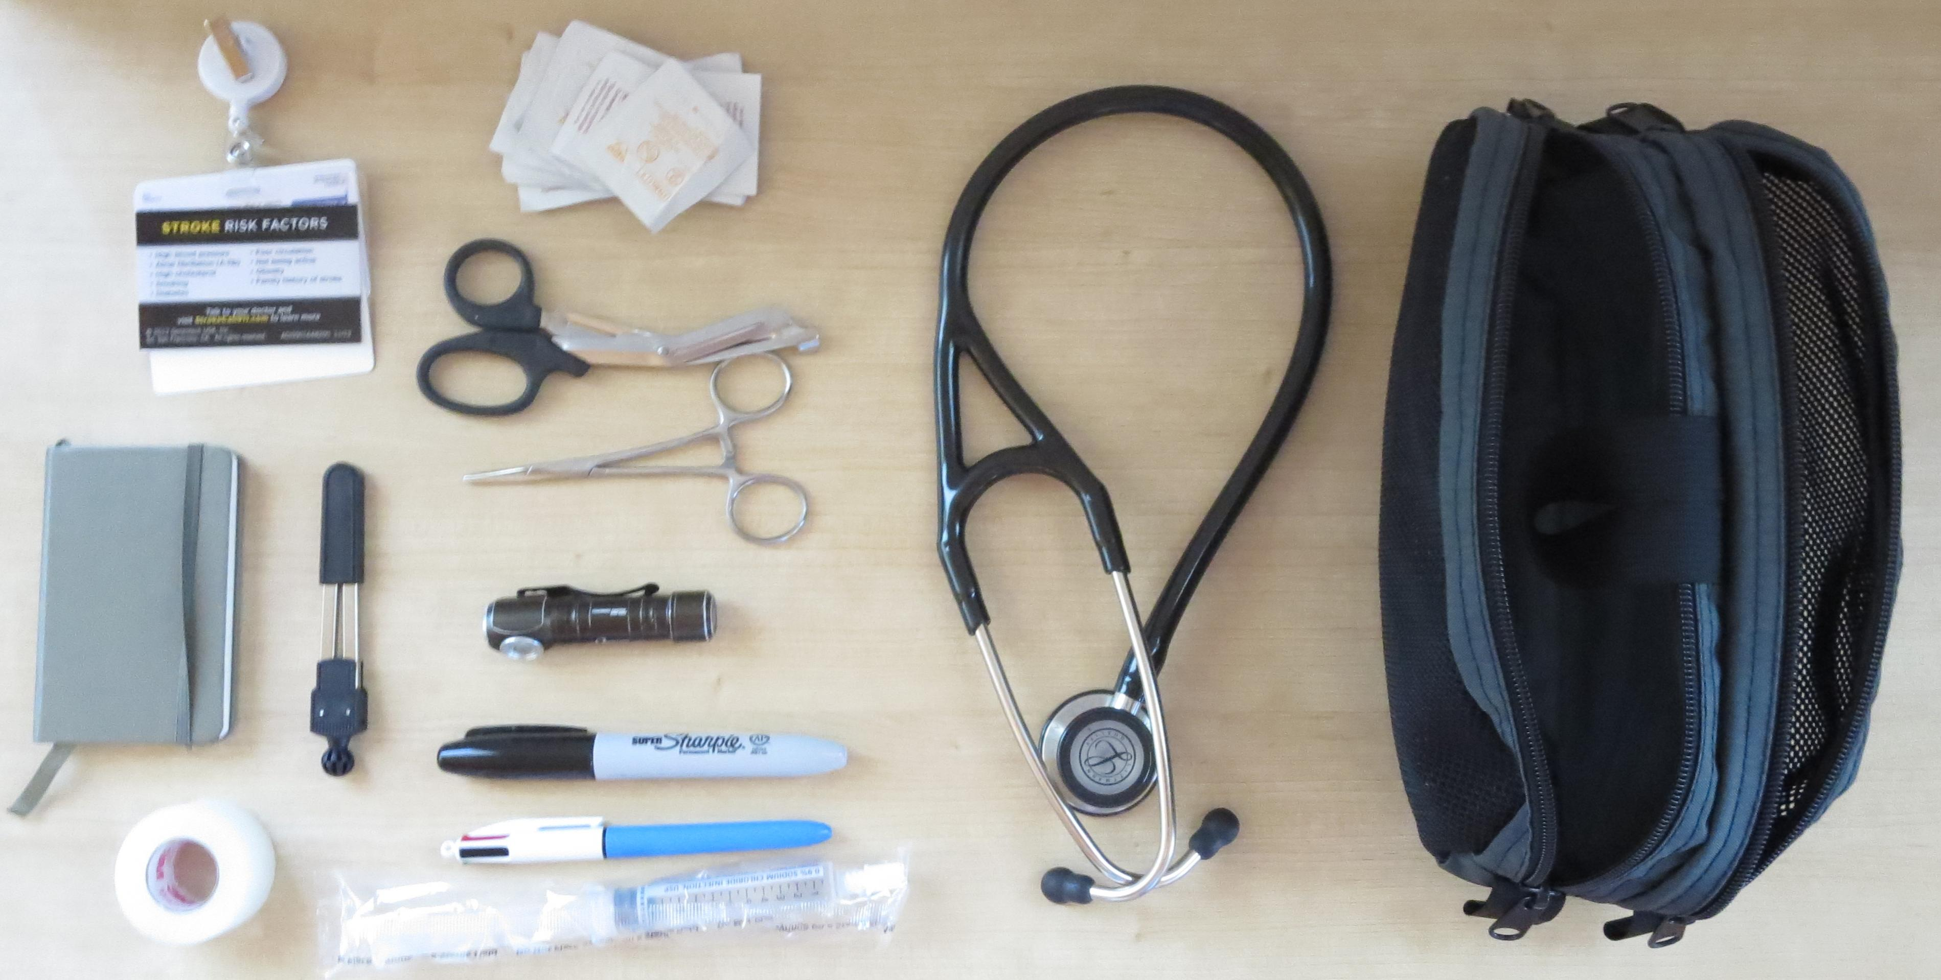
Efforts Underway
Information sessions
Educating HS counselors
AACC Health & Human Services Field of Interest advisor
Nurse Progression Navigator Advisement Sessions
Personalized Pathway
Navigating AACC

Slide 8
SAVE TIME. SAVE MONEY. START NURSING.

