Slide 1
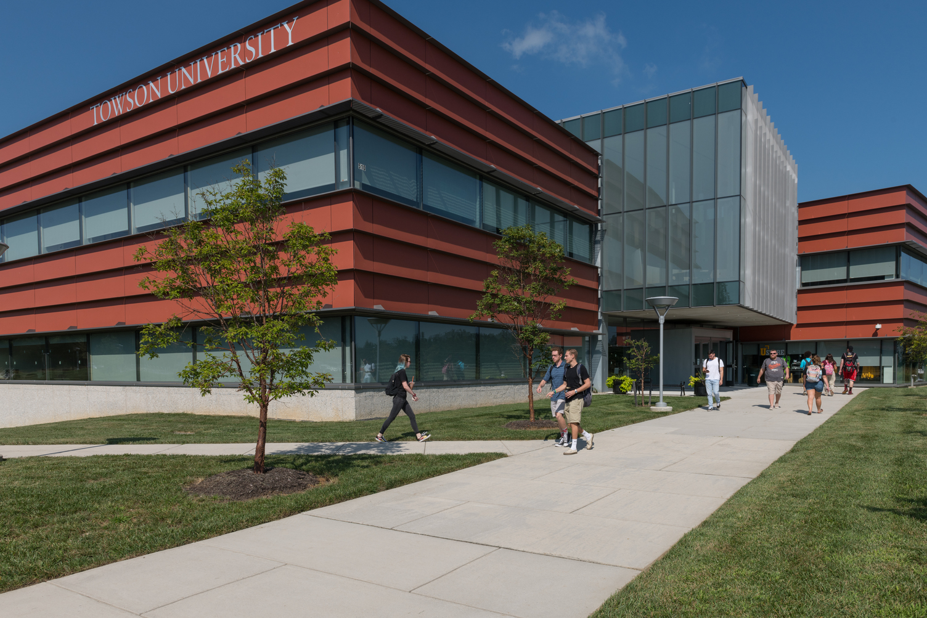
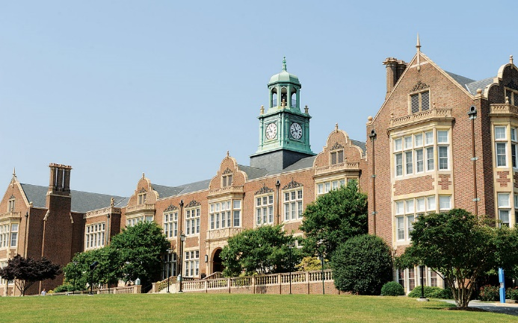
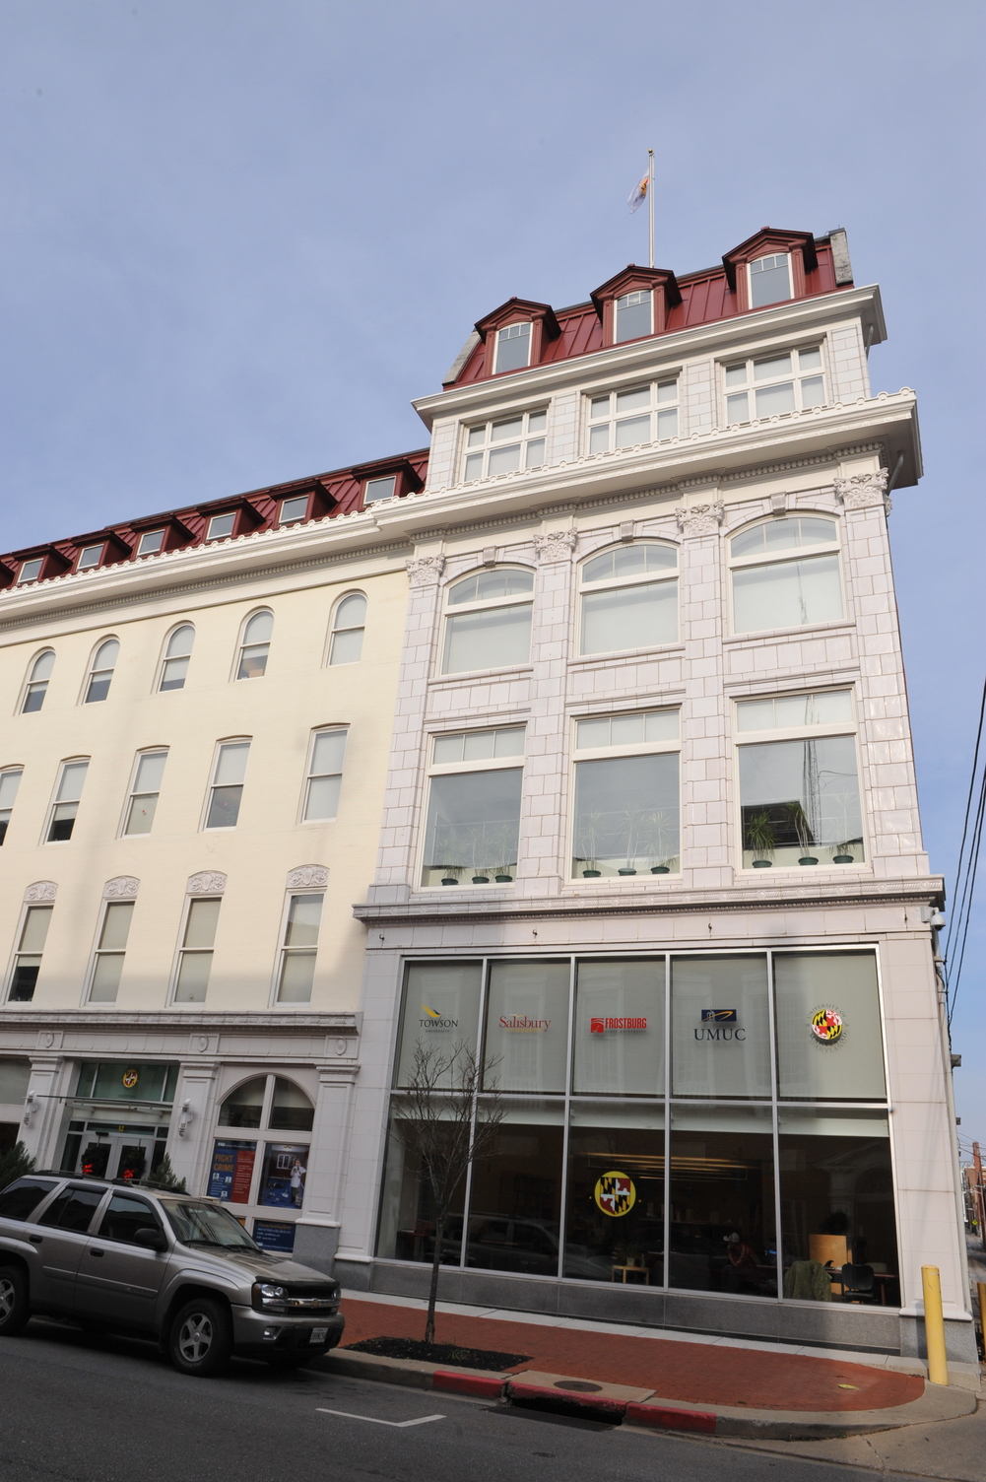
Towson university nsp ii grants 16-118 19-120
Elizabeth Crusse, ms,ma,rn,cne
Karen frank, DNP, RNC-NIC, APRN-CNS, CNE
Briana Snyder, PHD, RN-BC, CNE, RYT 200

Slide 2
Nsp 16-118
Five year grant, beginning July 1, 2015
Degree Completion students
Enrolled 426
Additional 50-75 not enrolled
Summer/fall 2018
Admitted - 150
Matriculated - 120
Spring 2019
Admitted - 93
Matriculated - 57

Slide 3
Graduates
Total through FY 2018 – 235
Projected FY 2019 – 220
December 2018 – 58

Slide 4
Goal #1
Increase Enrollment in Degree Completion Option
No new partners
Partnered with HCC and NSP II grant (19-106)
Proposed enrollment for this academic year - 210

Slide 5
Goal #2
Increase retention of enrolled students with a focus on the needs of diverse and non-traditional students
Faculty education
Provided professional development offering for TU and partnering faculty through Nurse Tim
Sponsored four faculty members taking CNE exam
Sponsored faculty traveling to nursing conferences
Hired additional faculty to teach courses

Slide 6
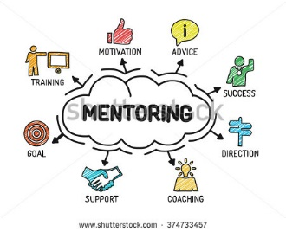
Goal #2 (cont.)
Expanded student success opportunities
Peer mentoring
Academic Support Coordinator (TUNE)
Student Success Specialist (Main)
Survey Degree Completion alumni and graduating students
Proposed retention 90%

Slide 7
Goal #3
Increase Program Completion Rate: decrease time to graduation through efficient, innovative curricular design using web-hybrid and online course delivery methods
Continual curriculum review to support student learning
One partner moving to second semester start of associate nursing program
Significant increase in practicum placements
Offering online format for all Degree Completion courses (except Practicum)

Slide 8
Nsp 19-120
Purpose of grant
Offer online Degree Completion course format
Increase enrollment by 100 students
Enhance online faculty education

Slide 9
Course formatting
Met with Dr. Pamela Jeffries – ongoing support
Hired part-time Instructional Designer – Dr. Emily Jones
Assisting faculty with course formatting
Entire plan of study online as of spring 2020

Slide 10
Increased enrollment
Marketing
Literature
Open houses
Partner information sessions
Hire additional faculty
Hire Academic Advising Specialist – summer 2019

Slide 11
Faculty education
Online Edge workshop trainings
Quality Matters Rubric course
Quality Matters Peer Reviewer Certification
Conferences (online learning)
PI attended two international
Faculty member attending one (summer)

Slide 12
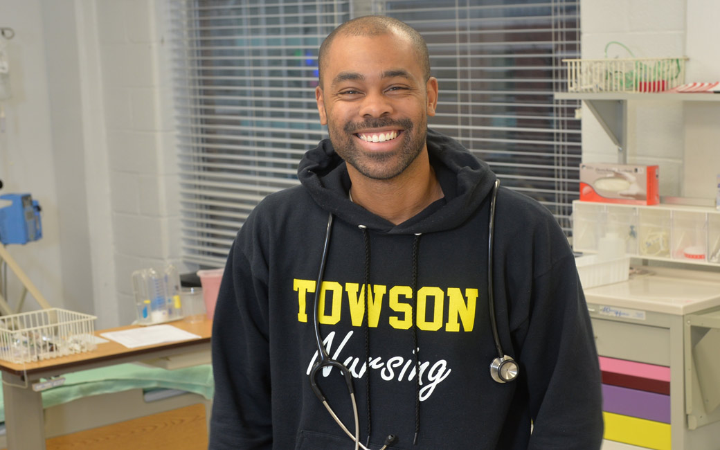
Conclusion
Continue to meet the growing number of students interested in baccalaureate education
Offer flexible course formatting options
Meet the needs of traditional and non-traditional students

