Slide 1

NSPII Project Directors Meeting
March 8, 2017
Chesapeake College
Wye Mills, Maryland

Slide 2
Objectives
Program
  Objectives
  Design
  Model
  Participation
  Cohort IV
2019 – 2020 Call for Applications
Discussion: barriers and challenges to participation

Slide 3
Program
Objectives
  Build Maryland nurse leadership capacity
  Facilitate collaboration between academia and practice
Design
  1 year Leadership Development Program
  Advisory Council
  Continuous evaluation process
  Longitudinal study project

Slide 4
Expectations of NLI Fellows
Familiar with Leadership Development Program (LDP)
Commit to:
  Participate in all LDP activities
  Utilize monthly e-communications and accompanying literature
  Engage in a leadership collaborative activity
Submit a summary report/reflection
Complete all evaluations

Slide 5
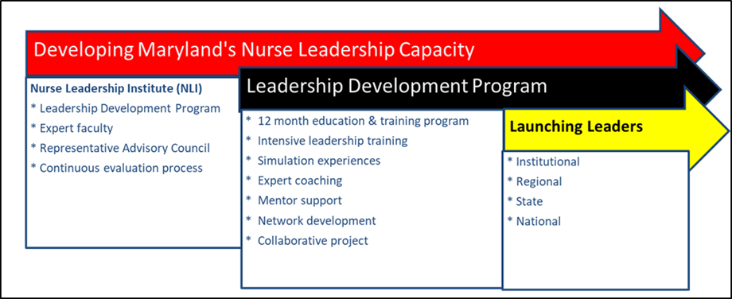
Model
Program Objectives
Notes:
On a scale of 1 – 5 with 1 = strongly disagree and 5 = strongly agree

Slide 6
Participation by year/cohort
Cohort | Applications | Selected | Attrition | Completed
2015 | 21 | 20 | 1 | 19
2016 | 22 | 20 | 4 | 16
2017 | 28 | 27 | 3 | 24
2018 | 41 | 38 | 4
37% of
counties represented
58% of
nursing programs represented

Slide 7
Academic/Practice
 | Academic | Practice
Cohort | % | %
2015 | 60 | 40
2016 | 65 | 35
2017 | 55 | 45
2018 | 39 | 61
37% of
counties represented
58% of
nursing programs represented

Slide 8
Cohort IV
Demographics | N
Professional Role
Academic | 8
Practice | 26
Gender
Female | 32
Male | 2
Education Preparation
PhD | 3
DNP/DSN | 6
Masters | 25

Slide 9




Cohort IV
Practice Organizations & Agencies
Anne Arundel Medical Center
Calvert Hospice
Carroll County Health Department
Doctors Community Health System
Johns Hopkins Hospital
Kaiser Permanente
National Institutes of Health
Nurse Practitioner Association of Maryland
MD Primary Care Physicians
UM Baltimore-Washington Medical Center
UM Capital Region Health
UM Community Medical Group
UM Medical Center
UMMC – Midtown
UM Medical System
VA Maryland Health Care System

Slide 10
Cohort IV
ACADEMIA
Anne Arundel Community College
College of Southern Maryland
Johns Hopkins School of Nursing
Montgomery College
Notre Dame of Maryland University
University of Maryland School of Nursing

Slide 11
Total
15 Maryland Board of Nursing – recognized nursing programs
26 unique health care service institutions
105 applicants selected
59 NLI Fellows completed the program
35 NLI Fellows to finish in June 2019
37% of
counties represented
58% of
nursing programs represented

Slide 12
Evaluation, Research and Reporting
Formative & summative evaluations
  Descriptive manuscript in process
  Additional manuscripts planned
Longitudinal design study
  Following each cohort over time
  Began recruiting 2016
    2 repeat measurements for cohort 1
    1 repeat measurement for cohort 2

Slide 13
2019 – 2020 Call for Applications
March 11, 2019

Slide 14
Marketing
Baltimore Business Journal
Deans & Directors
Maryland Nurses Association
Maryland Organization of Nurse Leaders
NLI Alumni
NSP I network
Social Media short videos
UMSON network & Digest
WYPR

Slide 15

Postcard and Flyer

Slide 16

The Fellow Story
Notes:
https://youtu.be/XUdXNkcLtaA

Slide 17
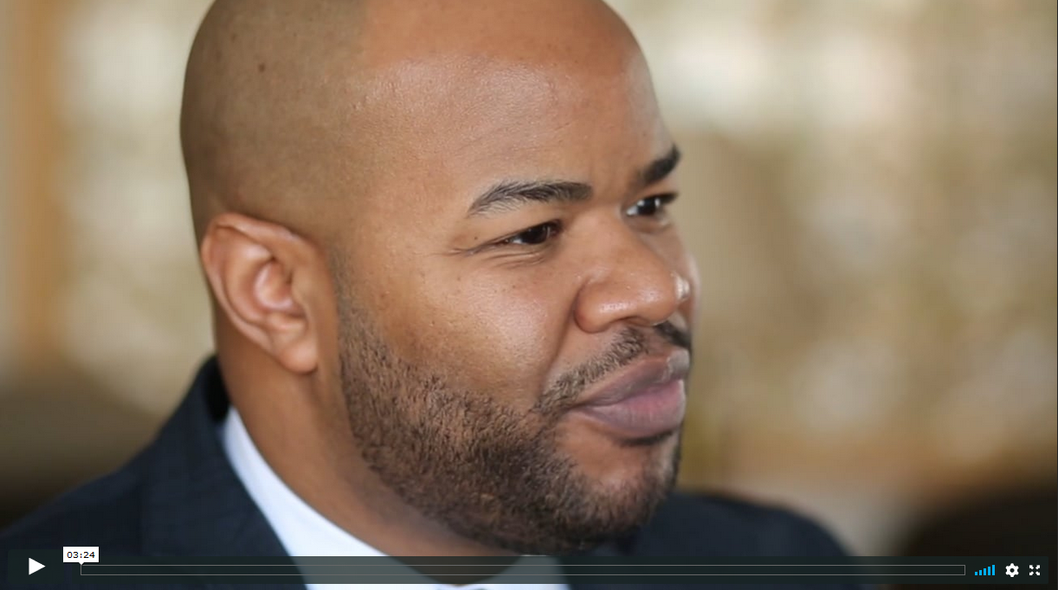
The Mentor Story
Notes:
https://vimeo.com/hartlove/review/258813100/9e4a41b6cf

Slide 18
Discussion
What barriers do schools of nursing face in
supporting faculty participation in the NLI?

