Slide 1
Development of Clinical Faculty for Maryland Nursing Schools
NSP II Project Director's Meeting
June 2018
Susan L. Bindon DNP, RN-BC, CNE
NSP II 18-127

Slide 2
Learning Outcomes
Identify need for developing clinical nursing faculty
Discuss teaching strategies to enhance application of content
Describe the process of working with standardized participants

Slide 3
Background
Nursing faculty shortage persists
Shortages may limit enrollment or affect group size
Large #s of adjunct clinical faculty needed
Clinical faculty influence student learning

Slide 4
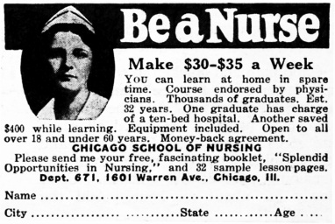
Help Wanted!

Slide 5
Overview
Series of 2-day workshops
ANCC continuing education contact hours offered
Information and skills practice for new adjunct clinical faculty
Statewide effort
Follow-up support planned to match learners’ needs

Slide 6
Process
Needs assessment and faculty survey
Collaborative effort with:
National clinical teaching author/expert
Standardized patient program coordinator
Nurse attorney
Three SON faculty with focused areas of expertise
Teaching and learning, professional development
Clinical teaching
Simulation and debriefing
Creative teaching/learning strategies*

Slide 7
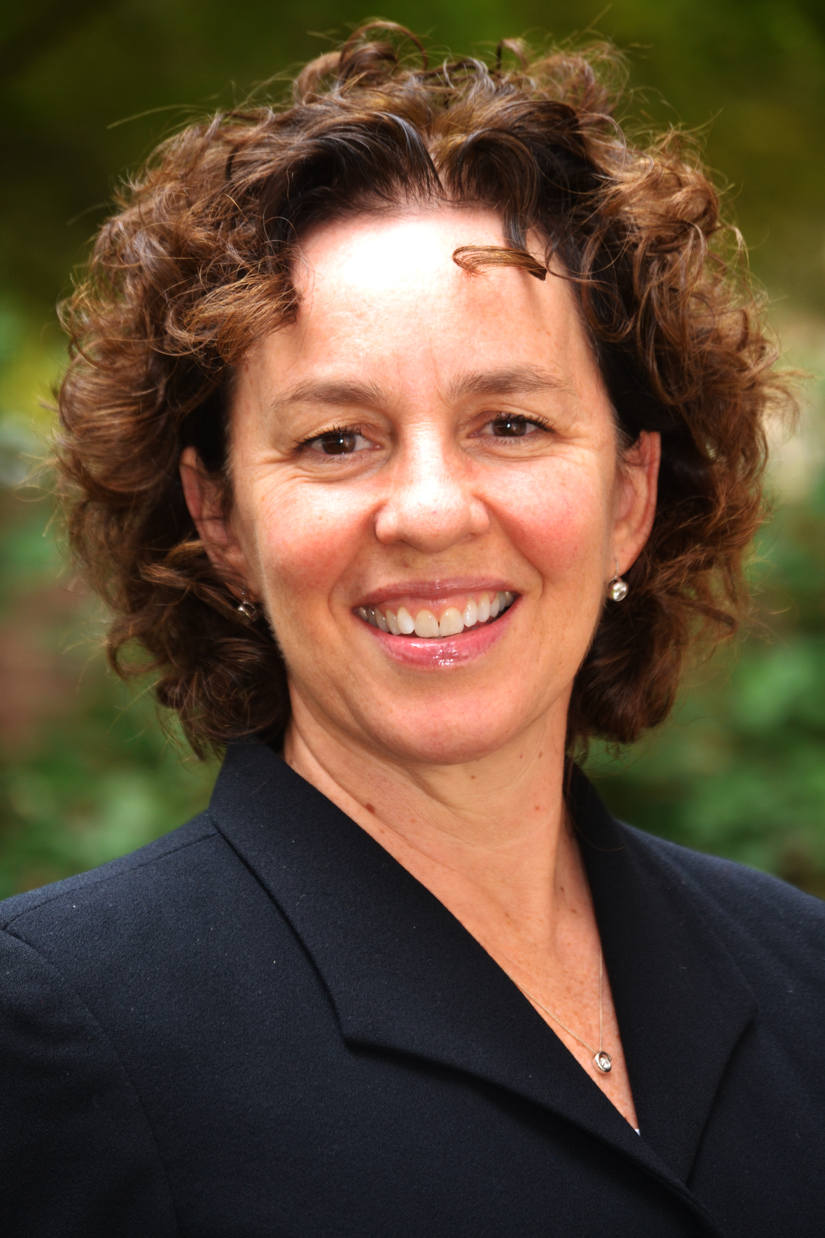
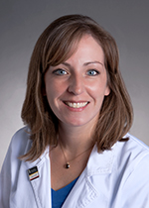
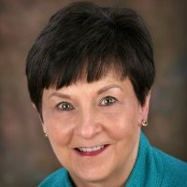
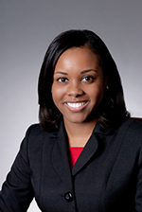
Faculty

Slide 8
Learning Needs: The 4 Rs
Role
Resources
Realities
Responsibilities

Slide 9
Learning Needs: The 4 Rs
Role
Resources
Realities
Responsibilities

Slide 10
Role
Expert clinician
Teacher and facilitator
School representative
Student advocate
Professional partner

Slide 11
Learning Needs: The 4 Rs
Role
Resources
Realities
Responsibilities

Slide 12
Responsibilities
Aviate, navigate, communicate*
Organization
Student assessment and evaluation
Safety!
*altitude = options

Slide 13
Learning Needs: The 4 Rs
Role
Resources
Realities
Responsibilities

Slide 14
Resources
Course director
School resources
Hospital partners
Peers
Formal education
Evidence

Slide 15
Learning Needs: The 4 Rs
Role
Resources
Realities
Responsibilities

Slide 16
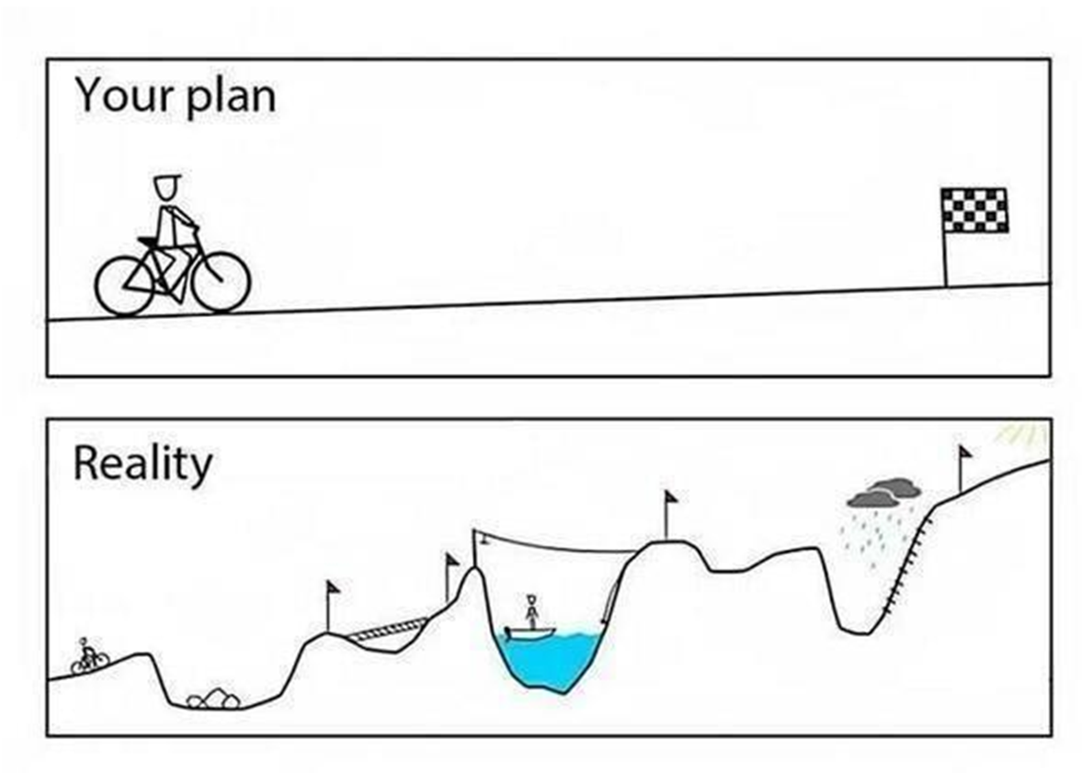
Realities

Slide 17
Program
Didactic
“What & How to” morning sessions
Application
“Hands on” afternoon sessions
Use of standardized students, group work, discussion

Slide 18
Readiness
Assessment and evaluation tools
Faculty support
Making assignments
Alternate learning activities
Legal and ethical aspects
Feedback strategies

Slide 20
Standardized students
SPs trained to portray students
Realistic scenarios developed by faculty
2 versions
Facilitated small groups
Time in, time out!
Goal to identify underlying issues and help student progress

Slide 22
Standardized students
Challenging
Exciting
Emotional
Realistic
Meaningful
Memorable
Applicable
Exhausting
Design/development
Neutrality/diversity
Cost
Availability
Time
Space
Facilitation
Debriefing

Slide 23
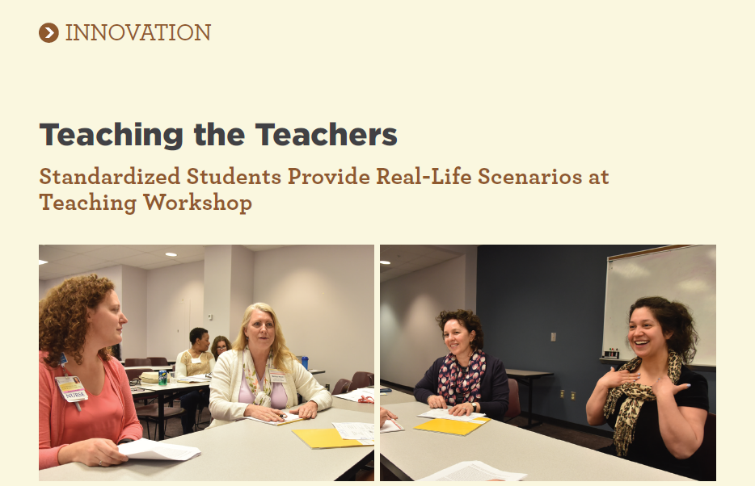

Slide 24
Outcomes
Participants FY 18 =72
# of Schools=22
Networking, resources, mentoring, collective wisdom
New 3-credit graduate elective-Introduction to Teaching Nursing in the Clinical Setting
Consistently strong evaluations
100% of participants would recommend course to other faculty/peers

Slide 25
Anne Arundel Community College
Anne Arundel Medical Center
Bowie State University
Carroll Community College
CCBC
Delaware Technical Institute
Frederick Community College
Frederick County Health Department
Frederick Memorial Hospital
Frederick Regional Health System
Harford Community College
Hood College
Johns Hopkins Univ. School of Nursing
Montgomery College
Morgan State University
NIH Clinical Center
Prince George’s Community College
Stevenson University
Towson University
Universities at Shady Grove
University of Maryland School of Nursing
University of Maryland Medical Center

Slide 26
Top Five
Should be mandatory workshop for all clinical faculty
Plan to use the tools to better provide feedback to students
Enjoy interactive activities, especially standardized student
Plan to listen more, better understand student goals and frames
Better understanding of how to communicate with students in the clinical setting

Slide 27
The student feedback sessions were great . I learned and it provided introspection.
New instructors need this training!
Awesome workshop!
Very useful workshop!
This was an excellent, well-thought out program. Loved the role-playing.
Excellent conference and I highly recommend it for all instructors.
Excellent conference! When we think we have arrived, we are no longer teachable! We all can continue to learn.
Please provide this training again to others.

Slide 28
Ongoing and future
Offered 3 x year
Marketed to broad audience
Extend support post-workshop
Dissemination

Slide 29
Susan L. Bindon, DNP, RN-BC, CNE UMSON Institute for Educators sbindon@umaryland.edu 410.706.8049

