Slide 1
Welcome
to the second
Doctoral Education in Maryland For Nurse Faculty
June 10, 2019

Slide 2
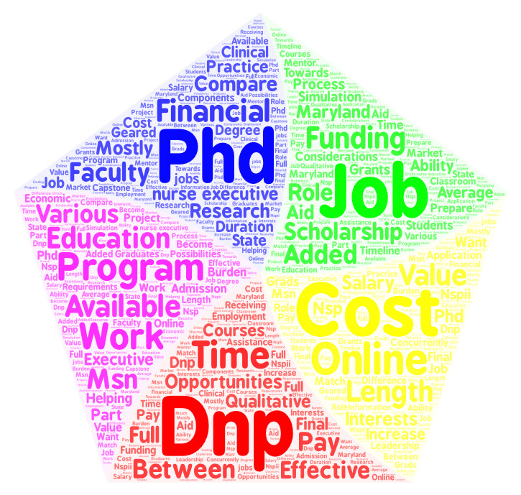
What do you hope to learn?
Notes:
Word cloud made from the responses to the registration question about what you hoped to learn…
DNP vs PHD
Job opportunities – and salaries – for both
Programs where can work full time and go to school
Cost/financial support

Slide 3
Program Overview
9:15-10:00 Doctoral Education in Maryland
Matching Goals-Education-Program
10:00-10:30 Panel - Unique Programs and Circumstances
10:30-10:45 BREAK - Visit information tables
10:45-11:15 Panel – Voice of students
11:15-11:45 Panel - Funding your education
11:45-12:00 Questions and wrap-up

Slide 4
Assumptions….Objectives
Describe the breadth of doctoral programs in Maryland – both nursing and not nursing.
Distinguish variations in doctoral programs.
Compare and contrast nursing research (PhD) vs practice (DNP) doctorates.

Slide 5
Common Doctoral Education Pathways for Nurses
BS → MS → PhD
BS → MS → DNP
BS → PhD
BS → DNP
MS → EdD
Notes:
Used to be MS required before doctorate in most professions.
True in nursing – either DNP or PhD
But, this led to nurses obtaining doctorate later in their career – early 40s. Obtain MS, then work, have children.
Now both have BS entry - DNP as entry for advanced nursing practice (BS to DNP) – DNP as entry to advanced practice by 2025

Slide 6
Doctoral Program Overview
Notes:
In Nursing, now PhD and DNP. This is where we will spend the majority of our time today.
--I am going to end this presentation talking about PhD programs in Nursing
--Rita D’Aoust is going to discuss DNP programs and issues to consider after my presentation
I am going to start with considering doctoral programs outside of nursing – education, public health, and business.

Slide 7
Continuum of Technology-based Learning
Source: https://opentextbc.ca/teachinginadigitalage/wp-content/uploads/sites/29/2014/05/Continuum-of-online-learning-3.jpg
Notes:
In the tables that I present, I use some terms about the format of program – F2F Hybrid Online
But, you need to ask exactly what is required.

Slide 8
Notes:
https://en.wikipedia.org/wiki/List_of_colleges_and_universities_in_Maryland
And, I will use programs in Maryland to illustrate some differences, both public and private. Note that some programs are available at different locations such as regional higher education centers, second campuses, etc.
Disclaimer – may not be all.

Slide 9
Maryland Doctoral Programs in Education
School | Degree | Format | Focus areas
Frostburg (also Hagerstown) | EdD | F2F | Leadership, Curriculum/instruction, Instructional technology
Johns Hopkins | EdD PhD | Online, PT F2F, FT | Educational leadership, EB methods
Morgan | EdD PhD | Online PT/FT | Community college leadership Urban educational leadership
Towson | EdD | F2F, hybrid, online | Instructional technology
Salisbury | EdD | Online, hybrid | Contemporary curriculum theory and instruction
Notes:
In education, both PhD and EdD are offered. Both focus on improving education/training
PhD – conducting research so more coursework in research methods and statistics
EdD – applying research to solving problems - see here, leadership is common

Slide 10
Maryland Doctoral Programs in Education - cont
School | Degree | Format | Focus areas
UMD - College Park College of Education | PhD | Varied – some FT, F2F | Educational policy & leadership Higher education Measurement, statistics, & evaluation Minority & urban education Technology, learning, & leadership
UMD – Eastern Shore | EdD | Cohort, weekend | Educational leadership
UMD - Baltimore | PhD | Hybrid | Health professions education – First cohort Fall 2020
Notre Dame of MD Baltimore, Eastern Shore, So. Maryland | PhD | Online F2F | Higher education leadership for changing populations Instructional leadership for changing populations
Notes:
UMCP College of Education – Maryland has several faculty who have graduated from that program –
Formats vary - note – weekend format at UMES
– but again, educational leadership and it may be more focused on K-12 so need to check program descriptions
UMB – health professions education - Clinicians who are academics and may have had little formal preparation for teaching. MHEC approved – first cohort fall 2020. We expect that this will be a good opportunity for nursing faculty – interprofessional. You will hear more about this program in one of the panels.

Slide 11
Maryland Doctoral Programs in Public Health/Health Services
School | Degree | Format | Focus Areas
Johns Hopkins - School of Public Health | PhD ScD DrPH | F2F, some online | Research Research/Methods in academia Specific PH field – apply knowledge
Morgan - School of Community Health & Policy | DrPH | F2F | Development and implementation of health promotion/disease prevention
UMD- Baltimore School of Pharmacy | PhD | F2F | Pharmaceutical health services research
UMD- Baltimore School of Medicine | PhD | F2F, some online | Epidemiology Gerontology (with UMBC)
UMBC- Public Policy | PhD | F2F, some online | Public policy
UMCP - School of Public Health | PhD | F2F, some online | Health services research, policy
Notes:
Public health – closely aligned with nursing. This may be after a MPH but some of these programs accepts MS in nursing
JHU – several faculty graduated from SPH and PhD students take electives there
PHSR – non nurses – study cost, quality, effectiveness, effects of policy related to pharmaceuticals.
UMB SOM – Gerontology program with UMBC, interdisciplinary. Some of our faculty graduated from this program.

Slide 12
Maryland Doctoral Programs in Business
School | Degree | Format | Focus Areas
UMD- College Park | PhD | F2F | Organizational behavior/human resources (many others)
UMD- Eastern Shore | PhD | Weekends | Organizational leadership (education, non profit, and business)
Morgan | PhD | F2F, some online | Business administration
Hood College | DOL/ DBA | F2F | Organizational leadership
Notes:
Examples with a business or organizational focus – need to go to web sites and look at curriculum/courses
GO TO WEBSITES FOR MORE INFO

Slide 13
DNP vs PhD Curriculums
DNP | PhD
EBP, performance/quality improvement, policy, populations, leadership, practicums, advanced practice (post BS) | Theory, research methods, advanced statistics, research practicums, domain content/theory
Full and part time plans of study | Full and part time plans of study
~80 credits post-BSN – 1000 practicum hrs ~37 credits post-MS - 500 practicum hrs | ~76 credits post-BS ~60 credits post-MS
Scholarly project | Dissertation
Notes:
DNP – clinical experts – Rita will talk more about this
PhD – intend to spend some part of work in research. May teach but greater focus on research rather than clinical

Slide 14
Intersecting Roles
Notes:
Both are working towards improved health outcomes
PhD – Extend science, knowledge, theories – including translational/implementation research
DNP – synthesize and translate evidence to improve outcomes
used knowledge/evidence
Both are charged with mentoring and leading – to the end of improved outcomes. Unfortunately, these programs have traditionally had little intersection of the programs but these are complementary roles.

Slide 15
Maryland DNP Programs
University | Programs
Coppin State University | Post MS
Johns Hopkins University | Advanced Practice/PhD Executive Track Executive Track/MBA Advanced Practice Tracks (check website)
Salisbury University | Post BS Family NP Post MS
University of Maryland-Baltimore | Post BS Advanced practice specialties (check website) Post MS
Frostburg State University | Now MS – planning grant for DNP
Notes:
Maryland DNP programs – check websites
Rita will talk more about this
Of course, other on-line programs – as you will ehar from other panel members, you need to research these programs to see what type of supports are given for arranging clinicals, meeting timelines, etc.

Slide 16
PhD Research Focus
Notes:
Basic Sciences and translational – test “Bench”/animal model to people - chemotherapy induced neuropathy models in mice translate to people
Efficacy – development and testing of interventions - RCTs to demonstrate what works – building the evidence
Outcomes and Effectiveness - how does it work in the real world? - not just one organization.

Slide 17
Maryland Nursing PhD Programs
School |  | Focus Areas
Johns Hopkins University | FT/PT F2F | Faculty expertise: Cardiovascular risk reduction, Domestic violence, Health promotion, Chronic disease management, Symptom management, Substance abuse, End-of-life care …and more
University of Maryland-Baltimore | FT/PT F2F | Faculty expertise: Healthy aging, Pain and symptom management, Health systems outcomes, Palliative and end-of-life care, Maternal and neonatal outcomes, Substance abuse Cellular and genetic disease mechanisms …and more
Morgan State University | FT/PT F2F | Particular focus on health service research and policy
Notes:
For PhD programs, having faculty to support research topics is essential. Ideally, students work on faculty research – matching is a critical criteria at admission. Education research is not a strong emphasis since there is little funding for faculty to pursue education topics (small grants NLN, STT, etc.)
For example, both have “bench” research but in specific topic areas.
Also, more and more PhD programs have on-line/hybrid options but you need to consider the quality and what type of support they provide to you. For online doctoral programs, you may need arrange your own clinical experiences and research networking.
Individaul and team mentorship as seen in dissertation committees is essential.

Slide 18
Which doctorate is right for you?
Focus – what is your passion?
Career – what do you want to?
-lead research -apply research -make health policy -teach (both DNP and PHD)
Feasibility – what works for you? -format -costs -competing demands
Notes:
Later presentations and panels will address many of these topics – and there is not one clear answer.
I wanted to study patient outcomes back in 1988 – I was into hospital administrative data – I interviewed at both nursing schools and schools with health administration programs. One nursing school told me that they did not really study outcomes!!!
Worked for me – I went to PhD Program in Health Services Research that was heavy in organizational and economic theory.

Slide 19
Summary
Many programs to consider
Review the websites but also call to ask questions
Talk with graduates of those programs
Notes:
Have heard of some nurse faculty attending EdD programs that are not a good fit …

Slide 20
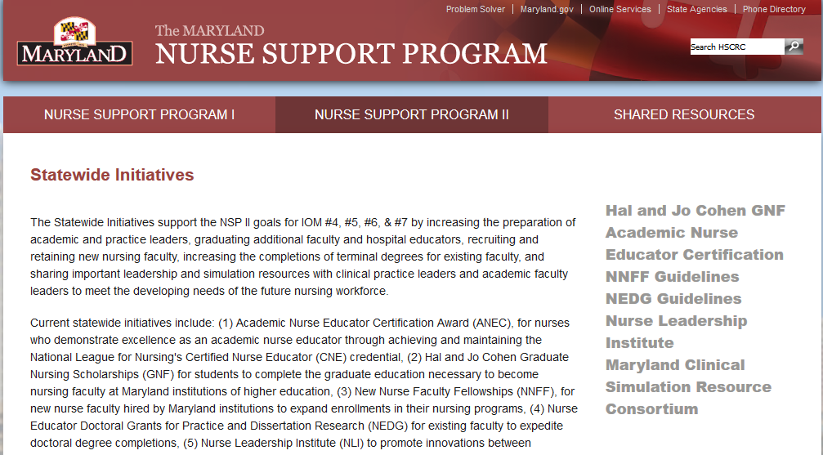
Thanks for attending!
Nursesupport.org

