Slide 1
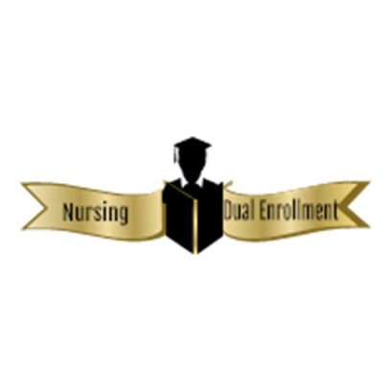
Nursing Dual Enrollment Program (N-DEP): A Pipeline Program for High School Students in Career Technical Education Nursing Pathways to Earn College Credits Towards a Baccalaureate Nursing Degree
Maija R. Anderson DNP, APRN ¹ Joice A. Stokes-James MPA, RN ¹ Vanessa P. Fahie PhD, RN ²
¹ School of Community Health and Policy ² University of Maryland School of Nursing
Background
Program Description
Planning Process
Discussion
Maryland Career Technical Education (CTE) Programs
Statewide model programs organized around career clusters
Prepare high school students for workforce and global economy
Certified Nursing Assistant/Geriatric Nursing Assistant Tracks
Creates a pipeline of future nurses
Introduces students to a career ladder approach
2013 College and Career Readiness and College Completion Act
Increases college and career readiness
Increases degree completion
Establishes a tuition agreement between HS & public colleges for dual enrollment
“Jump starts” high school students to earning college credit
Baltimore City dual enrollment 2% compared to 11% statewide
Low-income & minority students underrepresented among dually enrolled students
Early college access and readiness model
Partnership with State of MD Career Technology and Education High Schools & Morgan State University
Provides social, financial and academic services
Ensures successful transition from high school to college
Students may earn 28-31 college level credits towards a Bachelor of Science in Nursing (BSN) degree
Two CTE Nursing Assistant Pathway Schools identified
Baltimore City and Baltimore County
Ten students enroll/school
College adjunct professors teach classes at the high schools
Eight general education and two nursing courses
Fosters a seamless, sustainable academic model
Supports academic excellence in nursing
Increases exposure to rigorous STEM-based learning
Prepares additional diverse, licensed professional nurses
Explore interest in developing dual enrollment partnerships
Collaborate with Baltimore City & Baltimore County Public Schools
Establish formal Memoranda of Understanding between the University and School System Partners
Design pre-licensure nursing dual credit course sequence
Ensure alignment with CTE Nursing Pathways curriculum & MSU’s Nursing Curriculum
Design summer college experiences
Establish internal/external student-centered support systems
Determine admissions criteria
Develop recruitment strategies for students & adjunct faculty.
Advertise to parents and students
Explore program sustainability
Enroll first cohorts in fall 2020
Creates a pipeline of high school students interested in nursing/health careers
CTE Programs prepare students for employment and college matriculation
Initiates college coursework and experiences in high school
Provides a holistic, student-centered approach to learning
Offers academic, social and financial support services
Provides two week intensive academic summer program
Increases academic performance, college retention, persistence and graduation rates
Acknowledgments
Morgan State University School of Community Health and Policy Nursing Programs
Dean Kim Sydnor; Dr. M. Anderson, Nursing Program Director; Pawn Johnson-Hunter, Faculty, and Dr. Carl White, Staff Maryland Nurse Support Program NSP II Planning Grant Funds
Baltimore City and Baltimore County Public Schools
Dr. Vanessa P. Fahie, Project Consultant
Proposed Course Sequence
10th Grade
First Semester NURS 101 Introduction to Nursing/College Studies | 1 credit
Second Semester MATH 113 Introduction to Math (Analysis) SOCI 101 Introduction to Sociology | 3 credits 3 credits
11th Grade
First Semester NURS 102 Introduction to Professional Nursing for Allied Health Students ENGL 101 Freshman Composition | 4 credits 3 credits
Second Semester NURS 160 Introduction to Nutrition BIOL 103 Introduction to Biology-Nursing Majors | 3 credits 4 credits
References
Program Goals
Cook, L. (2015). U.S. education: Still separate and unequal. US News & World Report. Retrieved from http://www.usnews.com/news
Mitchell, H. D. (2016). Predicting NCLEX-RN performance: An Exploration of student demographics, pre-program factors, and nursing program factors." (2016). Electronic Theses and Dissertations. Paper 2413. https://doi.org/10.18297/etd/2413
National League of Nursing. (2016). Achieving diversity and meaningful inclusion in nursing education. Retrieved from http://www.nln.org/docs/default-source/about/vision-statement- achieving-diversity.pdf?sfvrsn=2
Phillips, J. M., & Malone, B. (2014). Increasing racial/ethnic diversity in nursing to reduce health disparities and achieve health equity. Public Health Reports (Suppl 2), 129(1), 45-50. Retrieved from http://members.coausphs.org/COADocuments/PHR/129/PHR129- 1_Supp2.pdf
Sunderman, G. (2017). Dual enrollment in Maryland and Baltimore City: An Examination of program components and design. Maryland Equity Project, University of Maryland College of Education.
Engages first year pre-nursing students with nursing students and faculty mentors
Increases retention, progression and graduation rates of native minority undergraduates
Improves first time NCLEX-RN® pass-rate for minority students
12th Grade
First Semester PSYC 101 Introduction to Psychology ENGL 1032 Freshman Composition 2 | 3 credits 3 credits
Second Semester CHEM 101 General Chemistry 1 CHEM 101L General Chemistry Lab | 3 credits 1 credit
Total Credits | 31 credits

